Slide 1

LO To plan a fable
Success criteria:
Include a moral/lesson
Include 2 animal characters
Include an appropriate setting to match the characters.

Slide 2
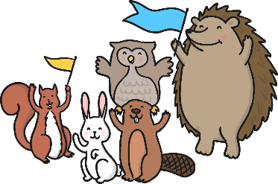
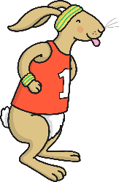

Fables
Short stories
Teach a lesson
Animal characters with human characteristics
Stress themes such as: the value of cooperation, looking at problems from different viewpoints, rewards if lesson is learned
Lessons may not be stated directly
Listener must find their own lesson in the tale

Slide 3
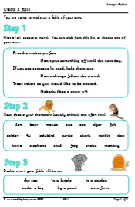
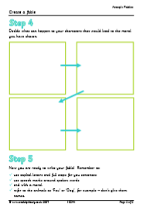
Step 1 – choose the moral/lesson you would like to include in your fable.
Step 2 – choose your animal characters. Draw your characters and write adjectives around them.
Step 3 – choose your setting. Match it to your characters carefully.
Step 4 – draw a story map to show what will happen to your characters to lead to the moral/lesson. Tell your story orally a few times until you are confident with what will happen and make some notes around each picture.

