Slide 1
English
Hello children! Please read the start of following story and answer the questions on lined paper.
Success Criteria:
Please answer in full sentences. ( Begin your answers using part of the question )
Use CAPITAL letters, full stops and other conventions correctly- spelling, punctuation, grammar etc.
Reread ( aloud ) each answer to make it better and make it right. ☺

Slide 2

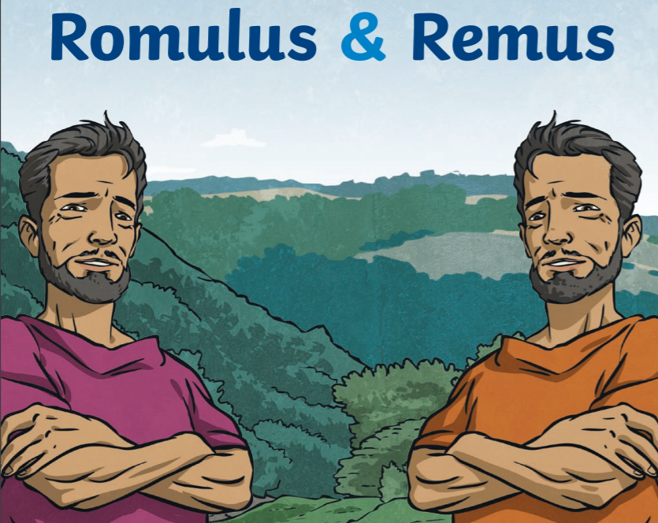
Romulus and Remus
Monday 11th January 2021

Slide 3
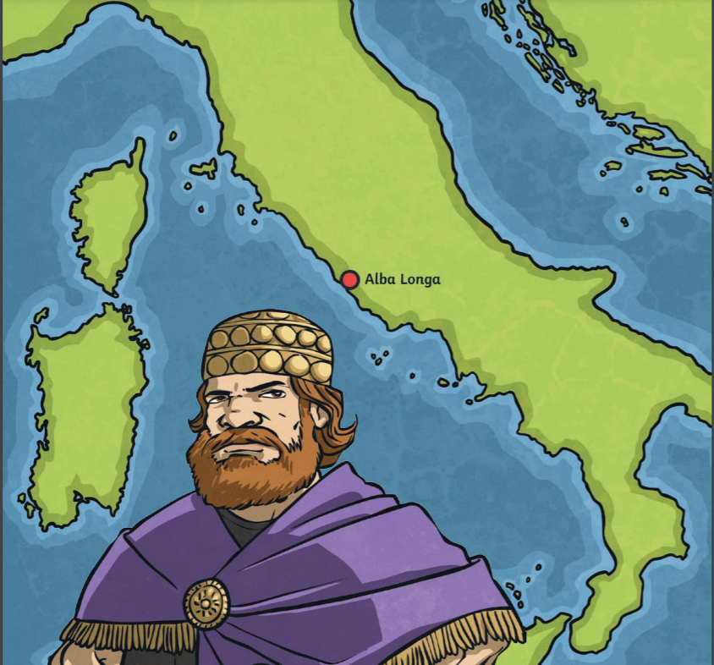

Slide 4
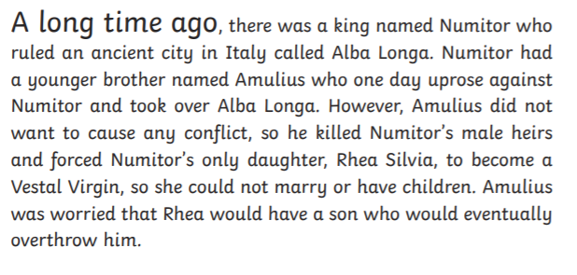
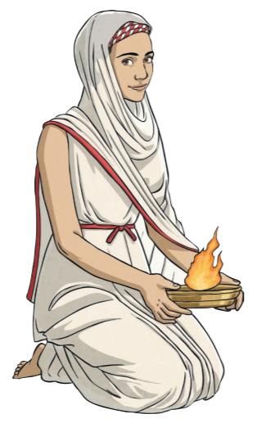

Slide 5
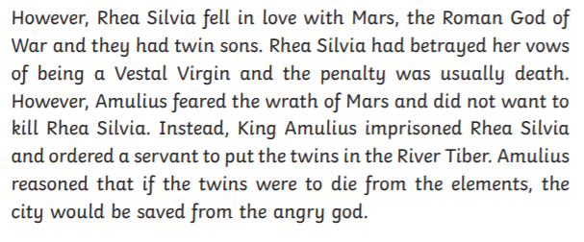
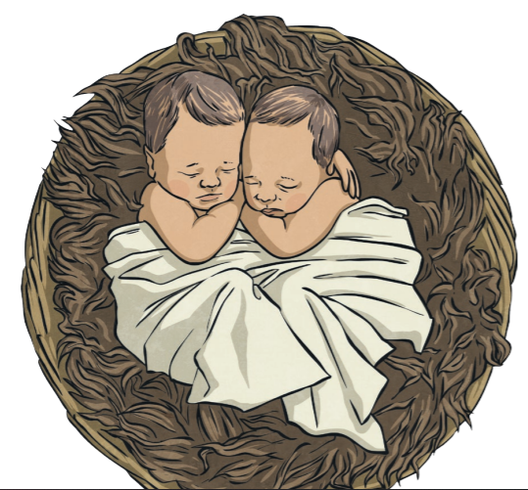

Slide 6
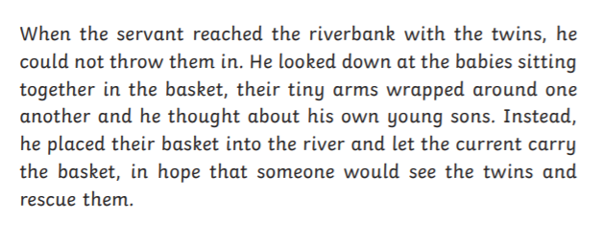

Slide 7
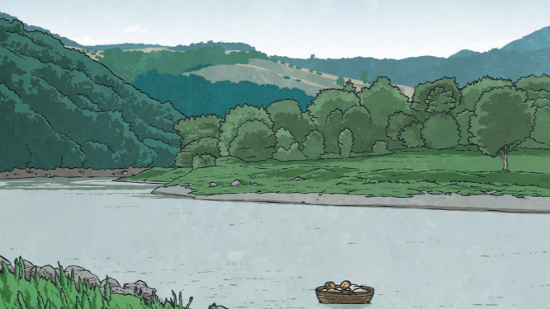

Slide 8
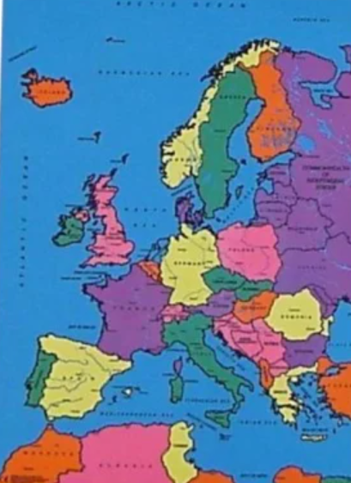
Can you locate Italy on a map? Why is Italy so easy to recognise?

Slide 9
Questions for you .
Where is the story set?
When is the story set?
Why did Amulius force Rhea to become a Vestal Virgin?
Who did Rhea fall in love with?
What does the word WRATH mean? ( slide 4)
What are the names of the characters in the story so far?
Can you write the last sentence on slide 4 again in your own words? Change the words ‘reasoned’ and ‘elements’ .
Predict what you think will happen next.

