Slide 1
English Tuesday 12.1.2021
Hello children! Please read ( either independently or with the help of an adult) the next part of the story and answer the questions on lined paper.
Success Criteria:
Please answer in full sentences. ( Begin your answers using part of the question )
Use CAPITAL letters, full stops and other conventions correctly- spelling, punctuation, grammar etc.
Reread ( aloud ) each answer to make it better and make it right. ☺

Slide 2
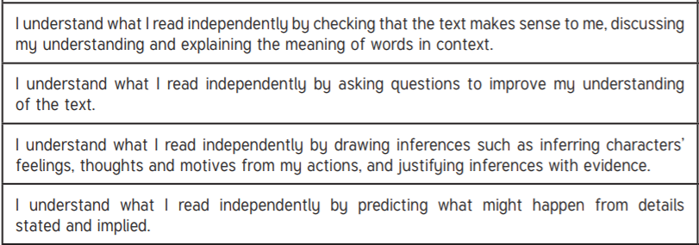
Reading Success criteria

Slide 3

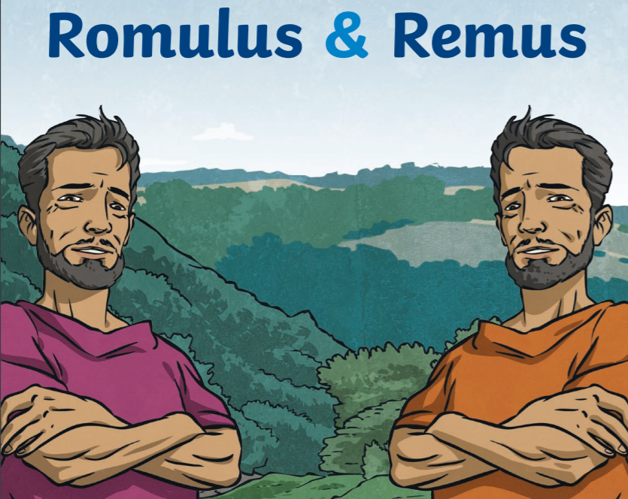
Romulus and Remus
Tuesday 12th January 2021

Slide 4
Recap the story so far…..
Remind yourself what happened so far. If you need to please reread the story from yesterday

Slide 5
The story continues.
Eventually, a compassionate she-wolf came across the basket in the river and pulled the babies out to safety. The wolf cared for the twins and protected them from dangers such as other wild animals. A friendly and cunning woodpecker helped the twins to find food.

Slide 6
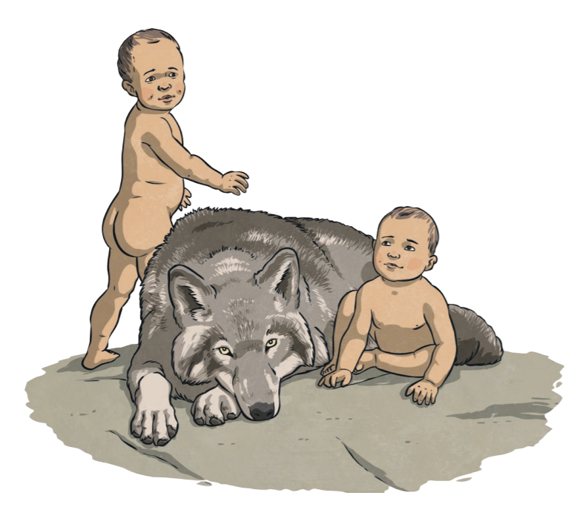

Slide 7
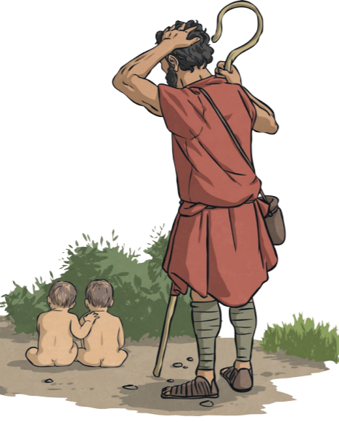
Soon, the twins were found by a caring shepherd who was out walking by the turbulent river. He took the twins back home, out of the howling winds of the night to his wife in their cosy cottage. They decided to call the boys Romulus and Remus.

Slide 8
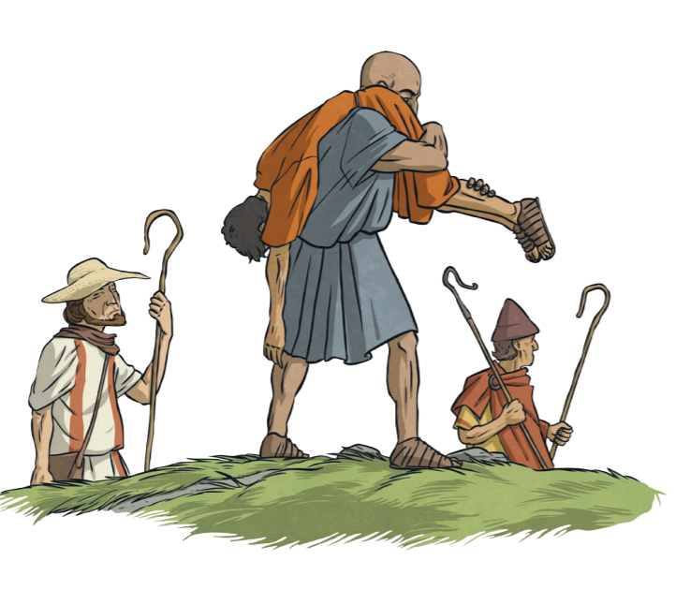
The shepherd and his wife brought the twins up like their own children. Romulus and Remus grew up to become shepherds like their father. One day, while the twins were herding their sheep, they were met by shepherds of King Amulius who started a fight with Romulus and Remus. Remus was captured by the shepherds and taken to King Amulius.

Slide 9
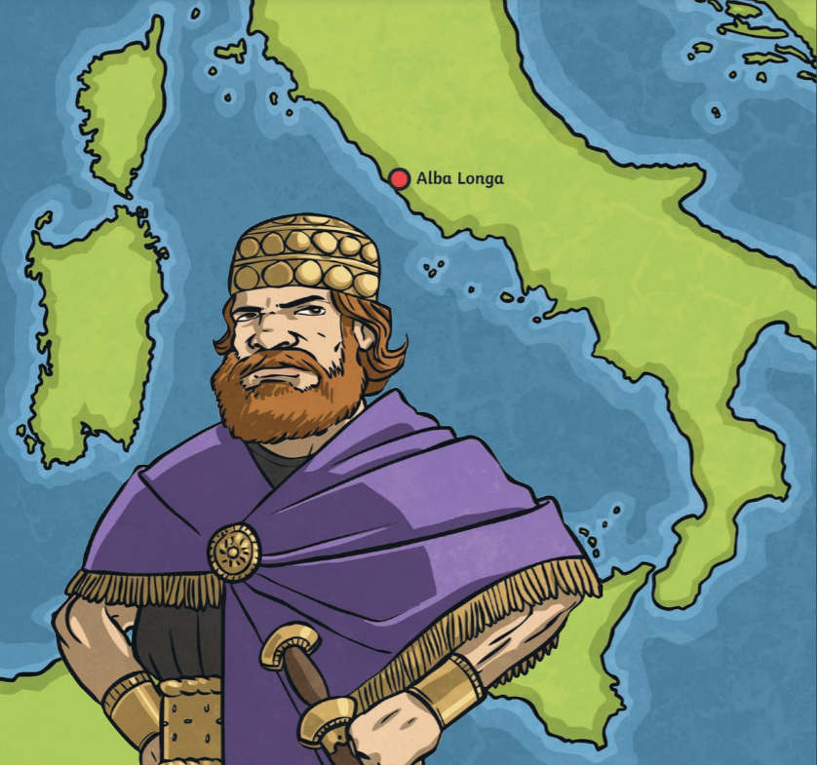

Slide 10
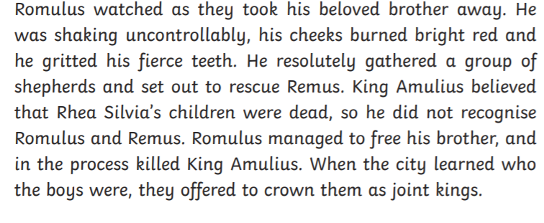

Slide 11
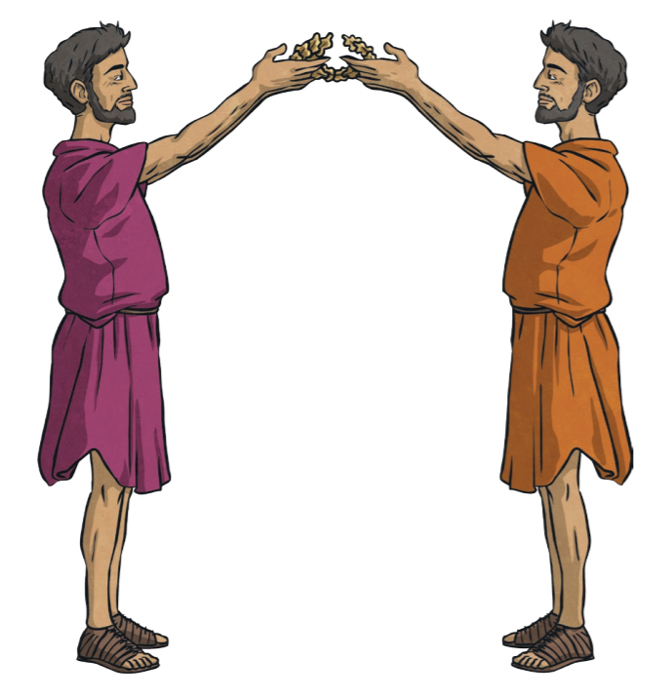

Slide 12
Questions for you .
What is another word for compassionate?
What does the word turbulent mean?
Find at least 2 other words for ‘resolutely’.
What time of day did the shepherd find the twin boys? Give evidence from the text to support your answer. ( The boys were found ………because in the text it says ………)
Deep thinking question - do you think these events really happened? Use the text to justify your answer.

Slide 13
Questions continued.
Think about the whole story so far.
6. Can you think of any stories that have similar events?
Record your answers in a table like shown. Draw your table in pencil using a ruler.
ROMULUS AND REMUS | SIMILARITIES WITH THE STORY OF …..……………….
Babies put into a basket and put onto a river. Wolves looked after a baby,

Slide 14
Success criteria
Check against the writing success criteria ( 3 points on slide 1)
Check against slide 2, the reading success criteria, it was Harder today as you had to justify your answers with Evidence from the text. Well done!

