Slide 1

LO To be motivated to make healthy lifestyle choices
Success criteria:
I know what I need to make my body healthy.
I understand it is important to try and stay motivated.

Slide 2

Calm me

Slide 3
Listen to the song!

Slide 4
Ways to stay healthy…
Healthy, balanced diet
• Exercise
• Drinking water
• Sleeping well
• Resting and relaxing
• Keeping clean

Slide 5
It isn’t always easy…
Why Jo might not want to go to judo?
Have you ever felt like not doing something active, even if you have enjoyed it before?
How might Jigsaw Jo feel when he does go to judo?

Slide 6
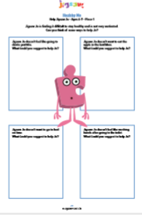
Independent Work
Fill in the worksheet to help Jigsaw Jo with his motivation to stay healthy.
Make a ‘Healthy Me’ poster.

