Slide 1
English wednesday 13.1.2021
Hello children! Please read ( either independently or with the help of an adult) the next part of the story and answer the questions on lined paper.
Success Criteria:
Please answer in full sentences. ( Begin your answers using part of the question )
Use CAPITAL letters, full stops and other conventions correctly- spelling, punctuation, grammar etc.
Reread ( aloud ) each answer to make it better and make it right. ☺

Slide 2
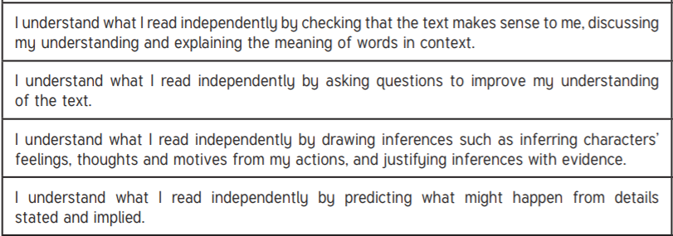
Reading Success criteria

Slide 3

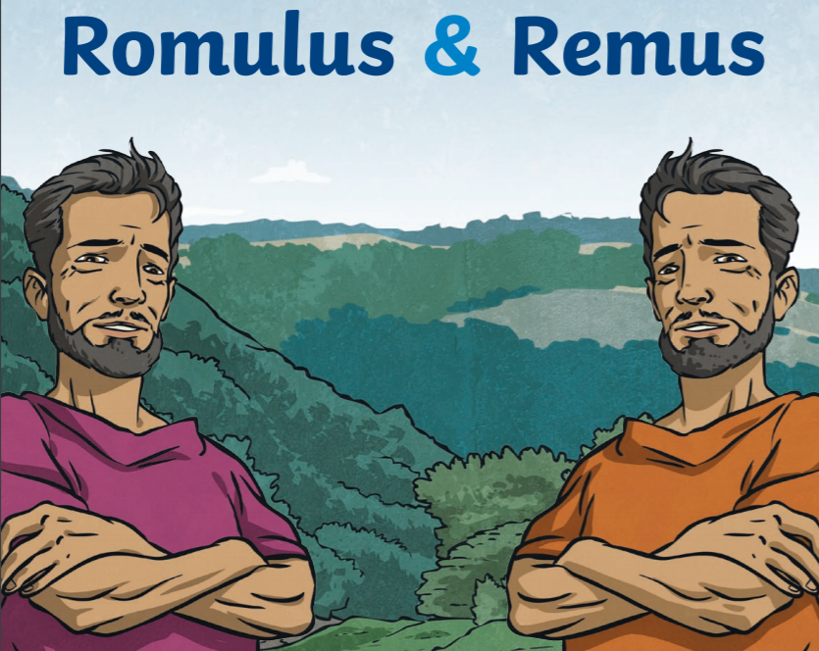
Romulus and Remus
wednesday 13th January 2021

Slide 4

Recap the story so far…..
Remind yourself what has happened so far

Slide 5
The story continues.
The twins were offered the crown , however the twins turned down the crown because they wanted to establish their own city. The twins left their hometown in search of a perfect place to build their city. They eventually came to the place where Rome is located today. They both liked the general area, except they both wanted to build the city on a different hill. Romulus wanted the city to be on top of Palatine Hill, while Remus preferred Aventine Hill.

Slide 6
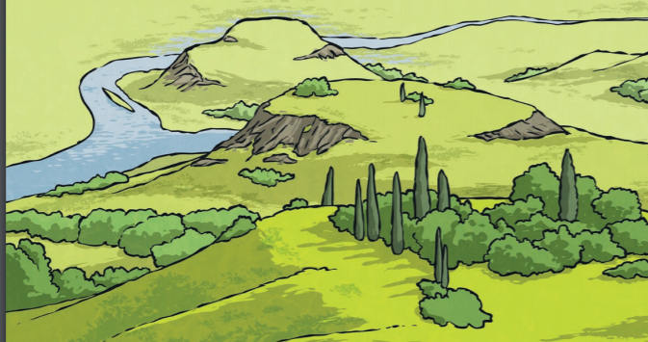

Slide 7
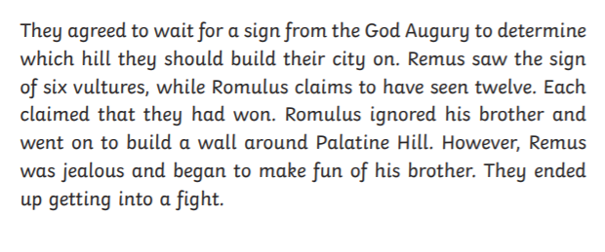

Slide 8
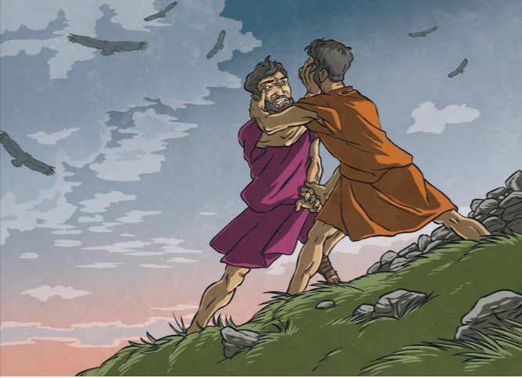

Slide 9
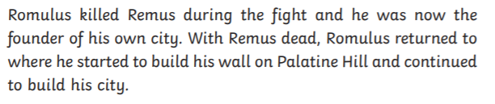
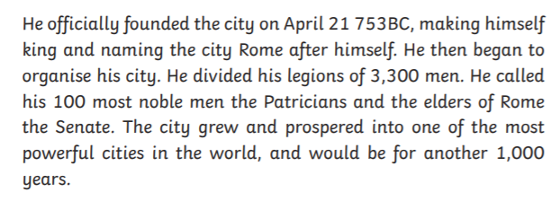

Slide 10
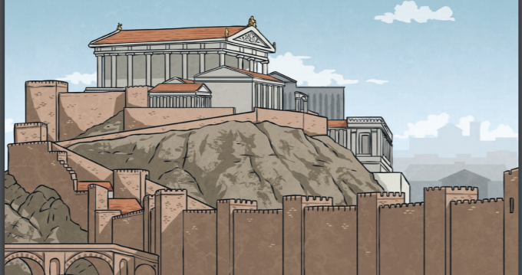

Slide 11
Work for you – put these sentences in order.
Just write down the number order- you don’t need to copy out the sentences!
Evil uncle orders twins to be thrown into the river Tiber
Twins are taken to the evil king to settle the argument between the shepherds.
Evil uncle tries to kill all male heirs.
Some shepherds have an argument with the twins.
Twins found by a she- wolf.
Rome was named after Romulus and built on Palatine Hill where it stands today.
Kind soldier does not kill the twins, he floats the basket on the River Tiber.
8. Romulus and Remus argued about who saw the most vultures , they fought and Remus was tragically killed by Romulus.
9. Kind Shepherd finds twins and takes them home , he names them.
10.God said whoever saw the most vultures could pick the hill they built their city on.
11. Silvia and Mars fall in love and they have twins.
12. Evil king is killed by the twins.
13.Although there were 2 hills, the twins wanted to build their own city on the same hill.
14. King A did not know the twins were alive.
15.Years later when they boys were grown up they became shepherds just like their father.
(once finished compare with the answers on the next slide)

Slide 12
ANSWERS
3, 11, 1, 7, 5, 9, 15, 4, 2,
14, 12, 13, 10, 8 and 6.
Finally I would like you to do the task on the next slide. You can pick 8 parts of the story from the last activity or use other main events.

Slide 13

Today I would like you to Create a comic strip of the story. In chronological order Draw a picture of the main parts of the story and write a very brief description underneath.

