Slide 1

Solids, liquids and gasses.
14.1.21

Slide 2
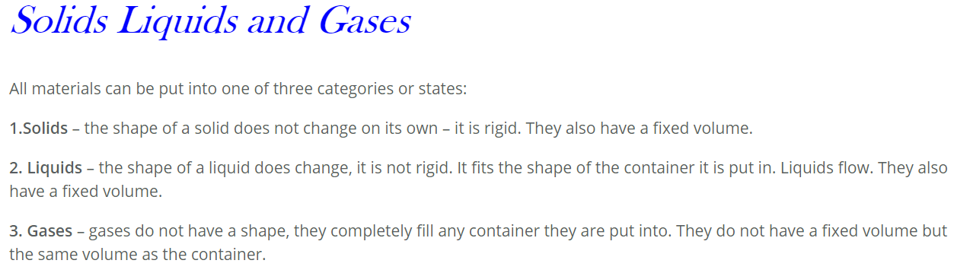

Slide 3
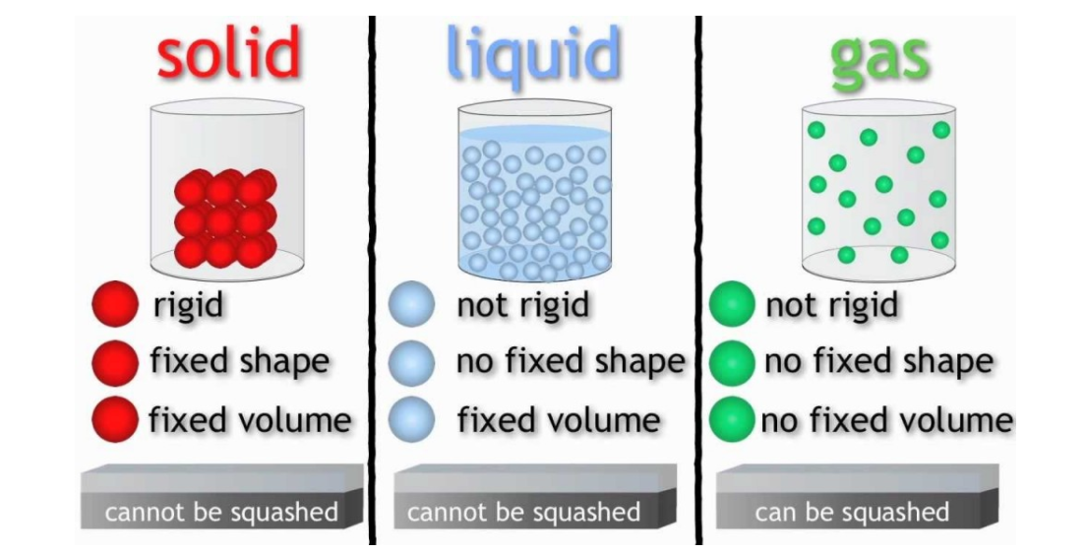
Properties

Slide 4
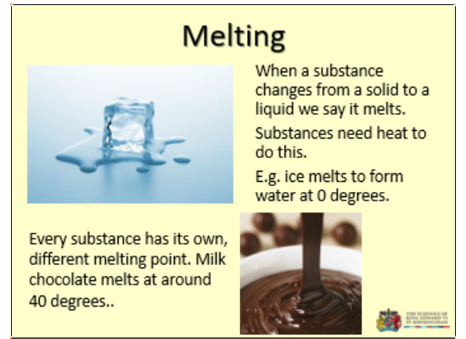

Slide 5
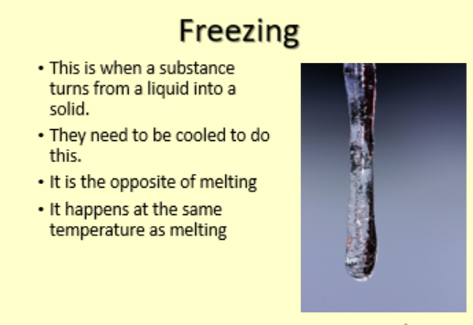

Slide 6
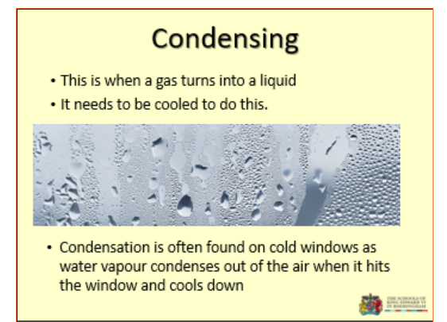

Slide 7
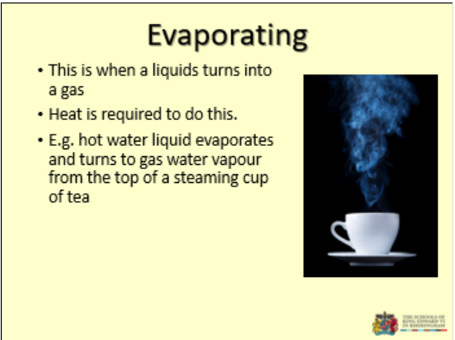

Slide 8
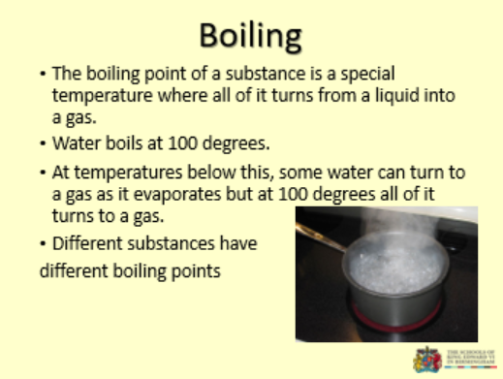

Slide 9
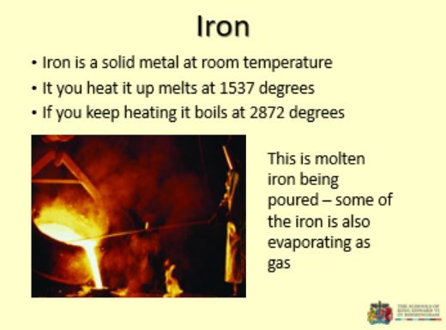

Slide 10
Find out some more . You may have to copy and paste the address in the browser
https://www.bbc.co.uk/bitesize/topics/zkgg87h/resources/1
Follow the link to a variety of clips about solids, liquids and gasses.

