Slide 1

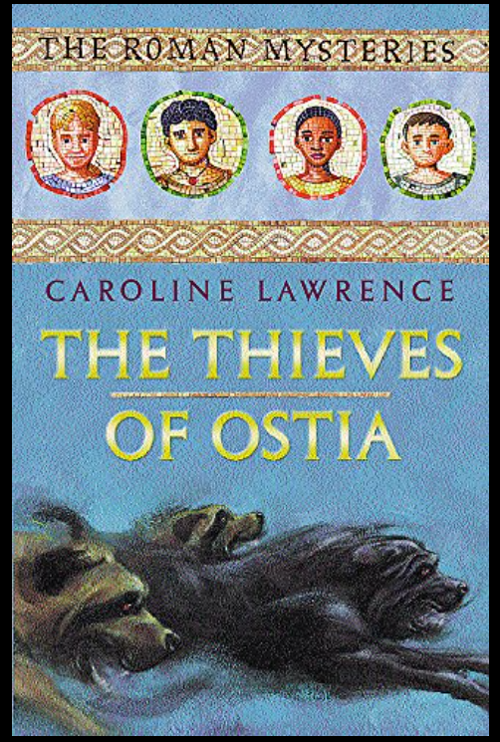

Slide 2
https://www.youtube.com/watch?v=77v2g6dFlac chapter one the Thieves of Ostia.
I have pictures of the first scroll/chapter, follow the text as Mrs Sellers reads.
The story starts with a map of Ostia and the River Tiber . Enjoy.

Slide 3
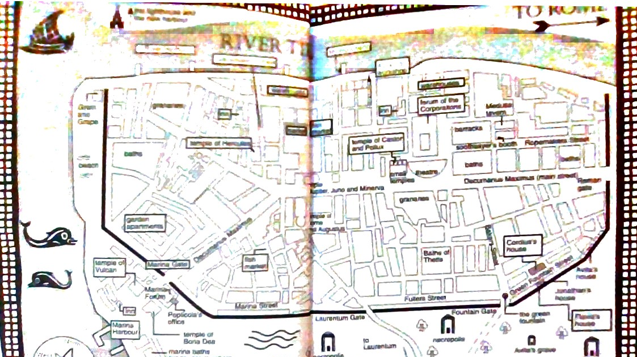

Slide 4
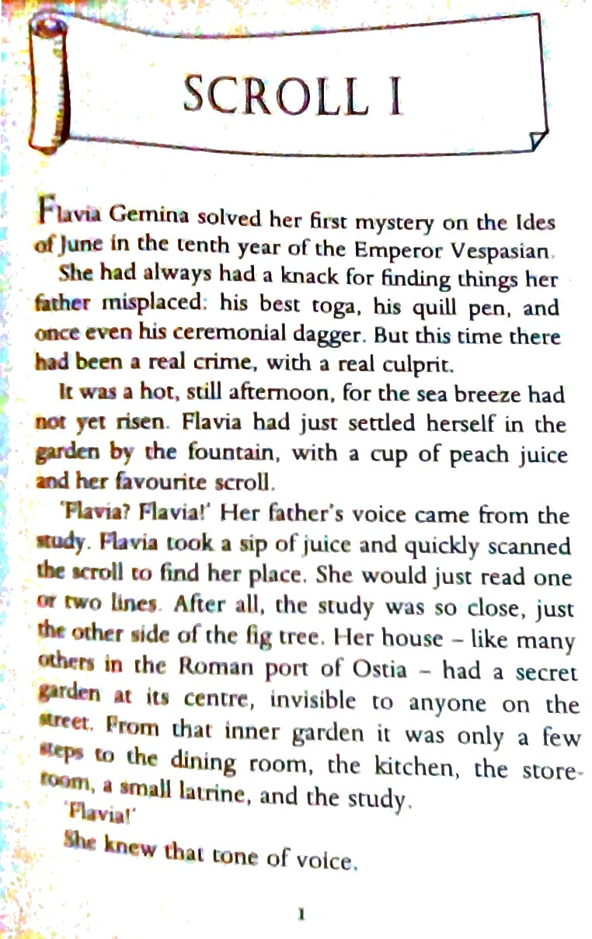

Slide 5
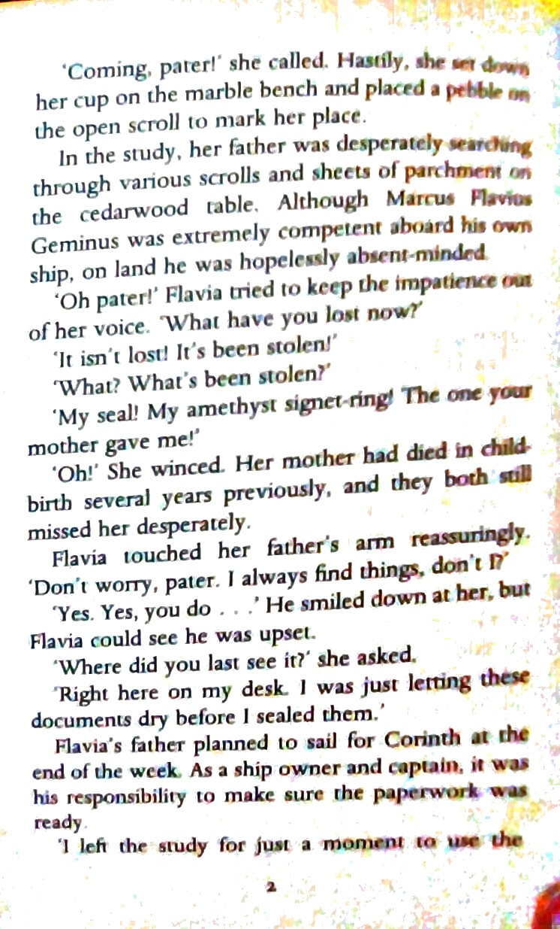

Slide 6
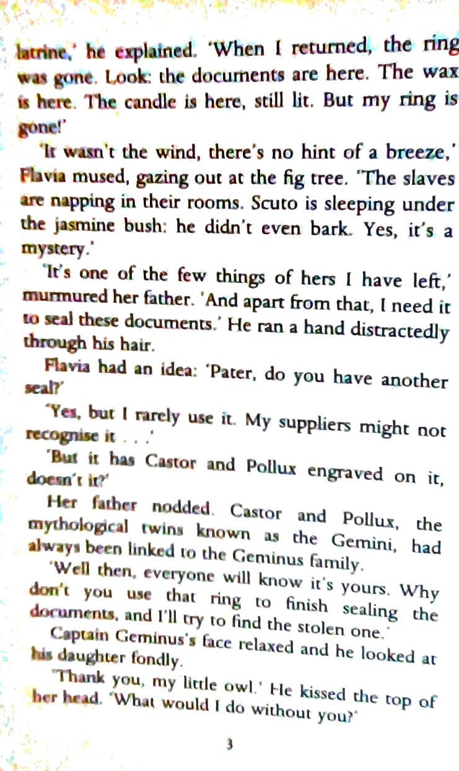

Slide 7
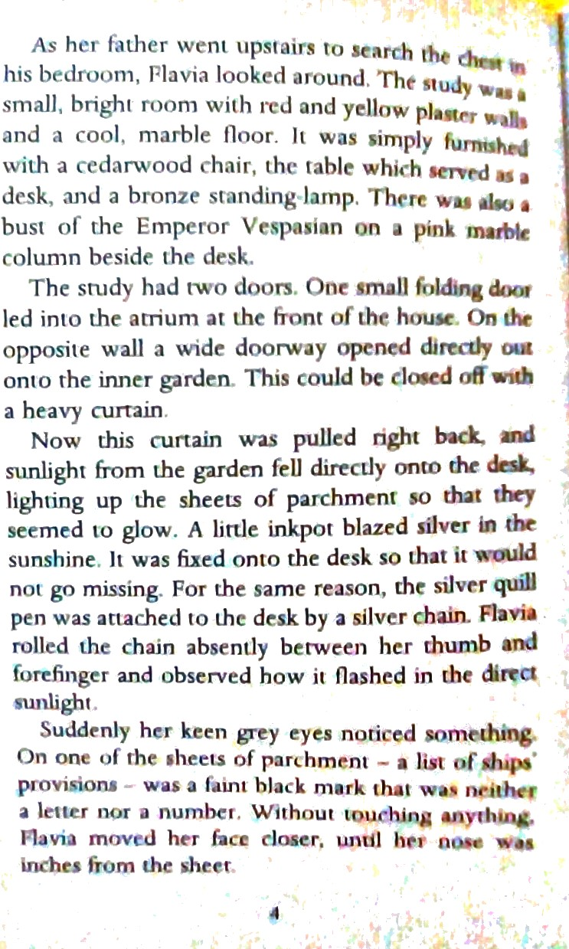

Slide 8
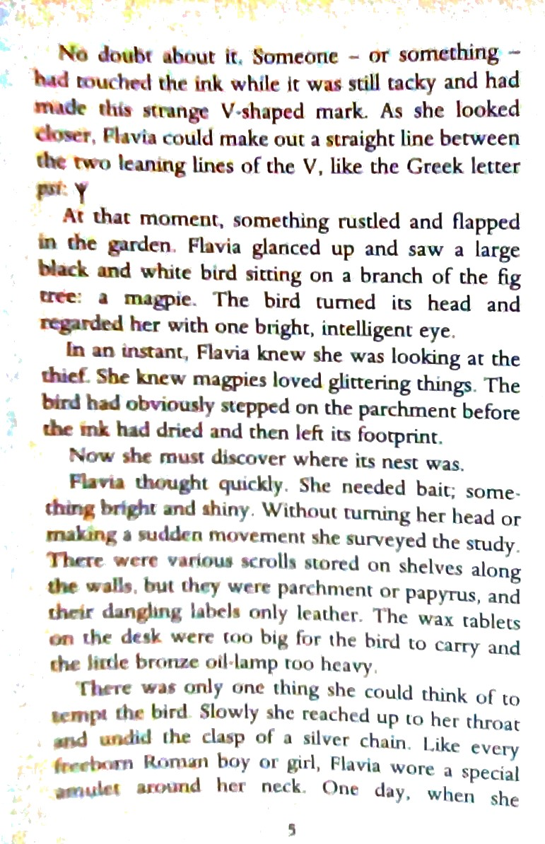

Slide 9
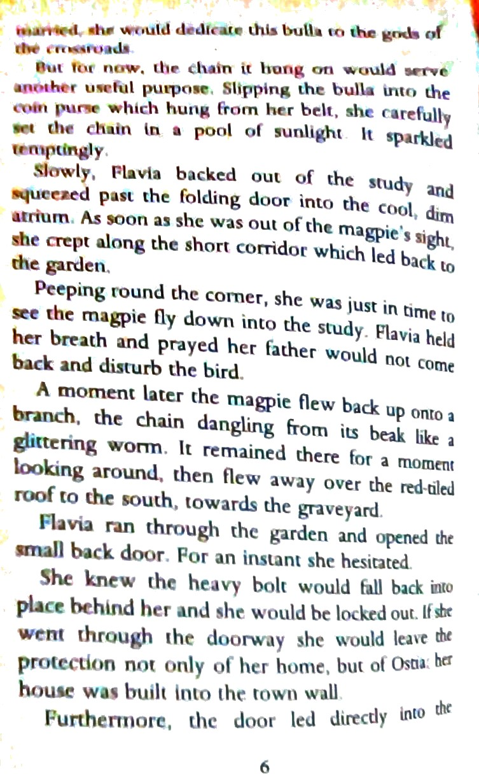

Slide 10
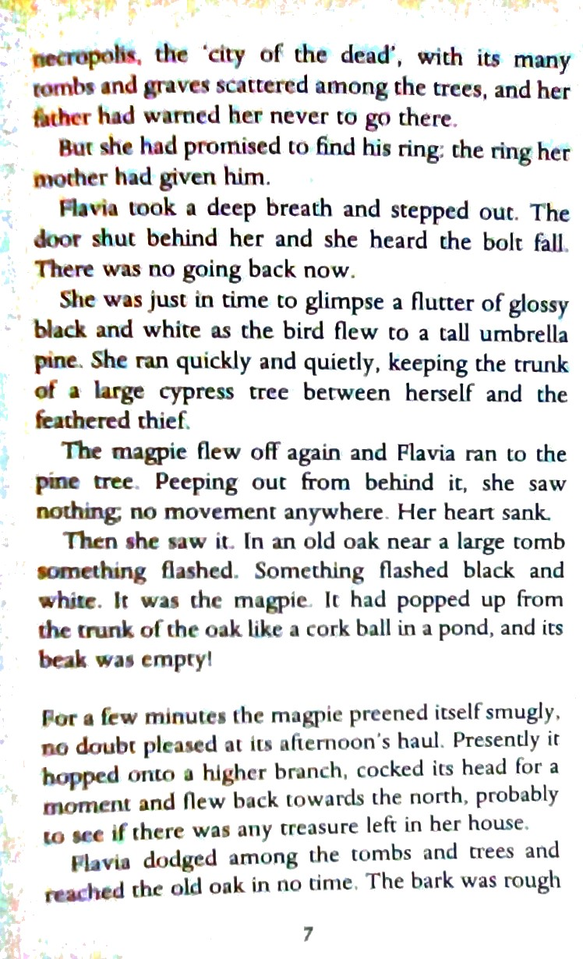

Slide 11
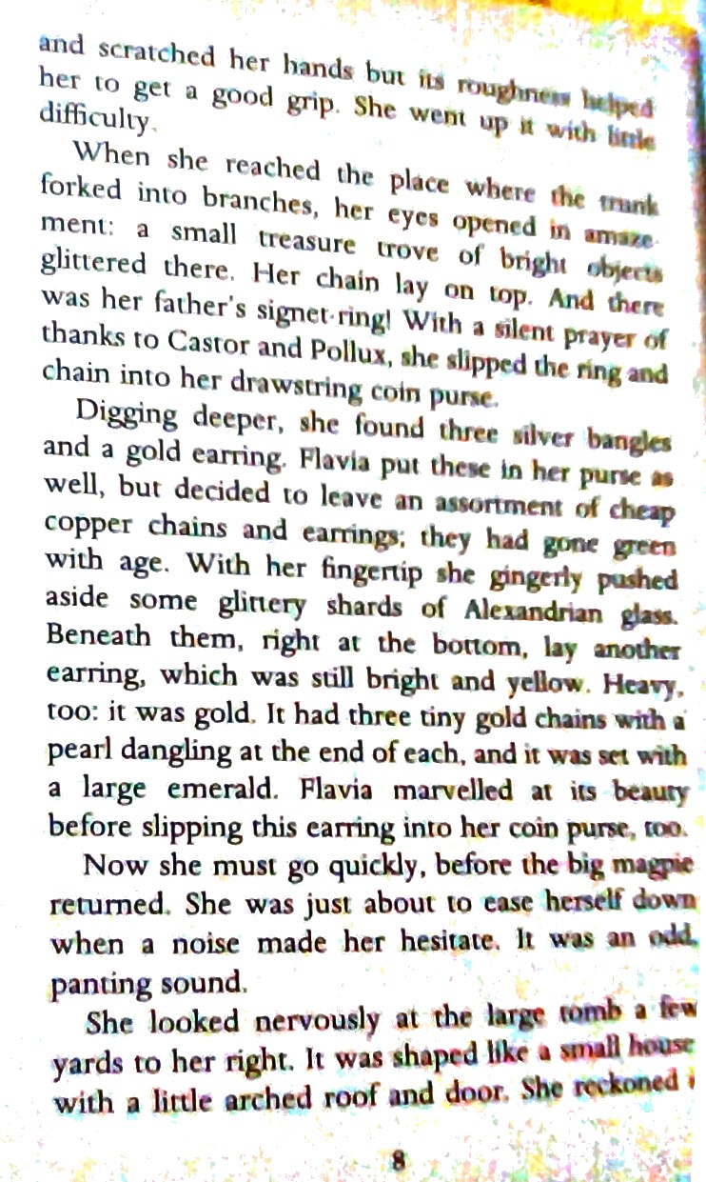

Slide 12
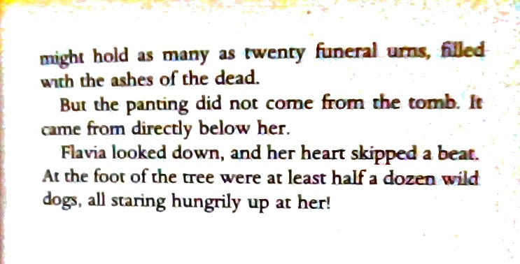

Slide 13
10 minute summary followed by some research.
Tell me what has happened so far in the story .
These questions may help you .
Where is the story set? ( place and time)
Who is in the story?
What’s the problem in the story?
What has happened?
How did that first chapter end?
Are there any words which you do not recognise? Make a list and see if you can find out what they mean.
Using the questions on the next slide, I would like you to do some research.

Slide 14


