Slide 1
Making an imperial helmet for a Roman Soldier.
Monday 18.1.2021

Slide 2
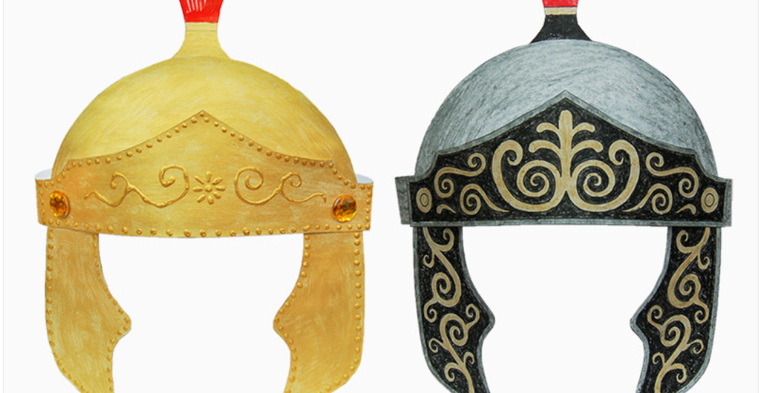

Slide 3
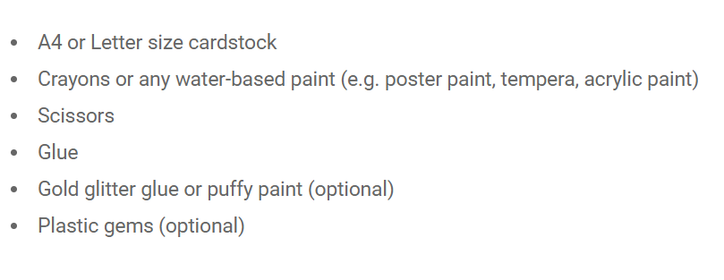
What you will need:

Slide 4
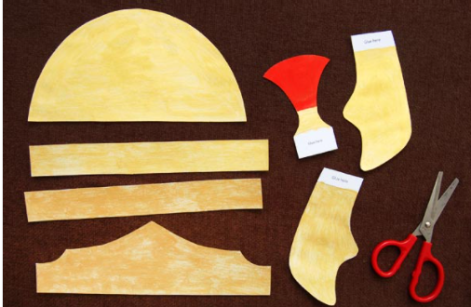
Instructions
Print out the template ( in curriculum sheets folder)
Colour in /paint/decorate the template. Remember to use yellow/gold or grey and black as shown in slide 1.
Cut all of the pieces out .

Slide 5
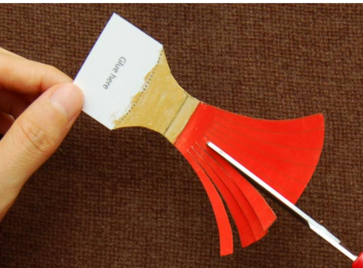
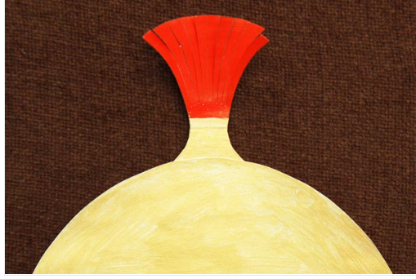
Cut the fringes on the crest like shown in the first picture, then glue the crest Apply glue on the crest's bottom tab. Glue the tab behind the top portion of the main helmet piece.( as in the 2nd picture)

Slide 6
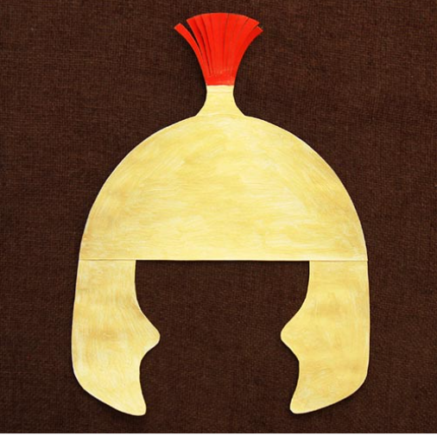
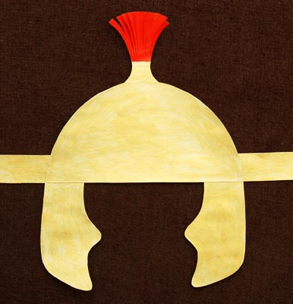
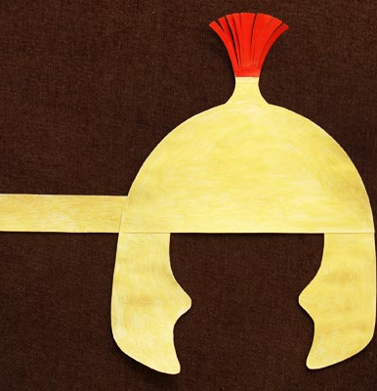
Picture 1, glue the cheek guards. Glue the pair of cheek guards onto the bottom corners of the helmet.
Pictures 2 and 3 Glue one band on the left and one on the right.

Slide 7
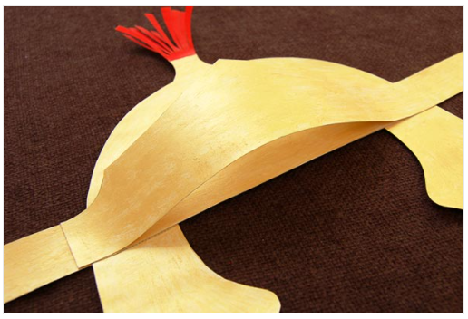
Decorate the visor first and glue it as shown.

Slide 8
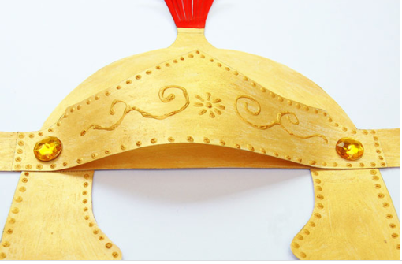
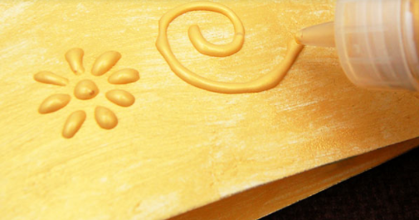
Decorate the helmet . You can stick on gems or sequins or colour gems onto the helmet.

Slide 9

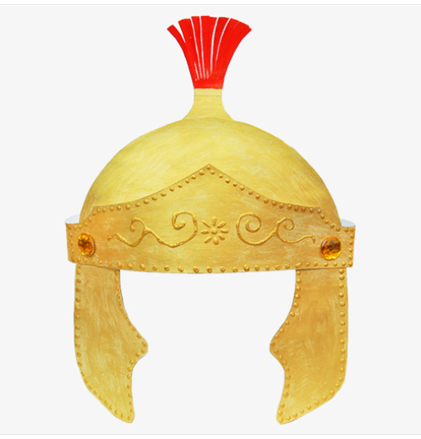

Slide 10
Strike a fierce pose!
Take a picture with your shield and soldier’s helmet on and send it to me!
Thank you !

