Slide 1

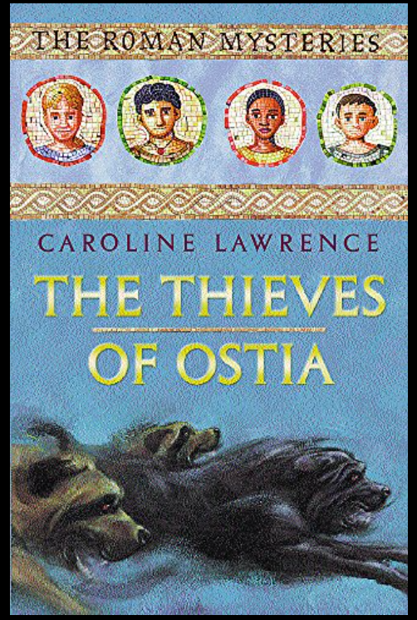

Slide 2
chapter 2 The Thieves of Ostia.
Children at Key worker school really enjoyed the first chapter yesterday. Luckily for me Mrs Sellers has also read chapter/scroll 2 .
Enjoy.

Slide 3
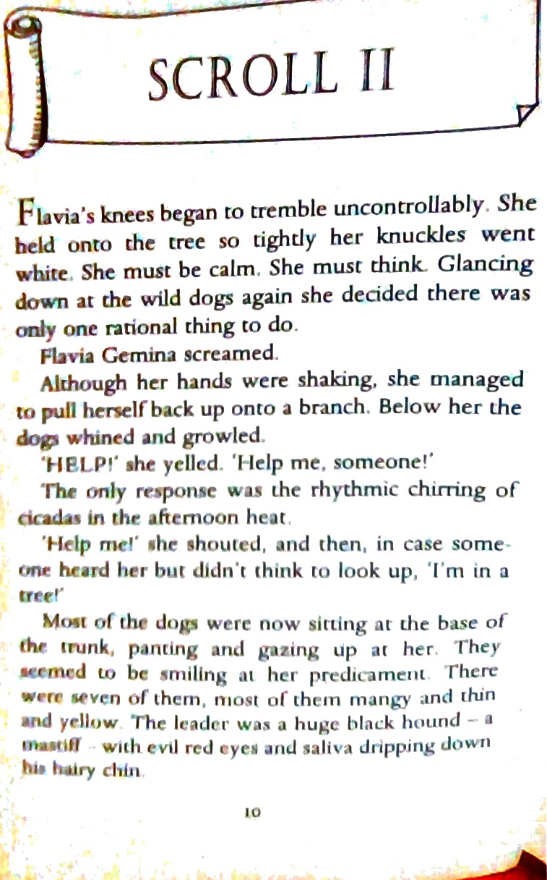

Slide 4
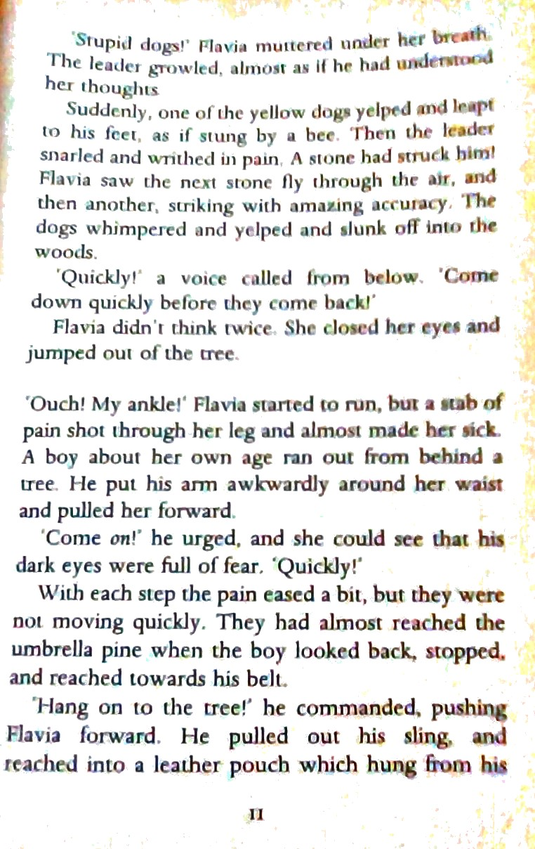

Slide 5
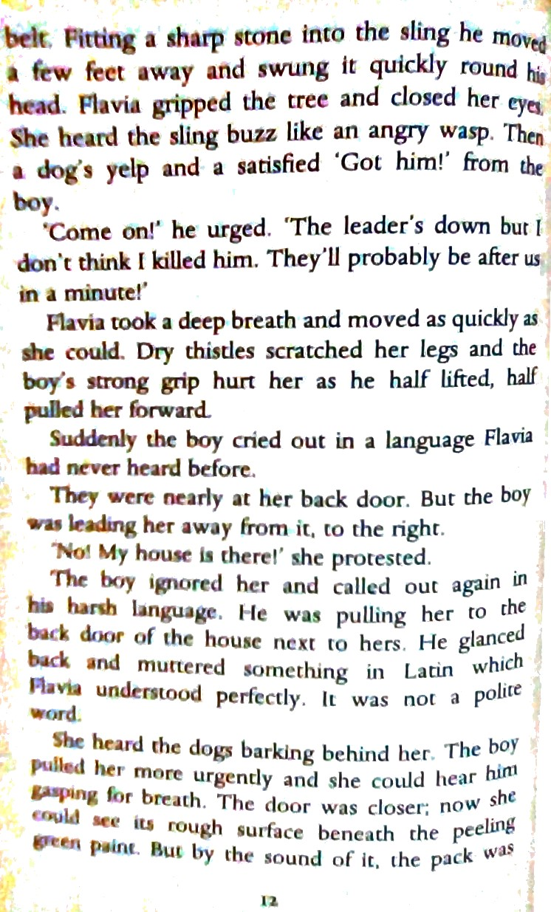

Slide 6
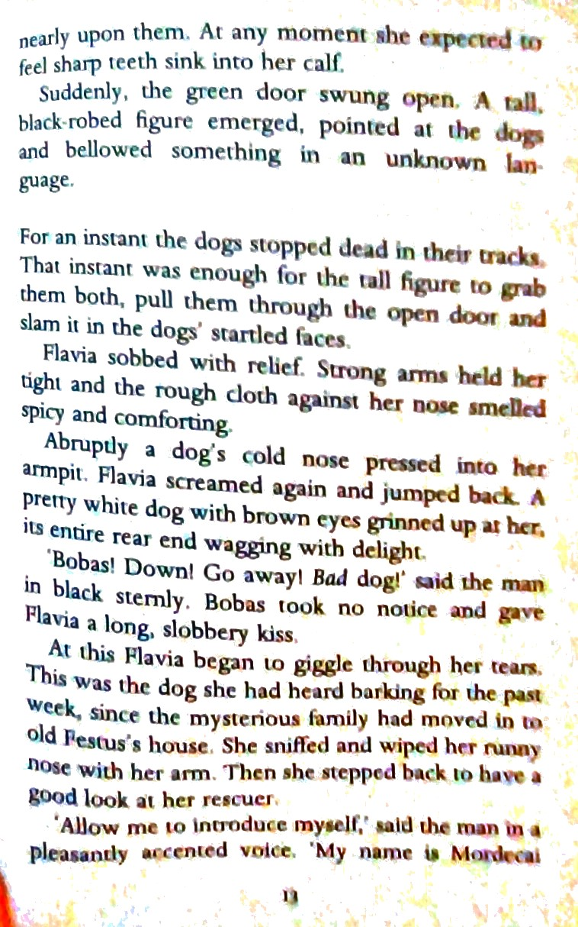

Slide 7
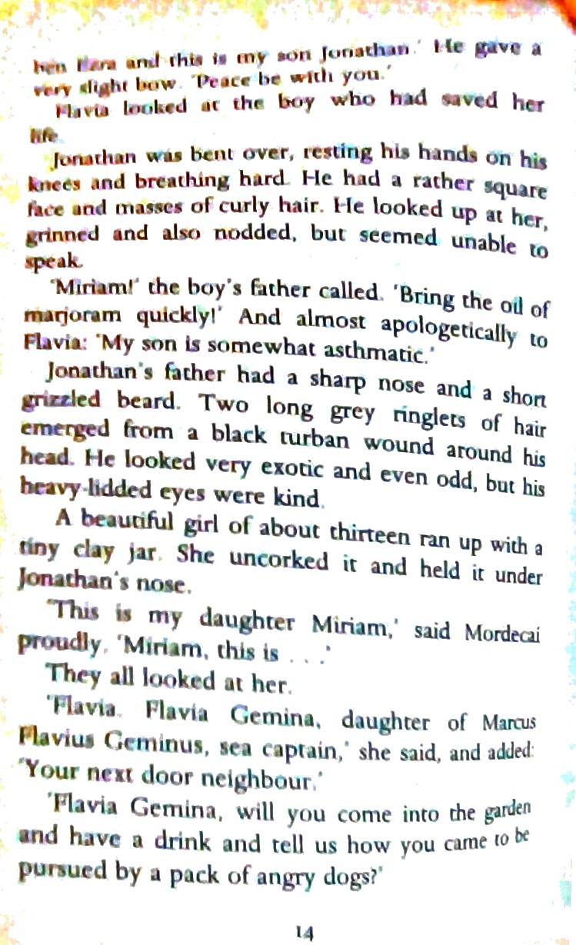

Slide 8
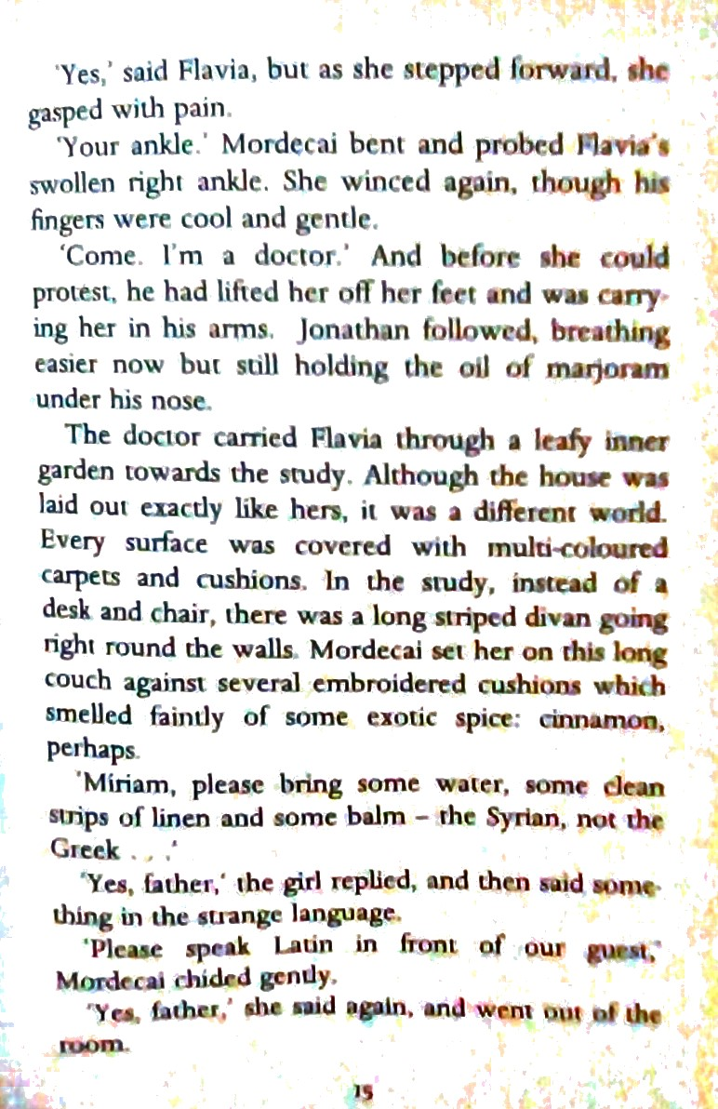

Slide 9
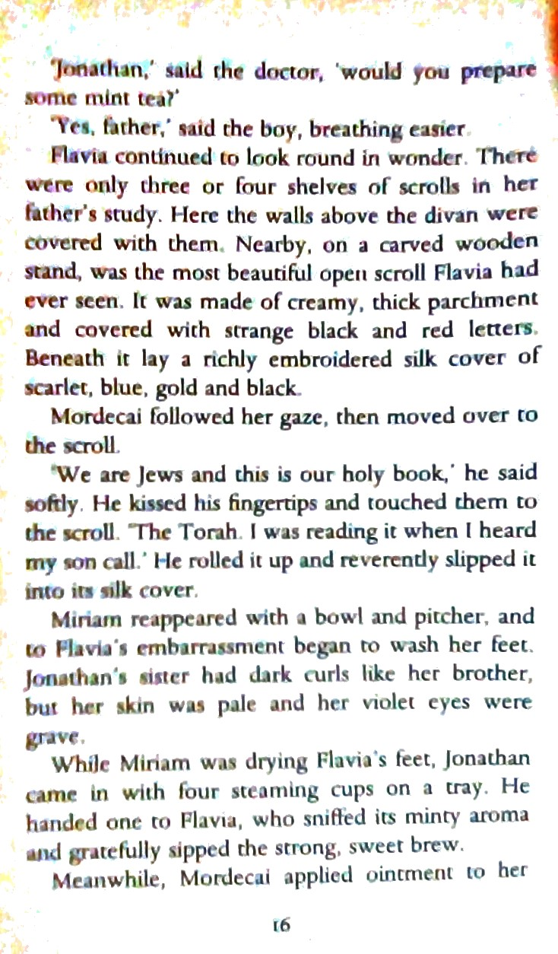

Slide 10
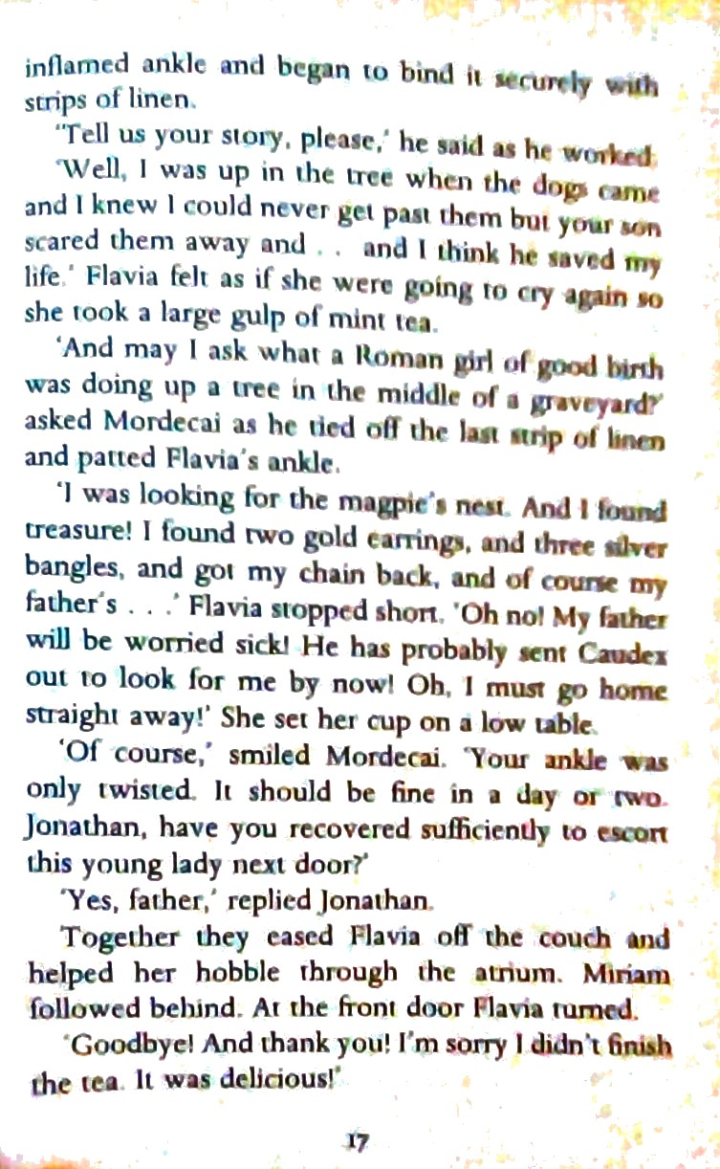

Slide 11
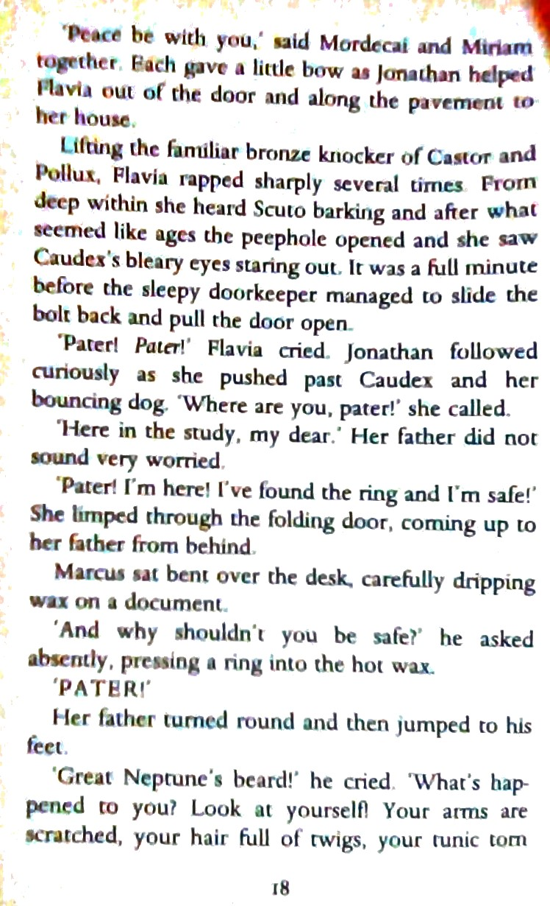

Slide 12
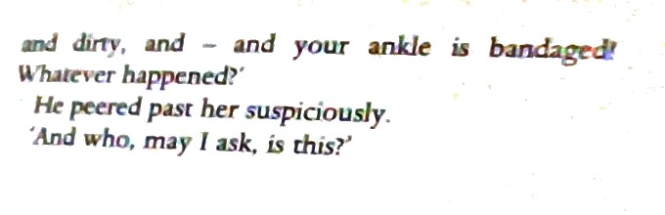

Slide 13
Reflect on the story so far….
That was close! I’m so glad Flavia was safe in the end.
Summarise scroll 2 orally to an adult. Lots of characters are
introduced in this scroll! Discuss what you think of them and why before you answer the questions that follow.

Slide 14
There are 10 questions that follow.
Challenge 1- questions 1-4, challenge 2- questions 3-8. challenge 3 -questions 6-10
How does the author describe the dogs?
What did the boy use to scare away the dogs?
What is the Jewish Holy book called?
How old was Miriam?
Who is Cordex?
What language did Flavia speak?

Slide 15
Up to chapter 2 . ( you may need to look back at yesterdays text )
Characters:
7. What are your first impressions of Flavia?
Give reasons and evidence from the text to support your answers. ( I think Flavia is …….because the
author describes her as ……….or she did ………………..which makes her………………..)
8. From the way Jonathan speaks and from his actions, what do you learn about him as a character?
9. How is Mordecai presented- ? What is his occupation?
Setting:
10. Flavia’s home is very different to Jonathan’s. Look at the way each is described. What do they
reflect about the two families and way of life? You may want to present this as table – comparing Flavia’s home with Jonathan’s.

