Slide 1

Subtraction day 2
Tuesday 19th January 2021

Slide 2
Lo subtraction using the column method.

Slide 3
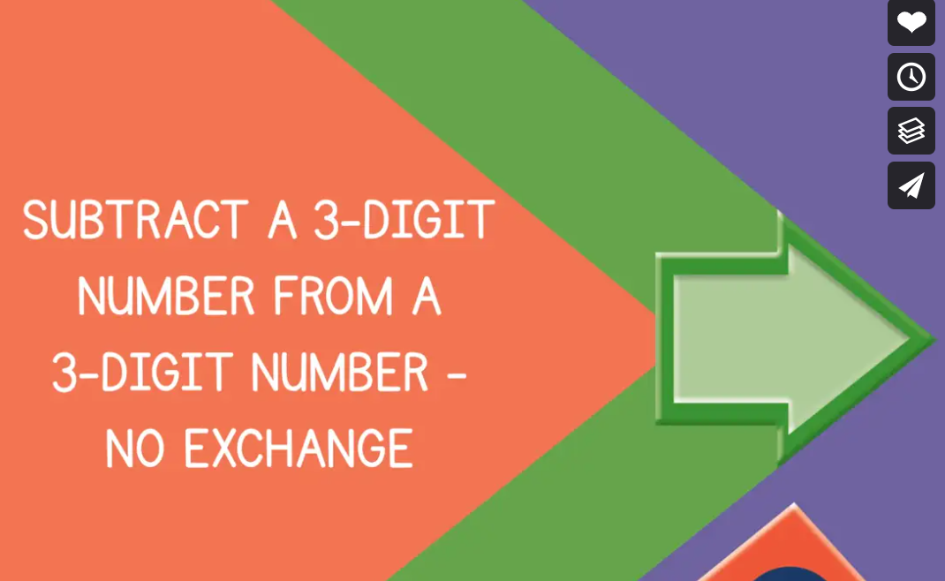
Challenge 1
Please watch this link https://vimeo.com/463005007
This will give you confidence to do this . Watch the video, stop where you are asked to and just follow the instructions. You will see bar models and number lines and part whole modelling used . I would you to stick to column method please.

Slide 4
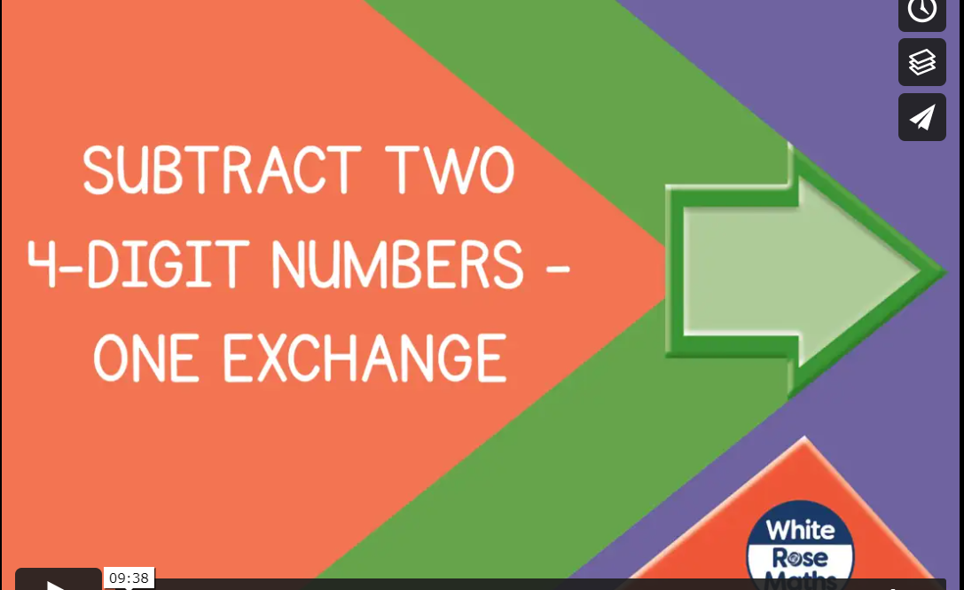
Challenge 2
Please watch this link
https://vimeo.com/463378320
. Watch the video, stop where you are asked to and just follow the instructions. You will see bar models and number lines and part whole modelling used , I would like you to stick to column method please.

Slide 5
Challenge 3 please complete your choice of sums from 1-54 in challenge 3 ( not all of them, only 20 sums)

