Slide 1

Thursday 21st January 2021
Subtraction

Slide 2
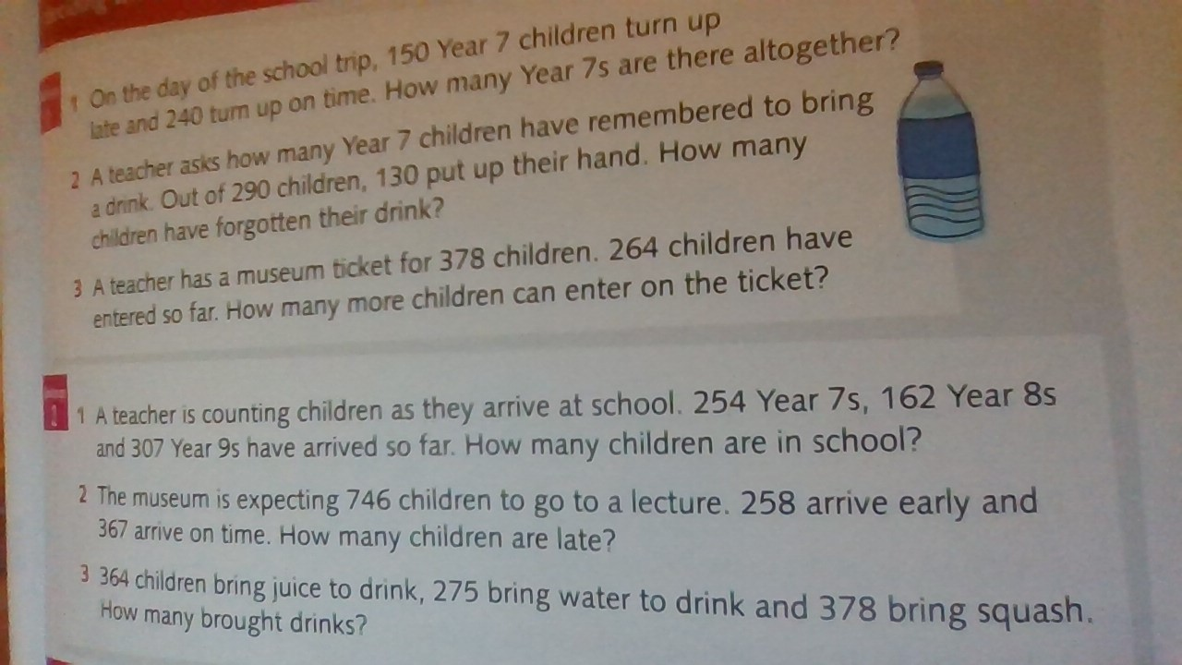
Challenges 1 and 2

Slide 3
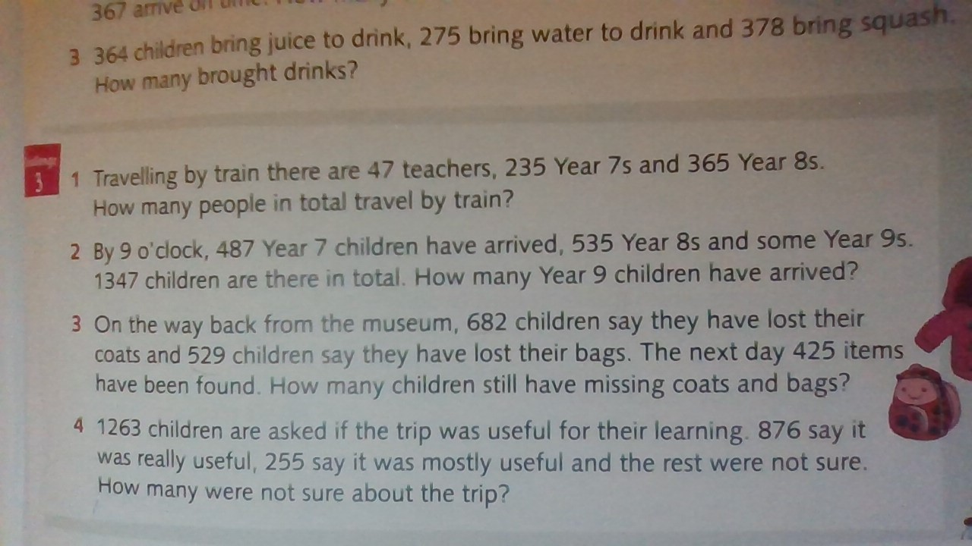
Challenge 3

Slide 4
Answers
Challenge 1
1) 390 2) 160 3) 114
Challenge 2
1) 723 2) 121 3) 1017
Challenge 3
1) 647
2) 325
3) A lot of children! 786
4) 132

Slide 5
After you have finished and marked your work…..
Please do Doodle maths x 20 mins and x 10 mins Doodle times tables.

