Slide 1
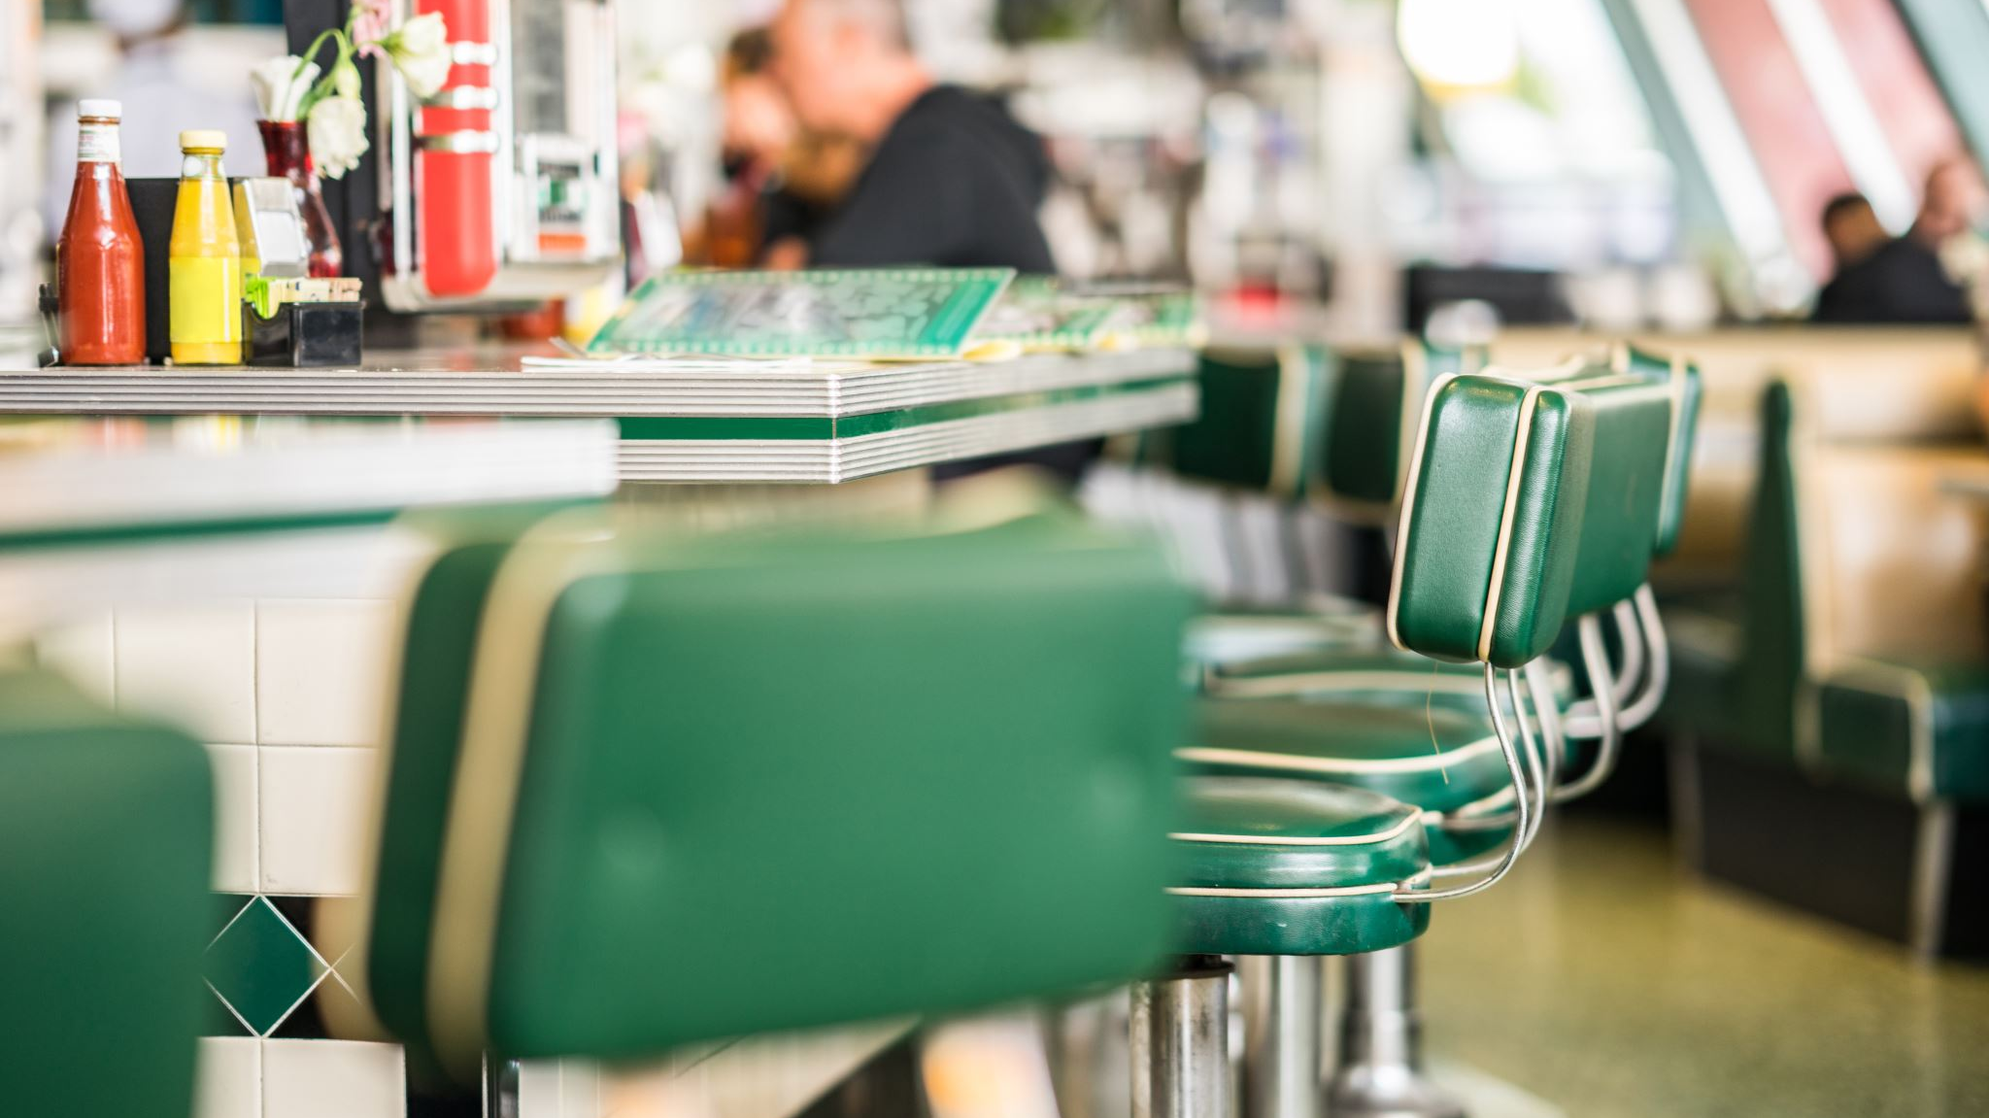
The Thieves of Ostia
Scroll 3
27.1.2021

Slide 2
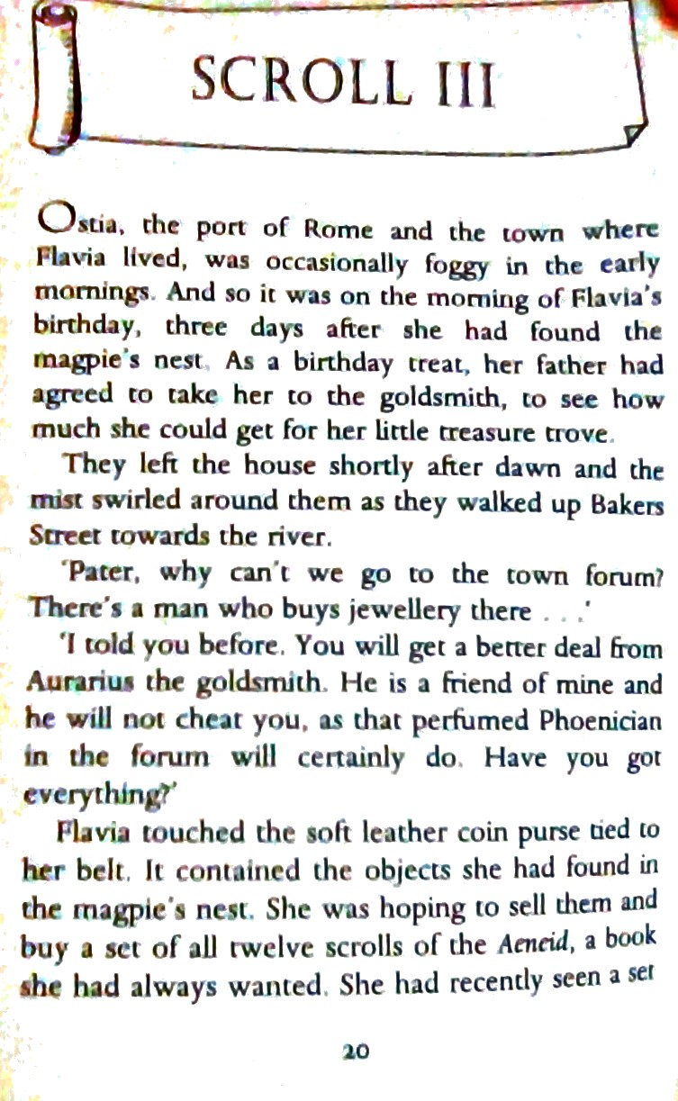

Slide 3
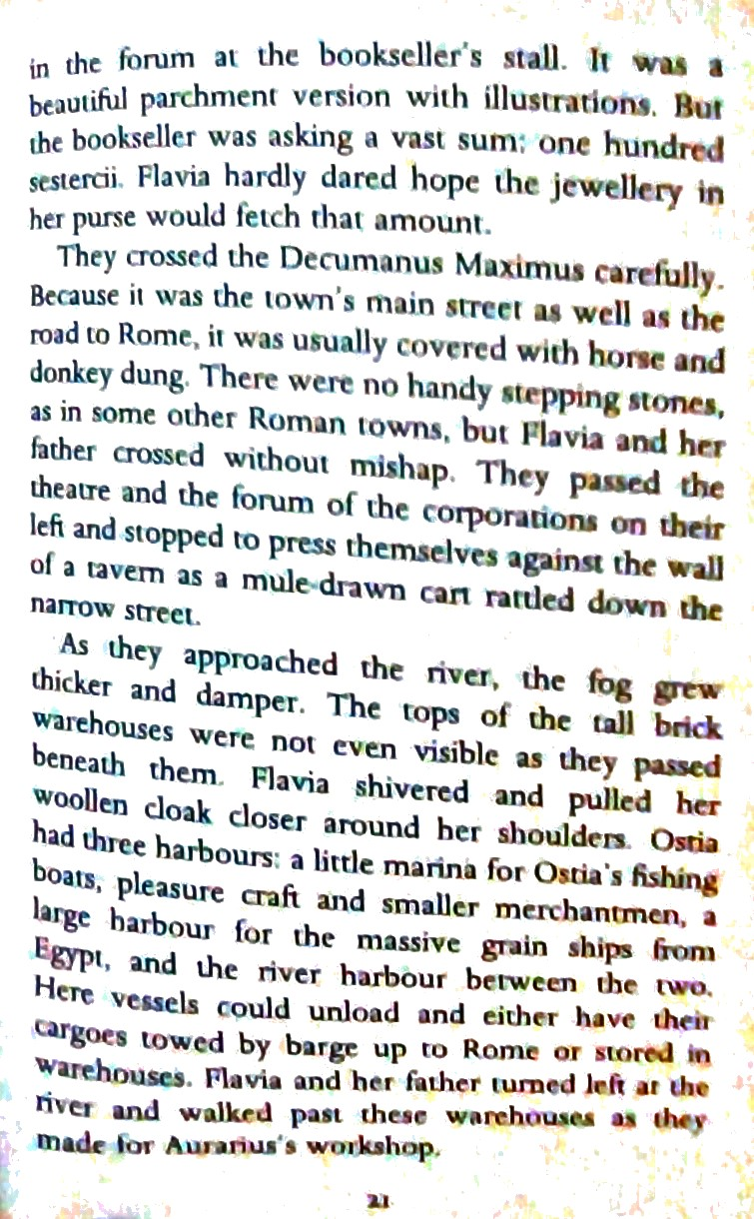

Slide 4
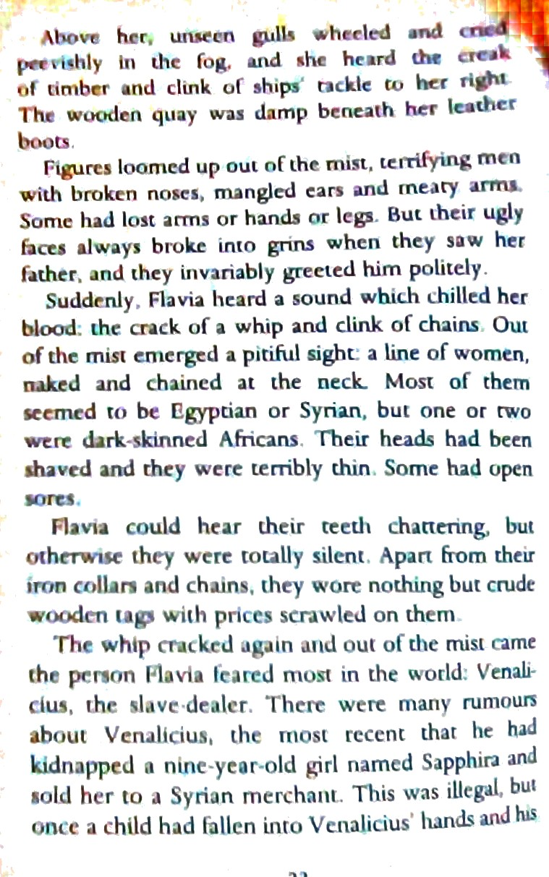

Slide 5
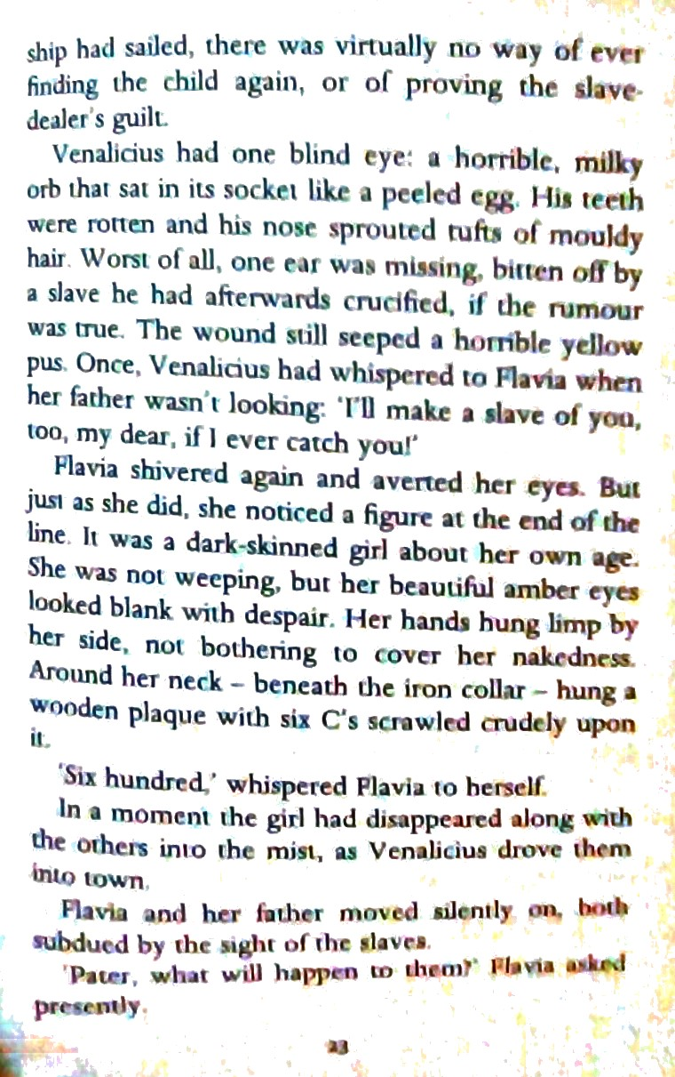

Slide 6
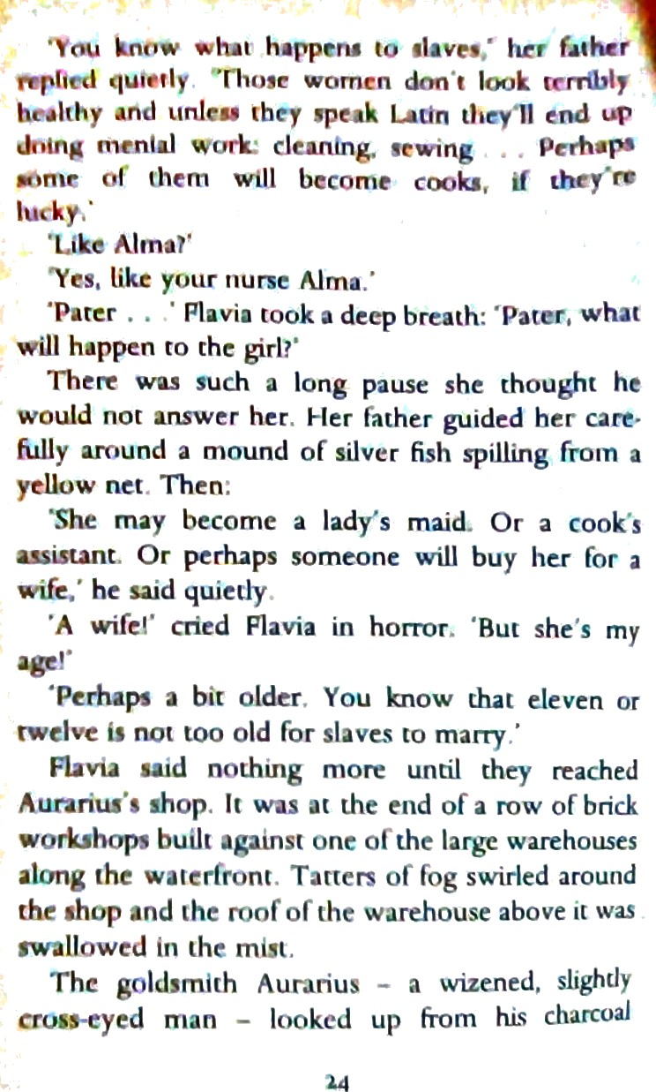

Slide 7
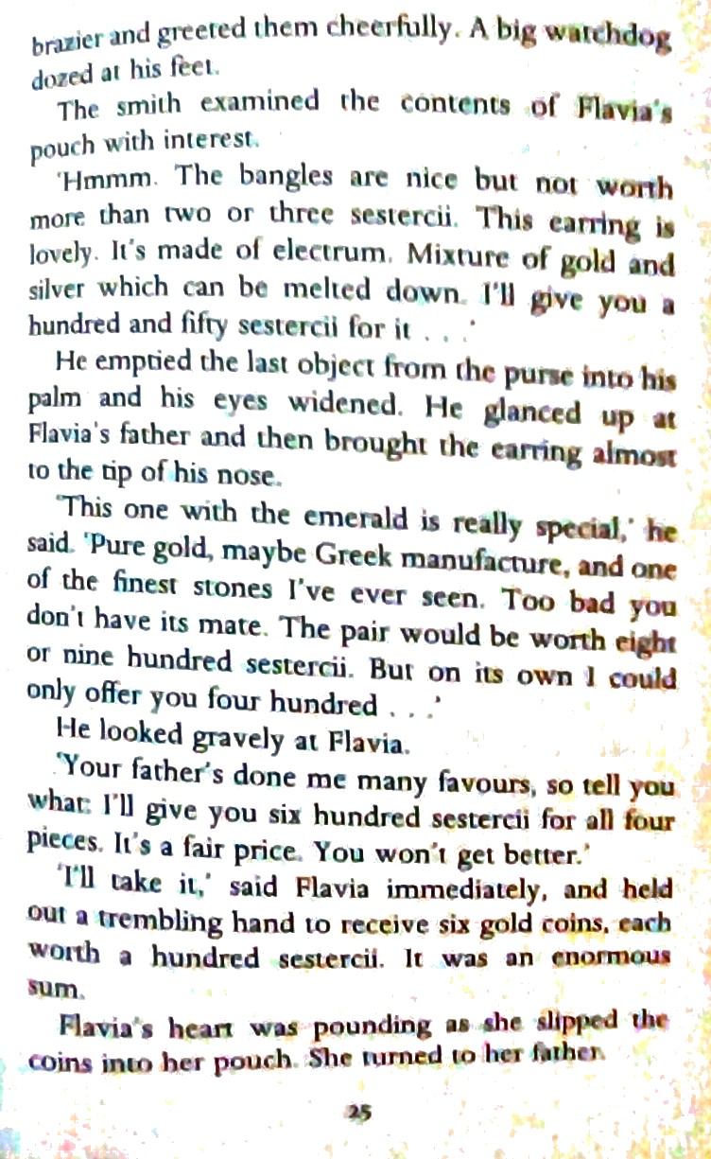

Slide 8
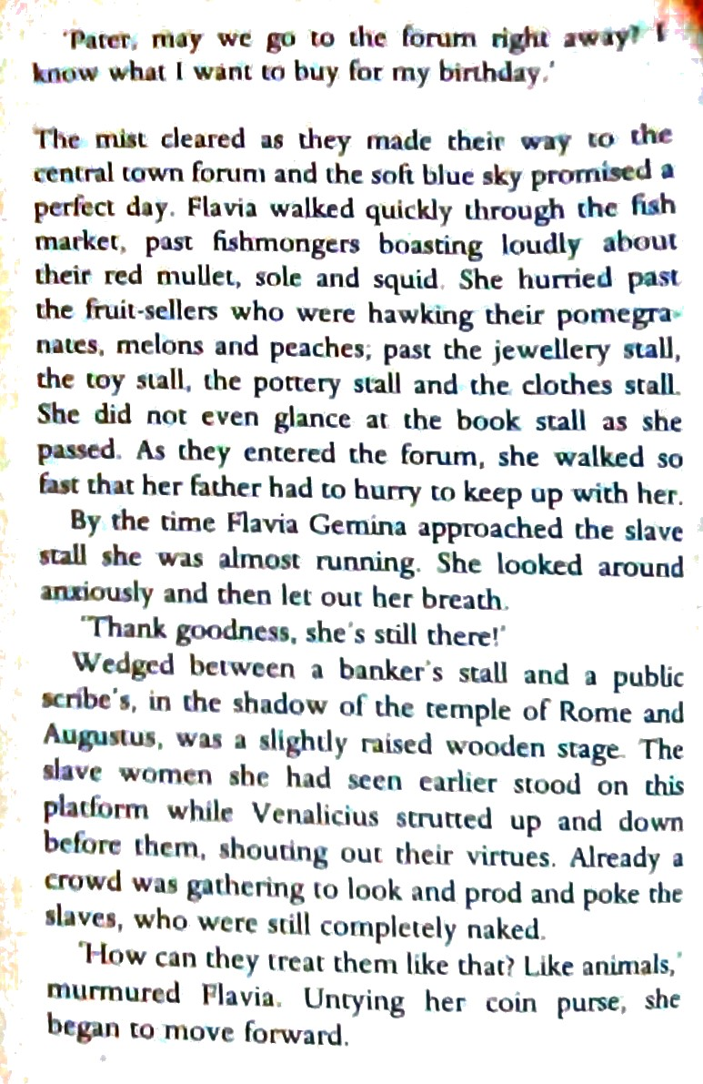

Slide 9
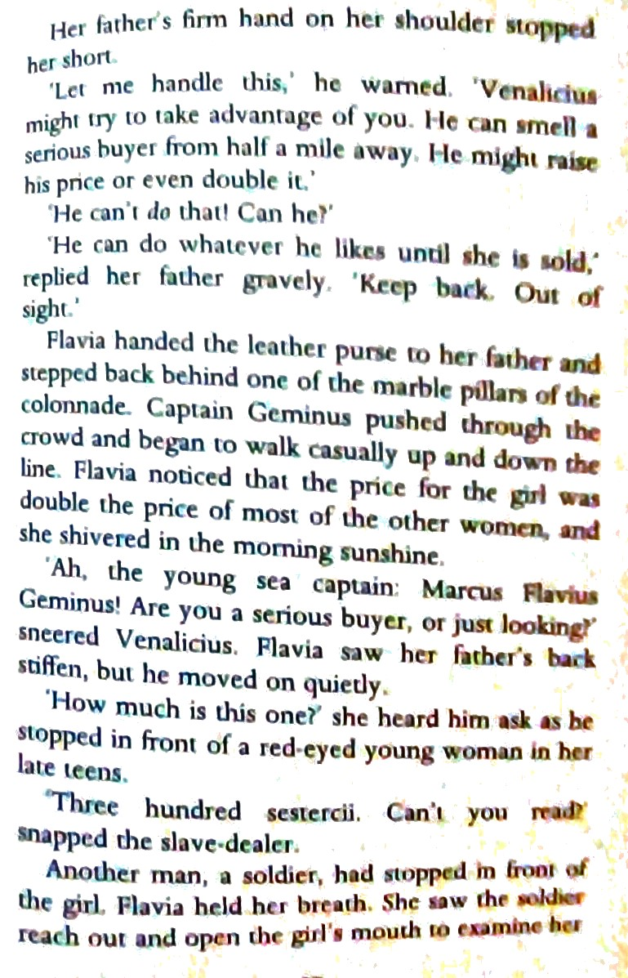
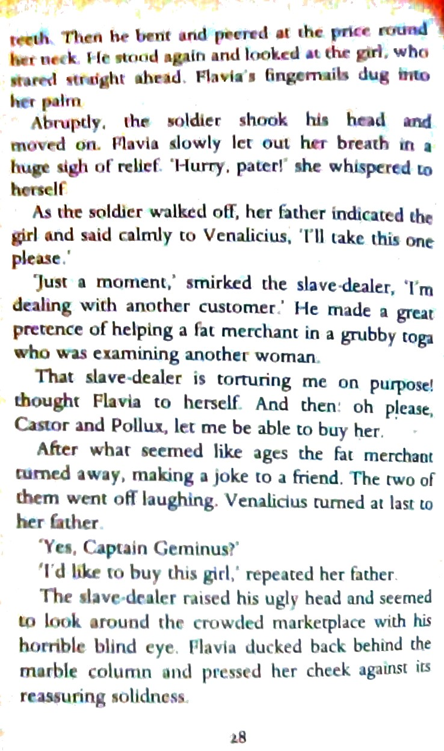

Slide 10
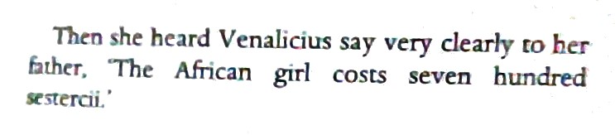

Slide 11
Any questions about the text ?
Check with an adult.

Slide 12
Select your challenge.
Challenge 1 Questions 1, 2, 3 and 4.
Challenge 2 Questions 4, 5, 6 and 7.
Challenge 3 Questions 7,8,9 and 10.

Slide 13
1 Summarise in 5 sentences what’s happened in scroll 3 . | 6 Why do you think ‘pater’ didn’t answer Flavia when she asked what was going o happen to the girl? ( p.24)
2 Why didn’t Flavia’s father want her to sell her jewellery in the forum? | 7 What do you think of Flavia’s decision to buy the slave girl instead of the scroll for her birthday?
3 What did Flavia want to buy with her money at the start of this chapter? 3ii Why do you think she changed her mind? | 8 What type of character is Venalicius? , Prove it with evidence from the text. Can you sketch what he might look like?
4 Do you agree or disagree with slavery? Why? 4ii. What do you think will happen to the African slave girl? | 9 How does the author use the setting to create a sense of foreboding ( a feeling that something bad is about to happen) in Scroll III? Giveat least 2 examples.
5 Make a list of words used to describe Venalicius. | 10. Find 2 similarities and 2 differences between life in Ancient Rome compared to life in 2021.

