Slide 1
GLADIATORS READY ?
To help with writing a commentary.
3.2.2021

Slide 2
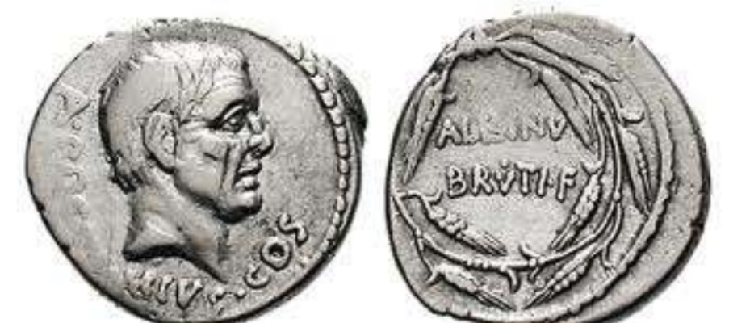
The one who started it all off. Emperor Brutus.

Slide 3
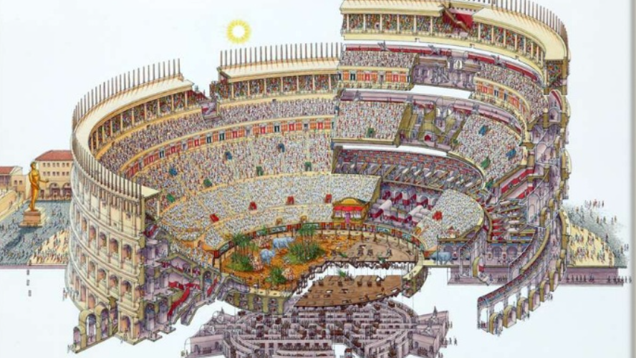

Slide 4
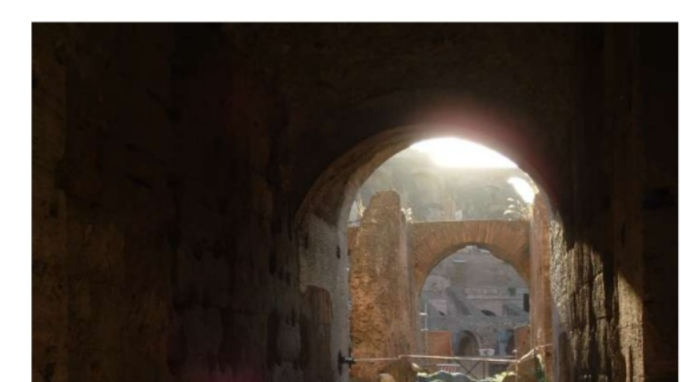

Slide 5
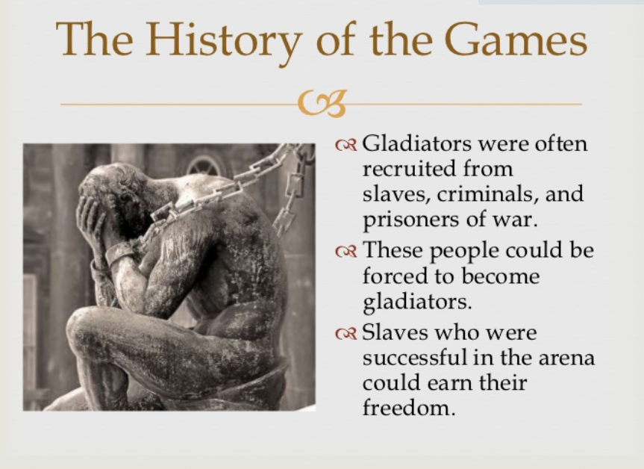

Slide 6
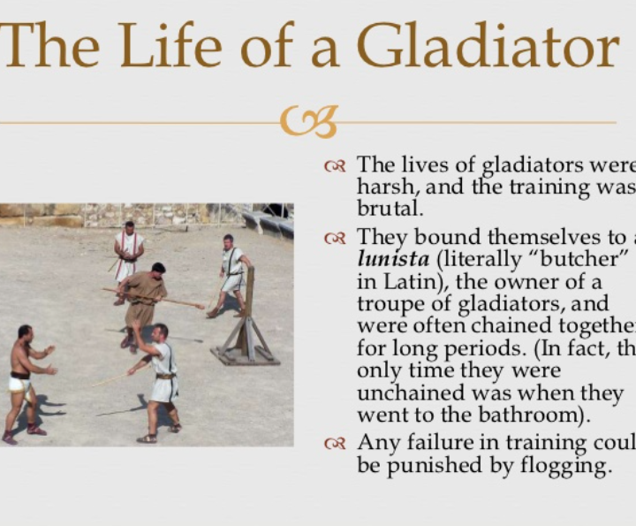
Gladiator School.

Slide 7
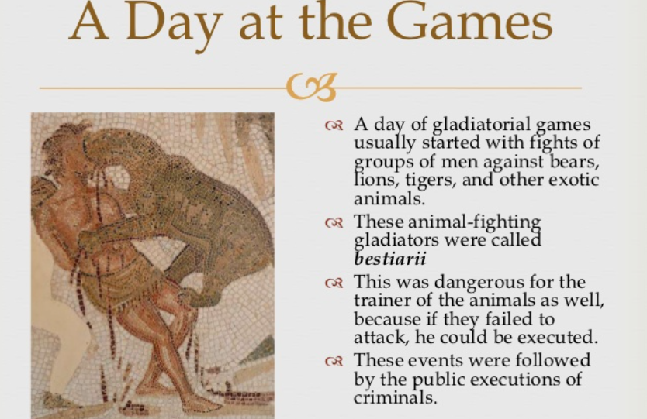

Slide 8
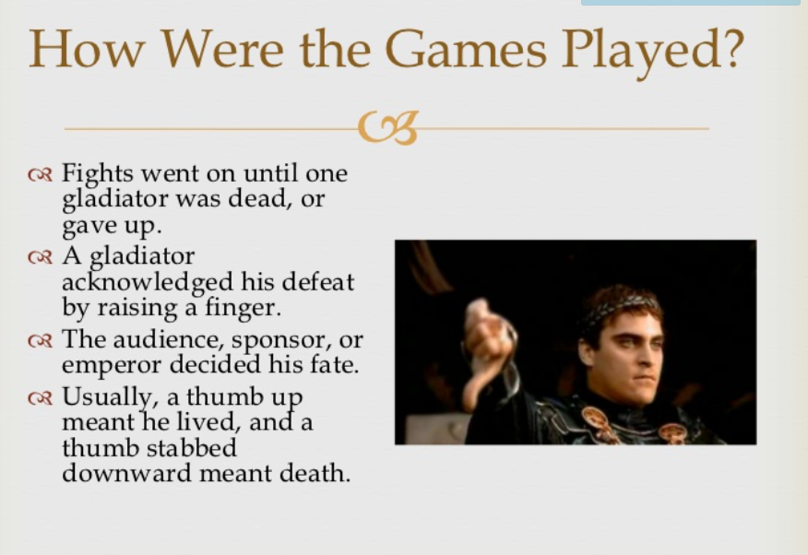

Slide 9
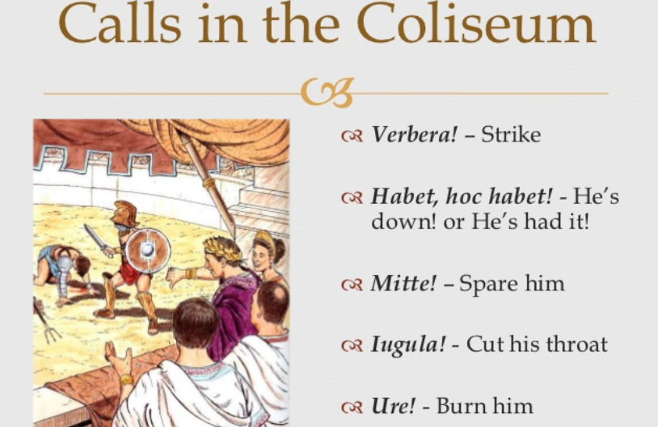

Slide 10
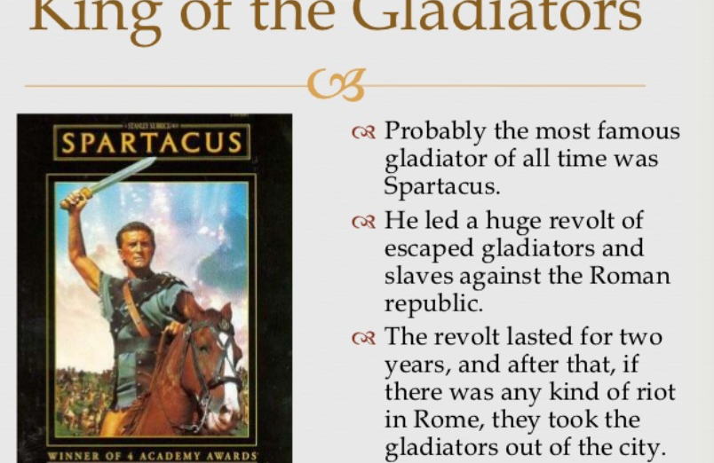

Slide 11
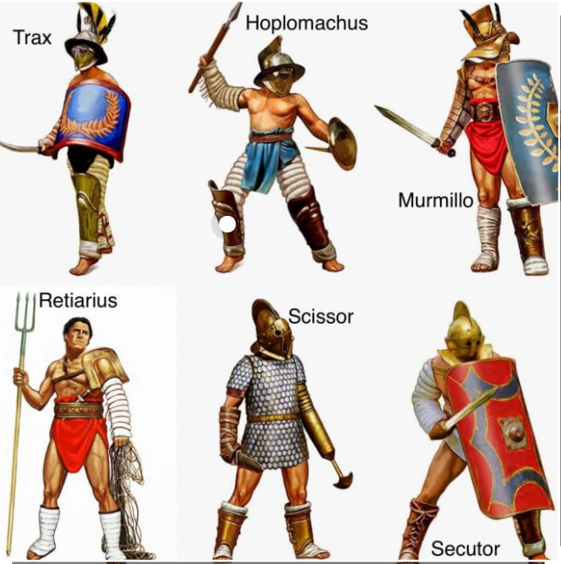
Different types of
Gladiators and their weapons

Slide 12
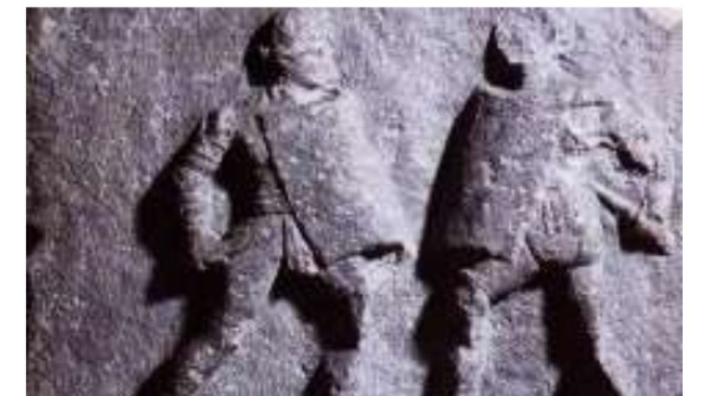
Female
Gladiators
GLADIATRICES
These two were called Amazon and Achillia

