Slide 1
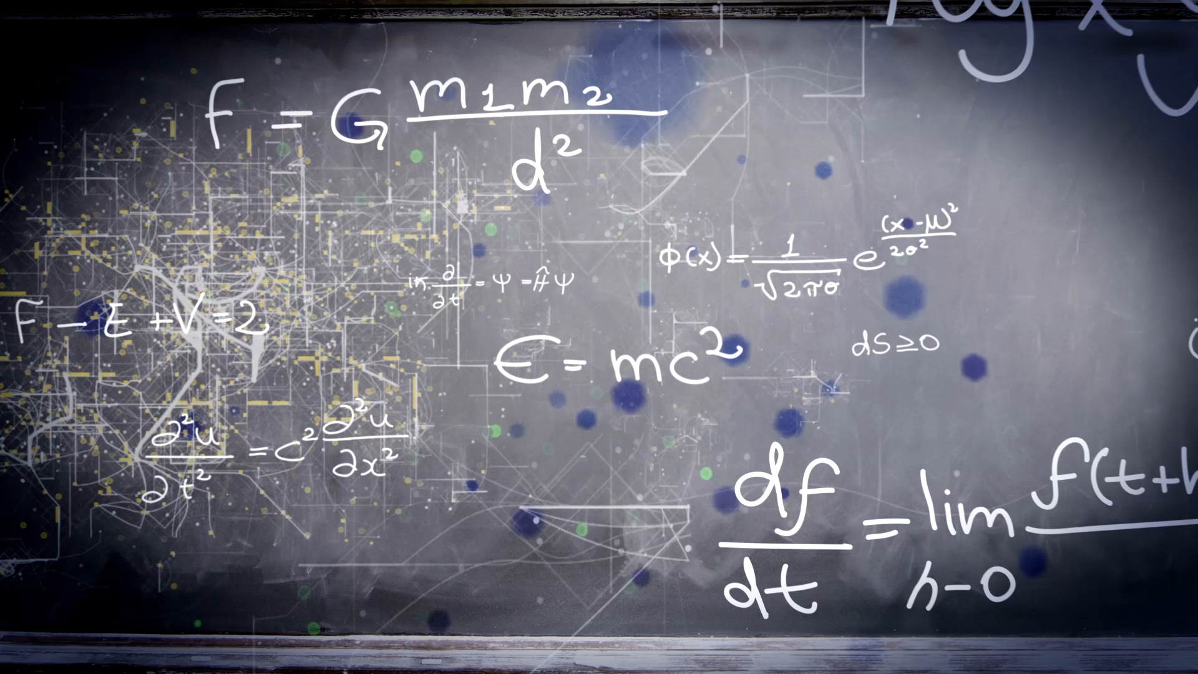
Maths
Mental and arithmetic
Friday 5th February 2021

Slide 2
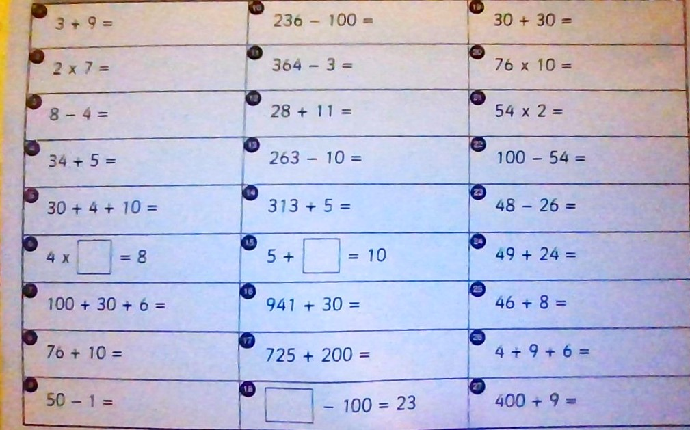
Challenge 1 Arithmetic test

Slide 3
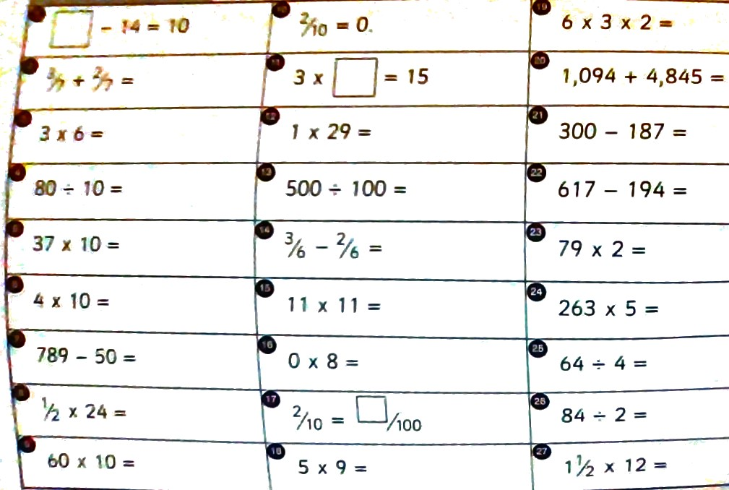
Challenges 2 and 3 Arithmetic test

Slide 4
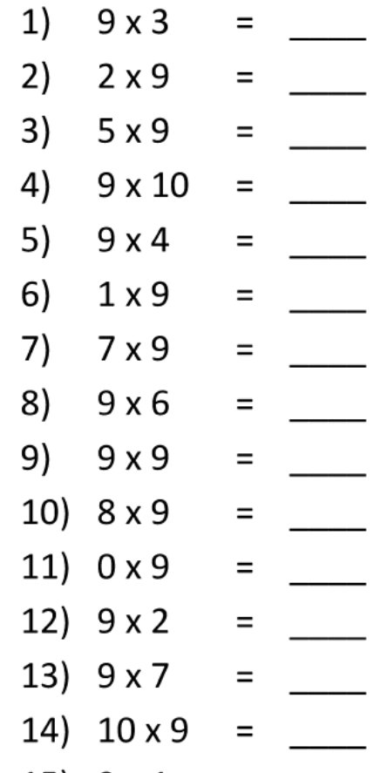
Times table test challenge 1

Slide 5
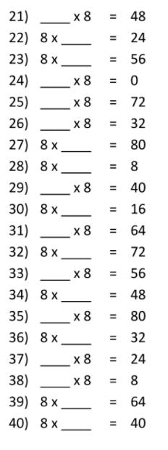
Times table challenge test 2

Slide 6
Times table challenge 3
1 | 7 x 19= | 9 | 11 x 16 =
2 | 12 x19= | 10 | 52 x 8 =
3 | 15 x 13= | 11 | 16 x 8 =
4 | 19 x25 = | 12 | 43 x 3 =
5 | 15 x9= | 13 | 78 x 20
6 | 91 x 8= | 14 | 15 x 12 =
7 | 8 x 17= | 15 | 36 x 5 =
8 | 7 x 45= | 16 | 9 x 18 =

Slide 7
ANSWERS

Slide 8
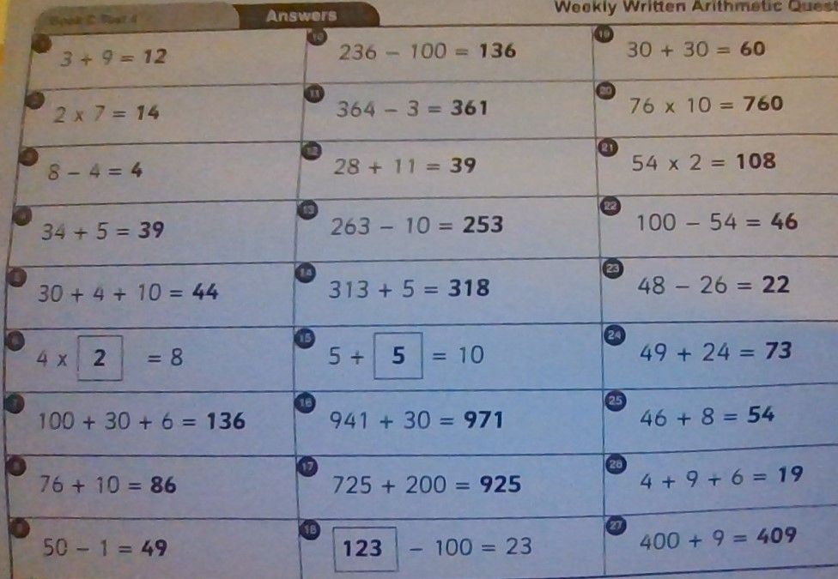
ANSWERS challenge 1 Arithmetic test

Slide 9
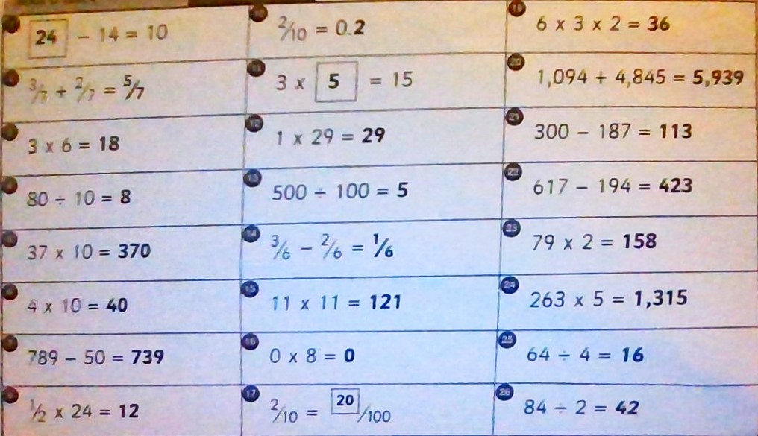
Answers Arithmetic challenge 2 and 3

Slide 10
Challenge 1 times table Answers
1 | 27 | 8 | 54
2 | 18 | 9 | 81
3 | 45 | 10 | 72
4 | 90 | 11 | 0
5 | 36 | 12 | 18
6 | 9 | 13 | 63
7 | 63 | 14 | 90

Slide 11
Challenge 2 times tables test. Answers for questions 21-36
21 | 6 | 29 | 5
22 | 3 | 30 | 2
23 | 7 | 31 | 8
24 | 0 | 32 | 9
25 | 9 | 33 | 7
26 | 4 | 34 | 6
27 | 10 | 35 | 10
28 | 1 | 36 | 4
 | 37 | 3
 | 38 | 1
 | 39 | 8
 | 40 | 5

Slide 12
Times table challenge 3 ANSWERS
1 | 7 x 19= 133 | 9 | 11 x 16 = 176
2 | 12 x19=228 | 10 | 52 x 8 = 416
3 | 15 x 13=195 | 11 | 16 x 8 = 128
4 | 19 x25 =475 | 12 | 43 x 3 = 129
5 | 15 x9=135 | 13 | 78 x 20 1560
6 | 91 x 8=728 | 14 | 15 x 12 = 180
7 | 8 x 17=136 | 15 | 36 x 5 = 180
8 | 7 x 45= 315 | 16 | 9 x 18 = 162

