Slide 1

Make a Chinese Dragon
5.2.2021

Slide 2
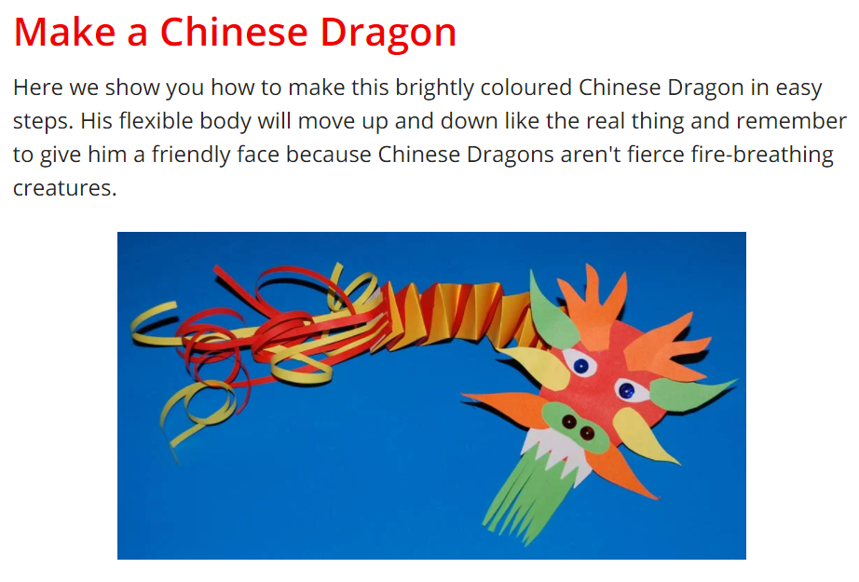

Slide 3
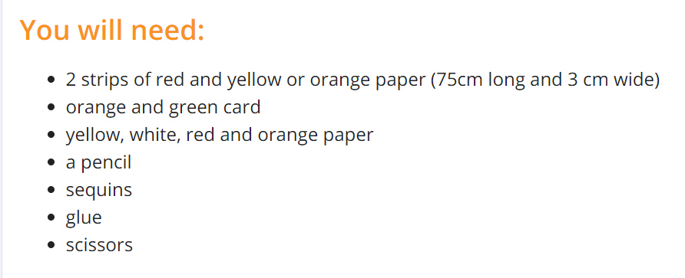
The colours are optional , use whatever you have . The sequins are also optional.

Slide 4
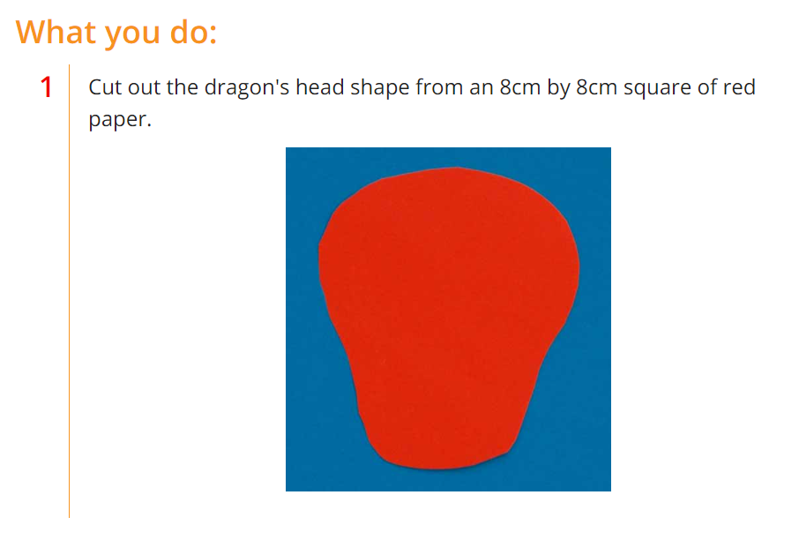

Slide 5
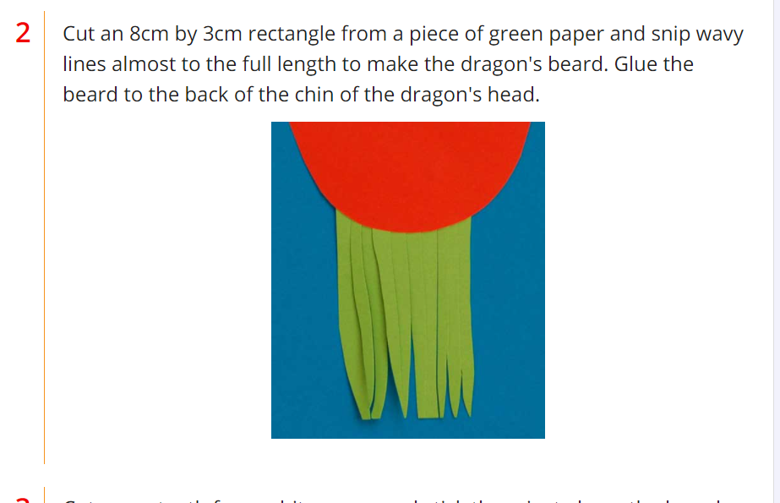

Slide 6
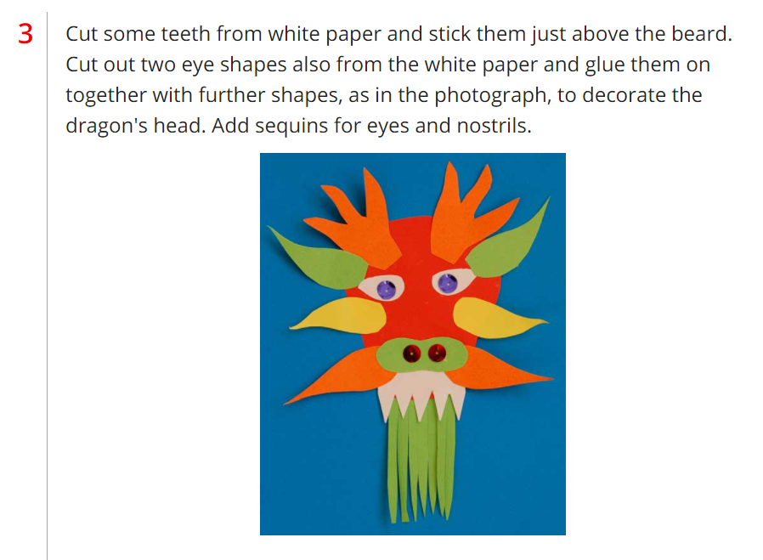

Slide 7
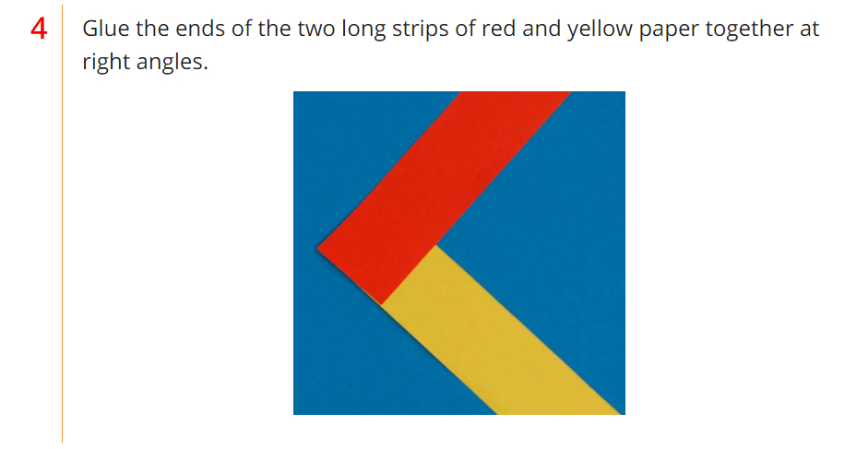

Slide 8
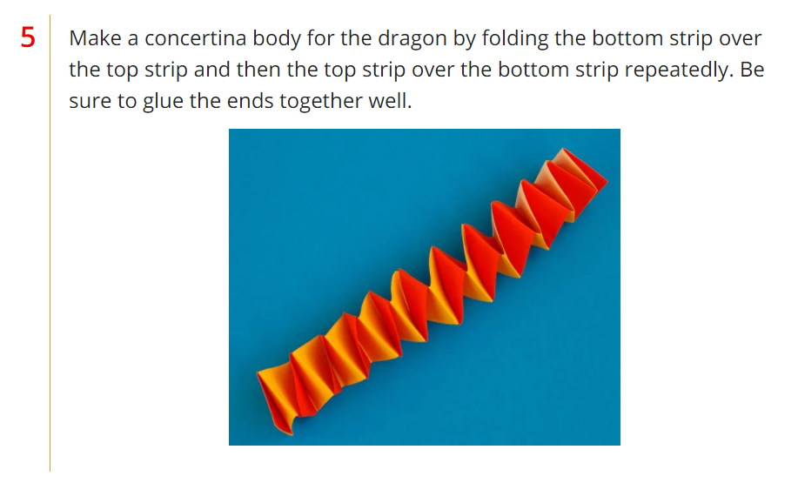

Slide 9
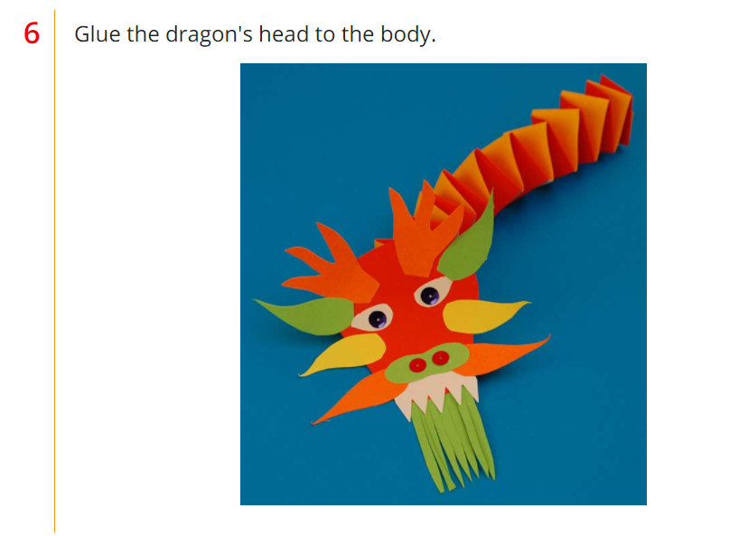

Slide 10
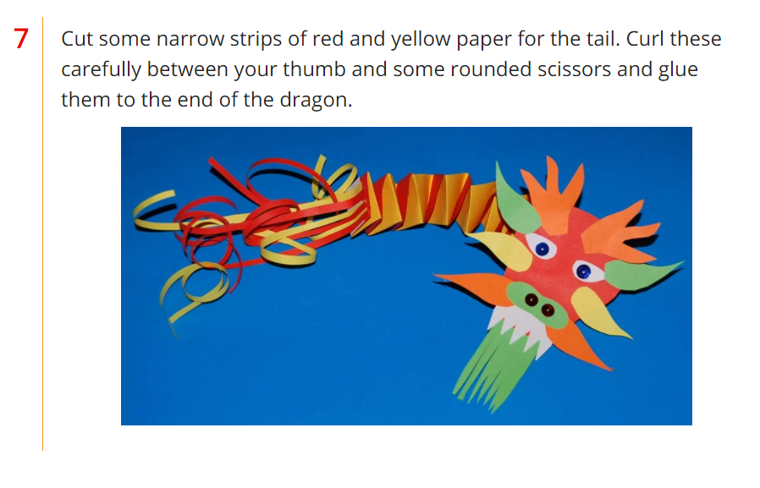
Stick lollipop sticks or straws at each end and you can make your Dragon dance.

Slide 11

ICT research
Find out about the Chinese new year story and New year traditions.

Slide 12


