Slide 1
Suffix ‘ation’
Monday 8th February 2021

Slide 2
Dictionary work
Find as many words with the suffix ‘ation’ as possible ( 10 Mins)
Station
N
Exper
Prep
Qual
Adm
ado
Sen
Inf
Fou
Explo
Exam
Make sure you know what these words mean!
Practice saying sentences out loud using your ‘ation ‘words.

Slide 3
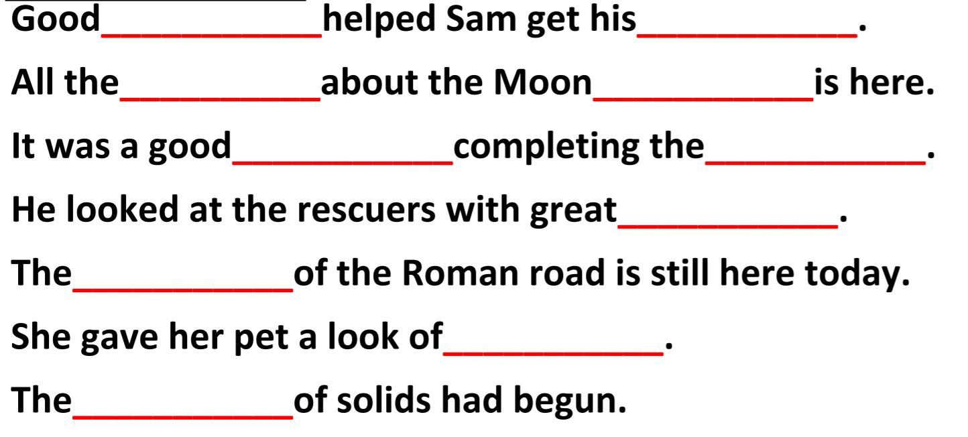
Where do the words go?
Copy and complete

Slide 4
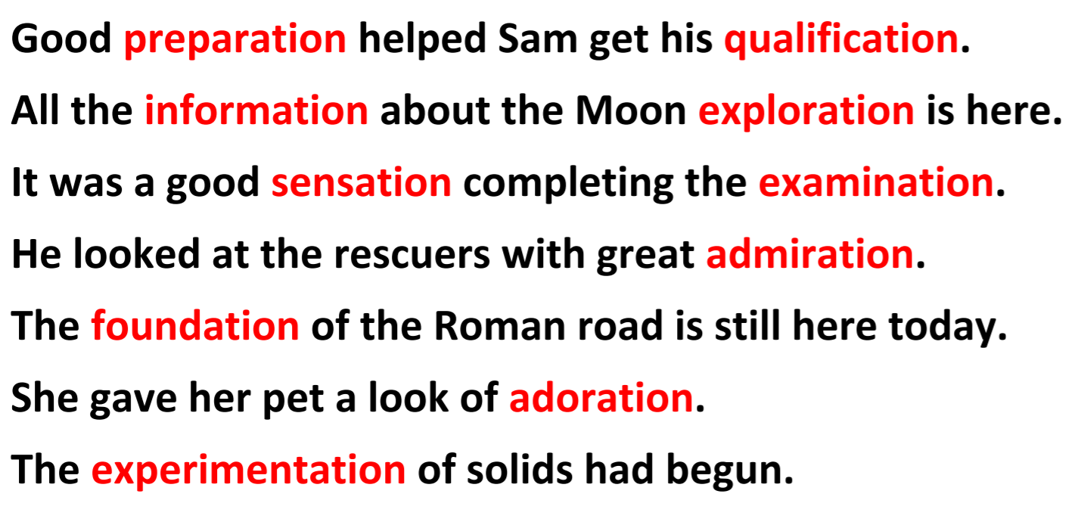
The answers.

