Slide 1
The Thieves of Ostia
Scroll VI
11.2.2021

Slide 2
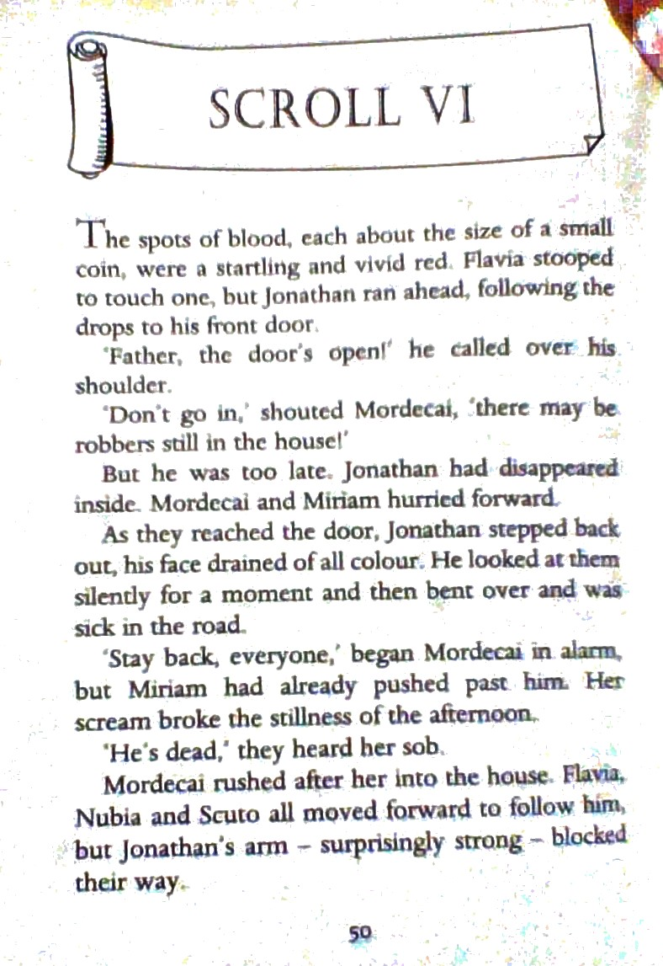

Slide 3
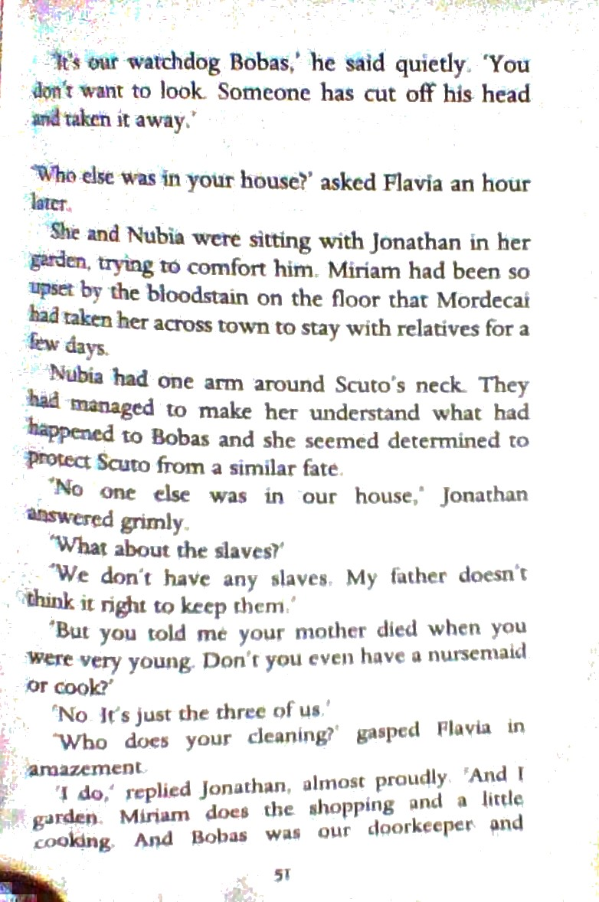

Slide 4
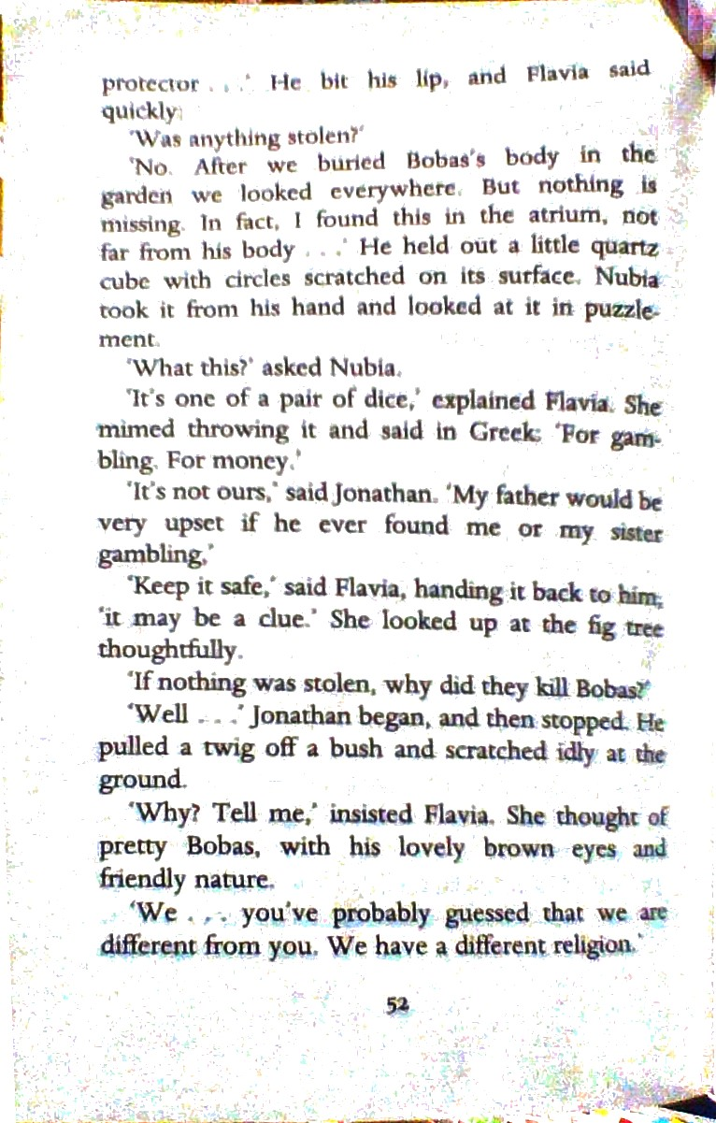

Slide 5
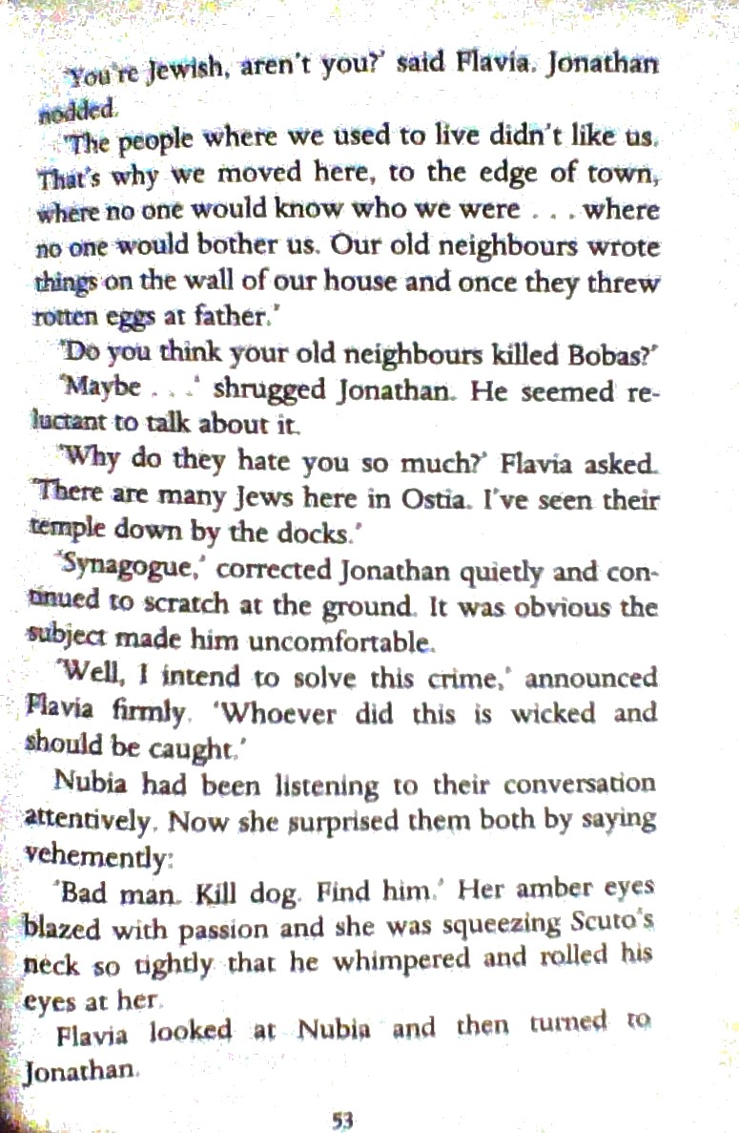

Slide 6
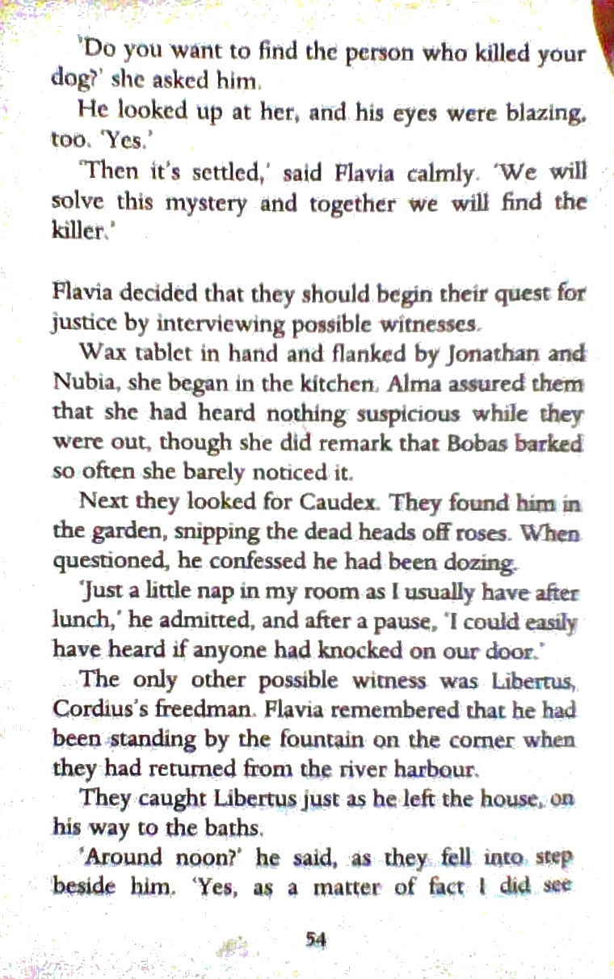

Slide 7
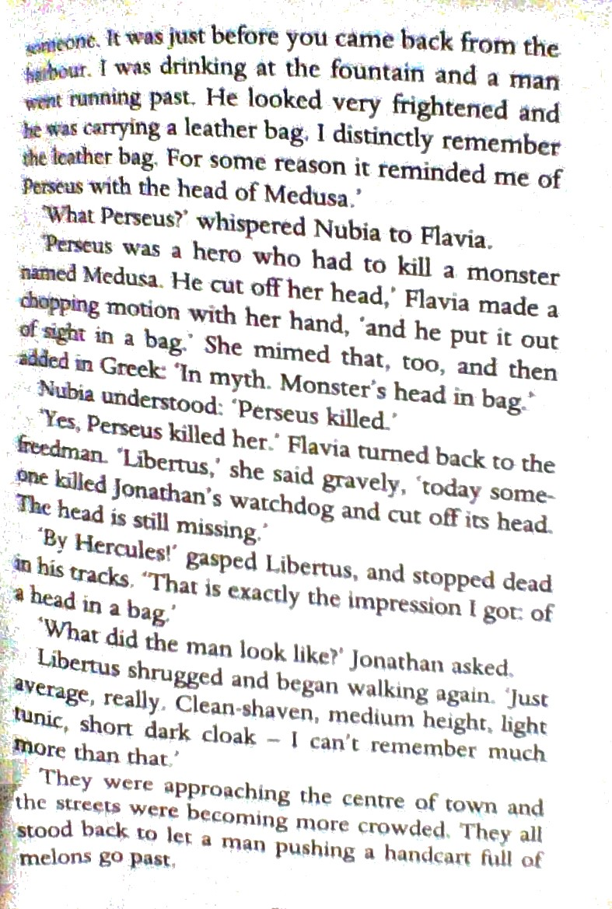

Slide 8
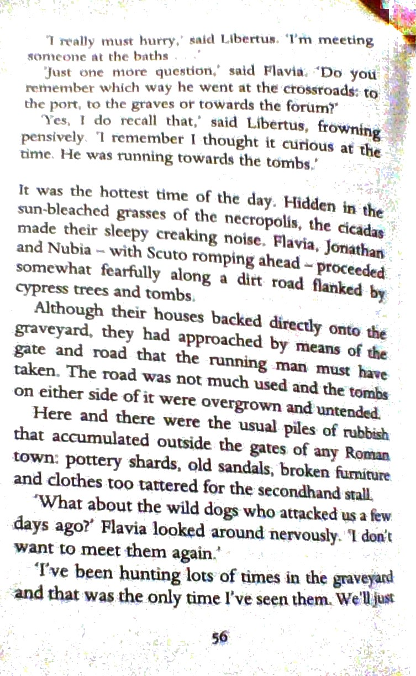

Slide 9
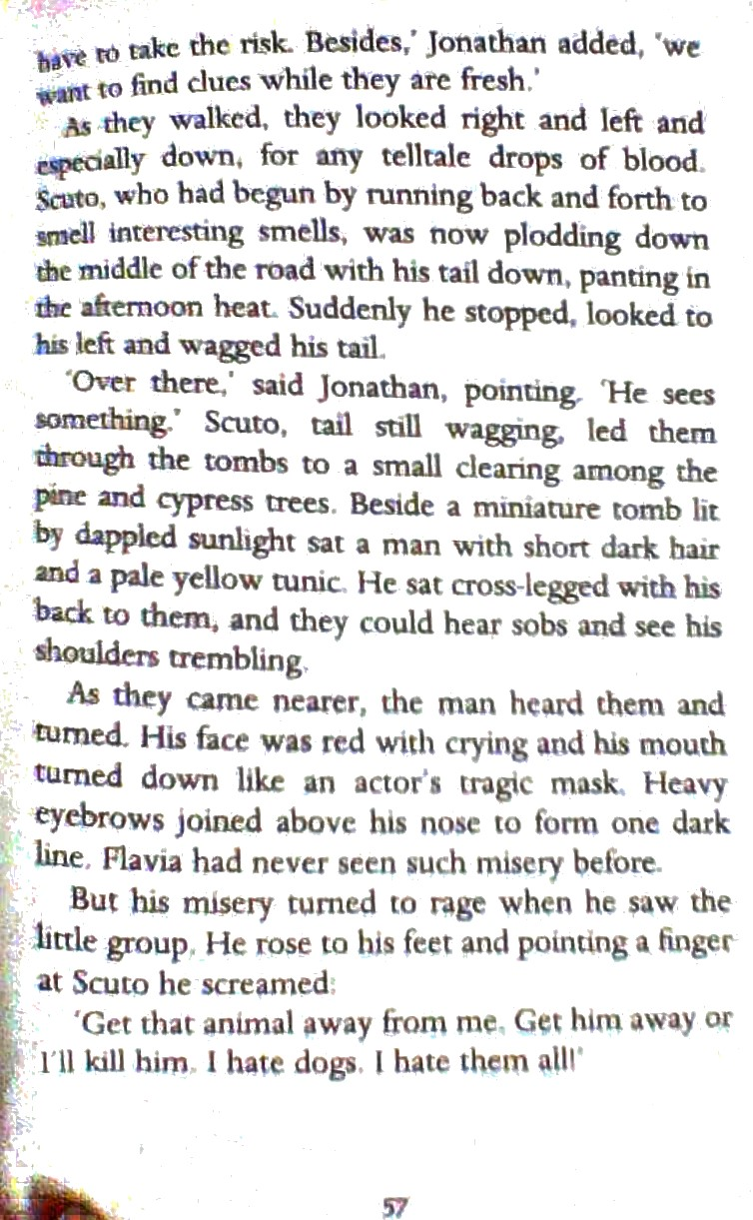

Slide 10
The Thieves of Ostia 11/2/2021
Scroll VI
Your task today is to answer the following questions .
What mysteries have presented themselves so far in the story from the beginning?
What is revealed about Mordecai and his family in scroll VI?
If you were trying to solve this mystery what would you do ? Who would you interview? What would you ask ?
What would you like to ask the character who is introduced at the end of scroll VI?
What do you think will happen next?

