Slide 1

Maths Friday 12th February 2021
Arithmetic and x tables tests + answers

Slide 2
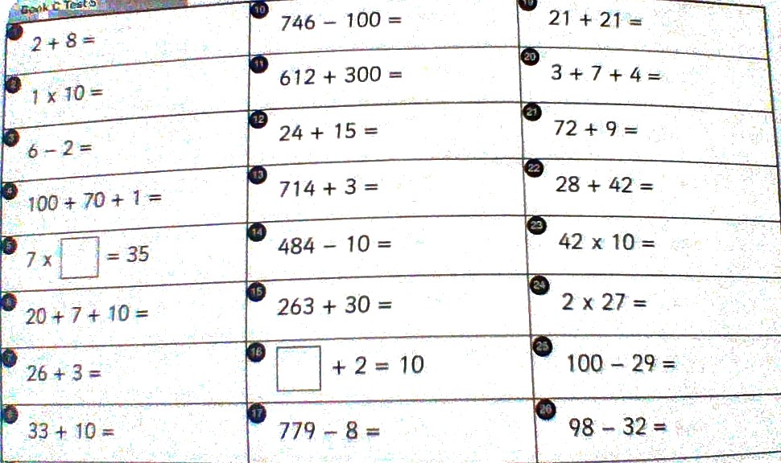
Arithmetic test challenge 1

Slide 3
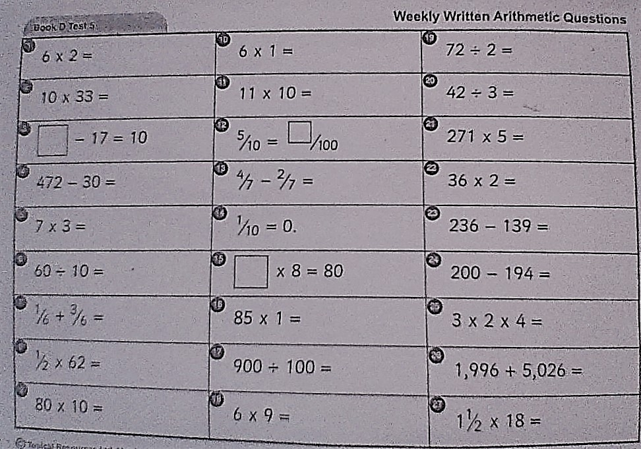
Challenge 2 and 3 arithmetic test

Slide 4
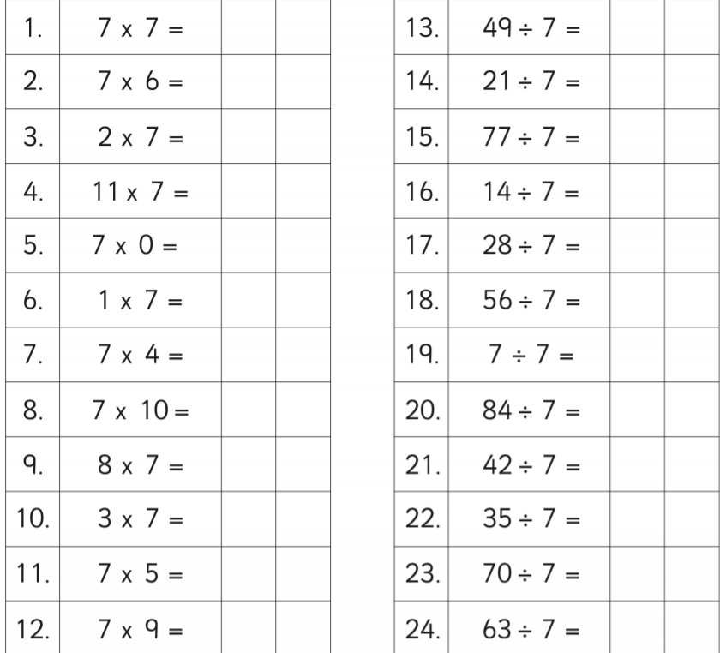
X table challenge 1

Slide 5
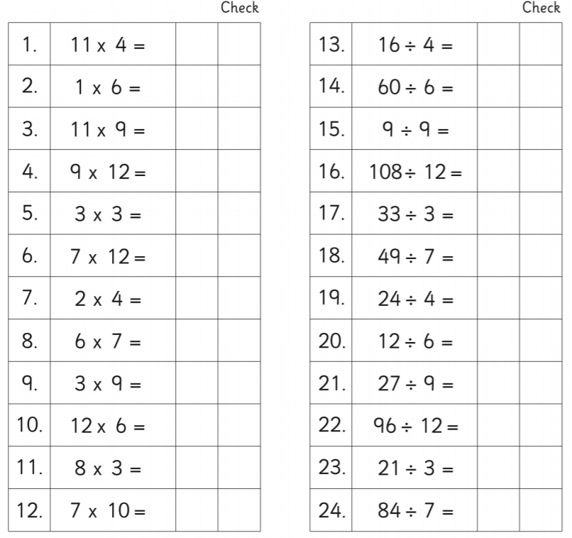
X table challenge 2

Slide 6
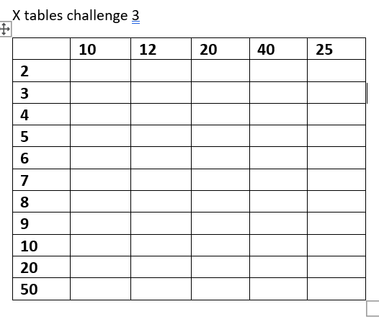
Challenge 3, x tables and related facts

Slide 7
ANSWERS
12.2.2021

Slide 8
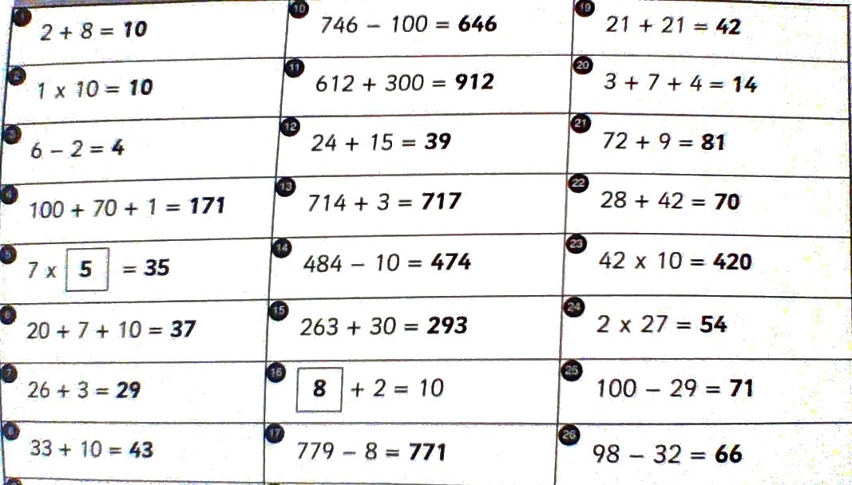
Answers challenge 1 arithmetic test

Slide 9
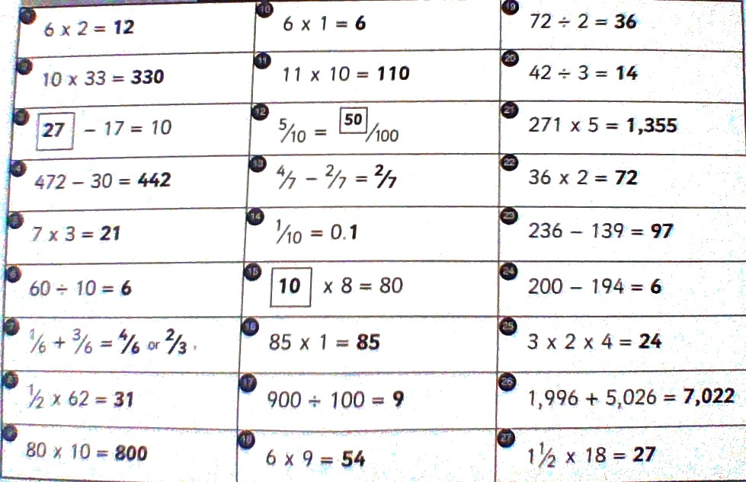
Answers - Challenge 2 and 3 arithmetic test

Slide 10
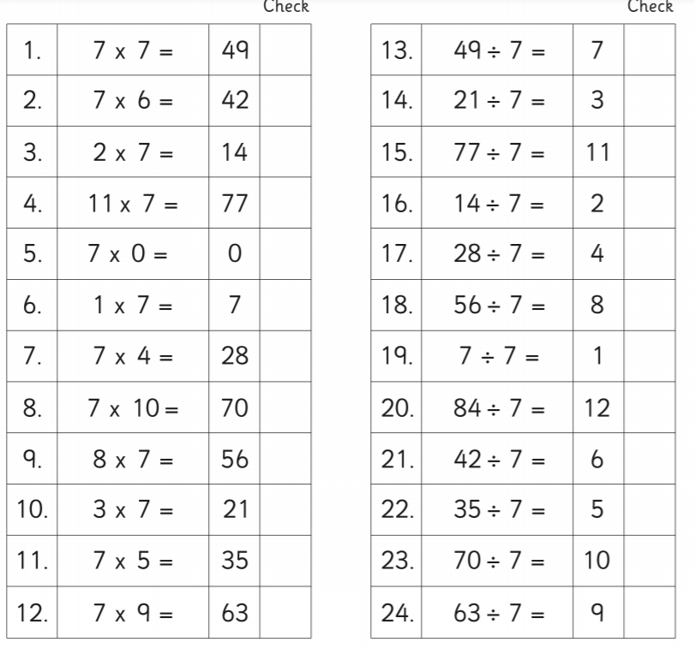
X tables challenge 1 answers

Slide 11
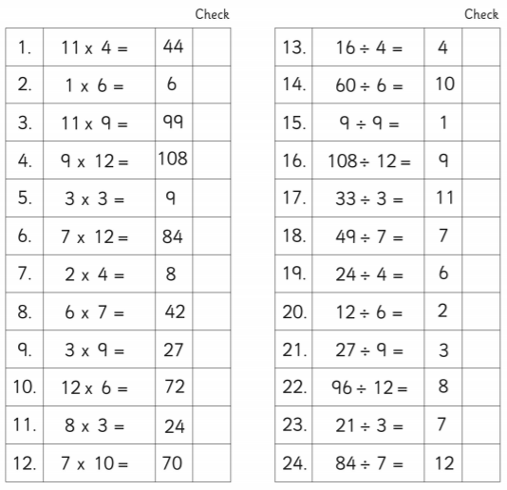
X Table challenge 2

Slide 12
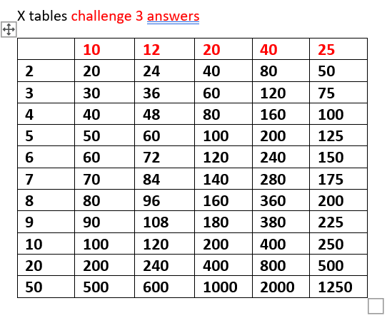
Answers - Challenge 3 , x tables and related facts

