Slide 1
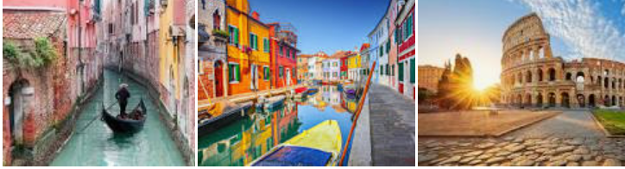
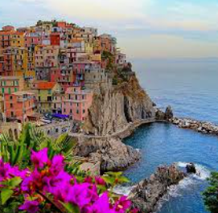
ITALY
Spring 2, 2021

Slide 2
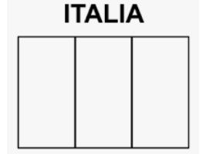
ITALY
First task before we start.
Write a list of what you know about Italy. We will compare it to a list you will do at the end of our topic to see what you’ve learned. Remember that your last topic was about Ancient Rome.
Questions to answer ( first without research, then find the answers)
Have you ever been to Italy?
What does it look like on a map? Can you describe it?
How many different regions do you think there are?
What continent is it in?
6. What is the Capital city?
7. What three colours are in the Italian flag?
8. What countries border Italy?
9.How many seas surround Italy?
10. What currency is used there?
11. What is the national language ?
12. Name a famous Italian. What are they famous for?

Slide 3
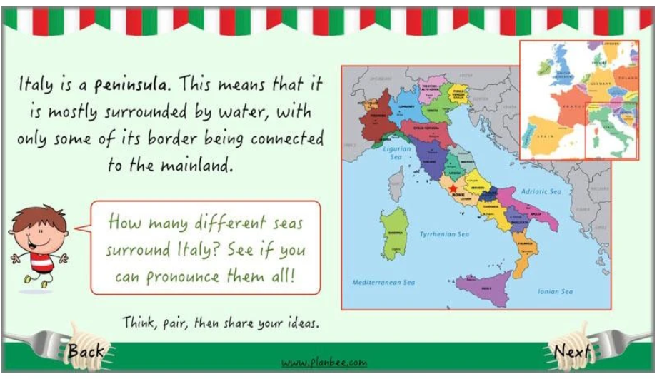

Slide 4
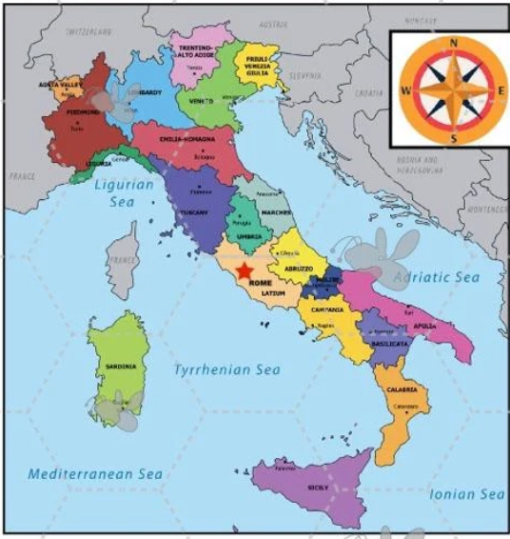

Slide 5
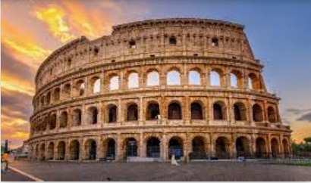
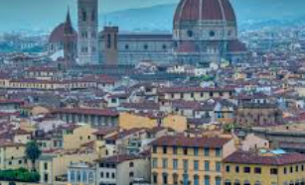
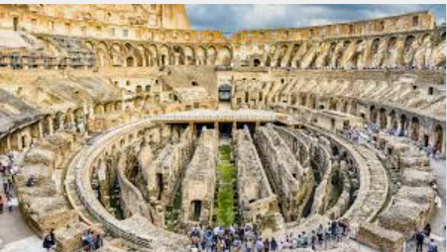
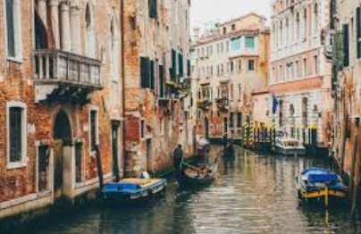
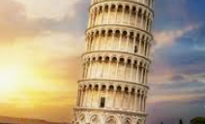
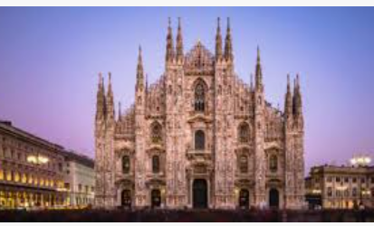
Match these pictures to the places .
Rome,
Milan ,
Pisa,
Florence,
Venice?
Where would you find these in Italy? Point them out on the next slide.

Slide 6
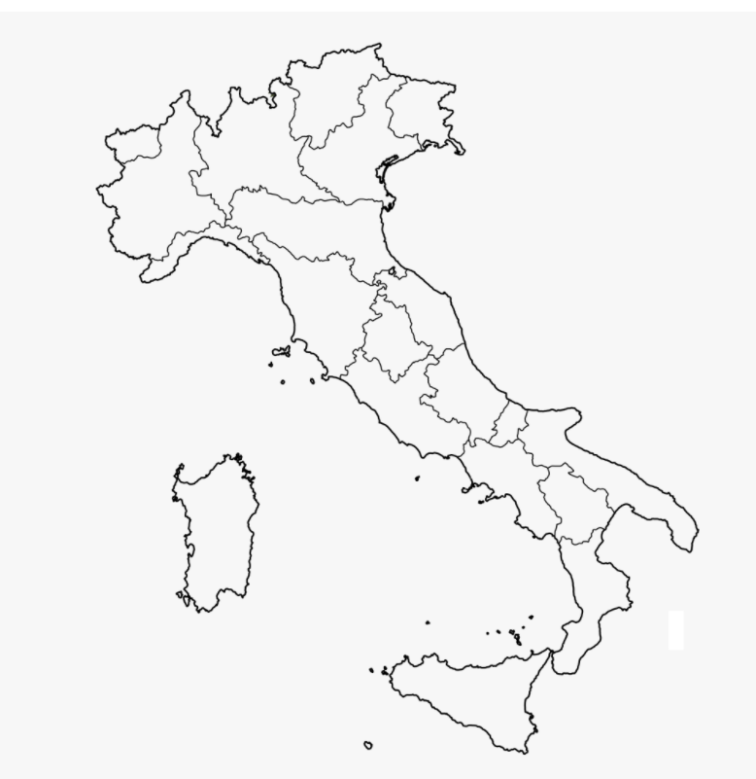

Slide 7
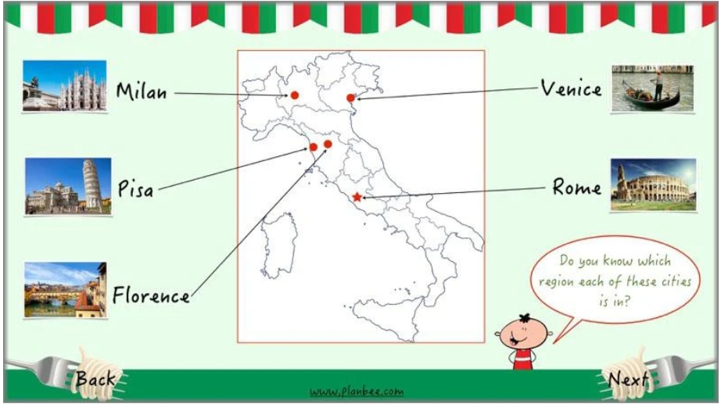

Slide 8
Research and find the answers to the questions on slide 2.
Make sure you can locate the main places on slide 6.
Can you remember what a peninsula is?

