Slide 1
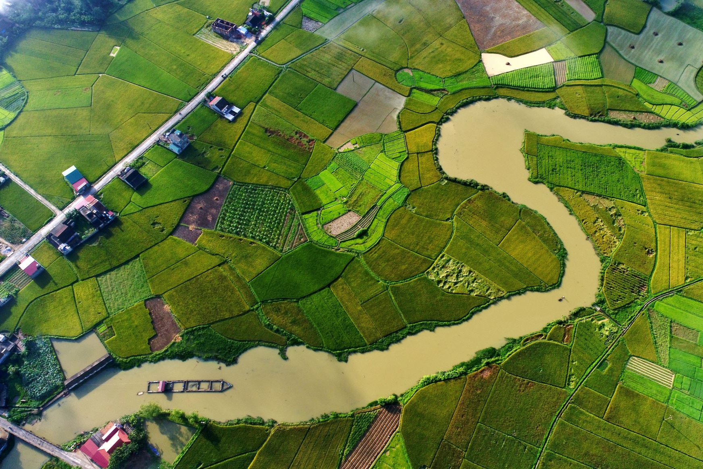
Physical and Human geography.
Week beginning 22.2.2021

Slide 2
Find out the difference between the two ( physical and human geography) by following the link .
https://www.bbc.co.uk/bitesize/topics/zqj3n9q/articles/zr8q7nb

Slide 3
Your turn!
Create your own map of the way to school using both human and physical features.
See an example of a map of the walk to school on the next slide. Rather than write on your map , create your own key ( like you did this week with the work on teeth) and add it to the bottom.

Slide 4
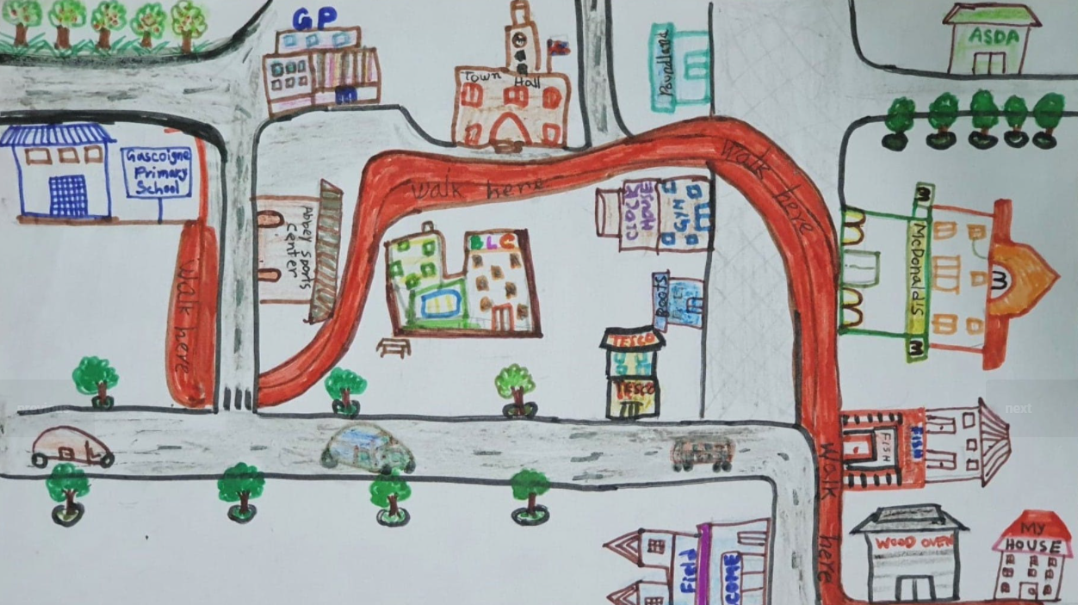

Slide 5

See if you can locate where you live on this map extract.
Next slide

Slide 6


