Slide 1

Scroll IX
The thieves of Ostia
2.3.21

Slide 2
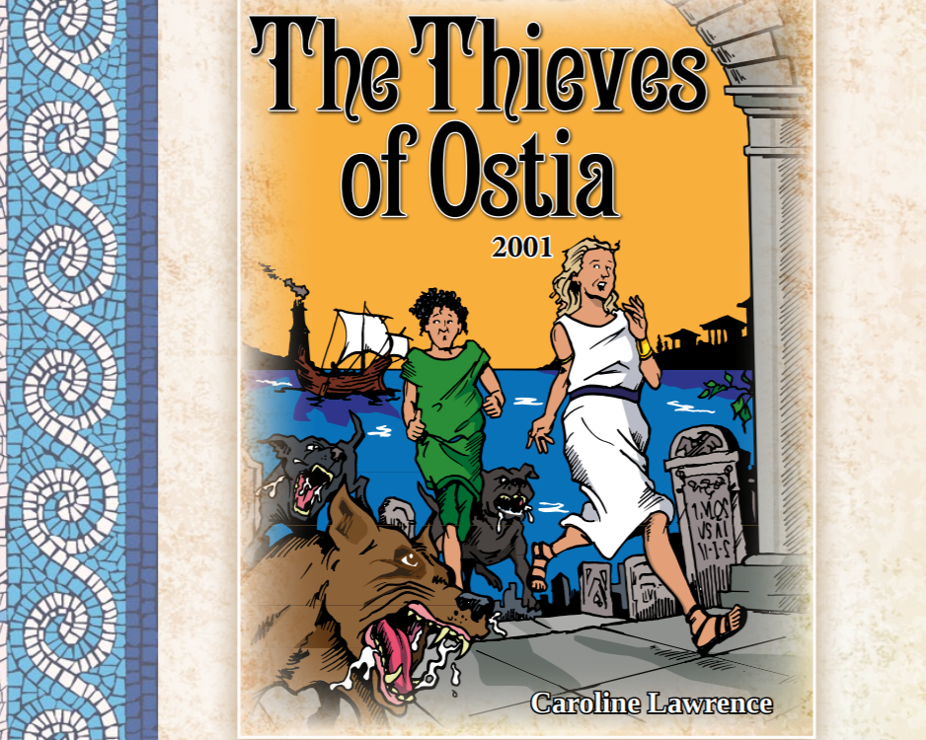

Slide 3
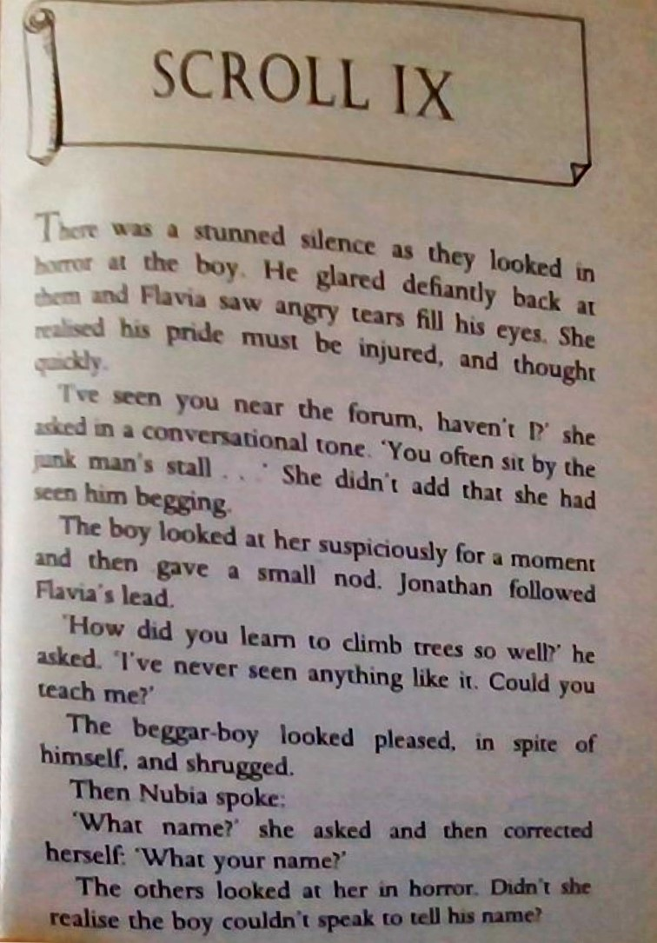

Slide 4
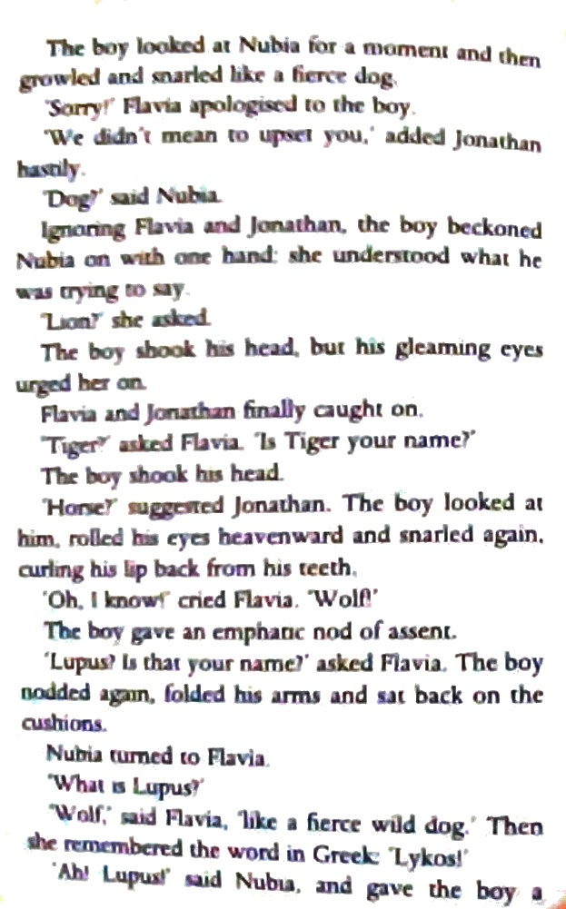

Slide 5
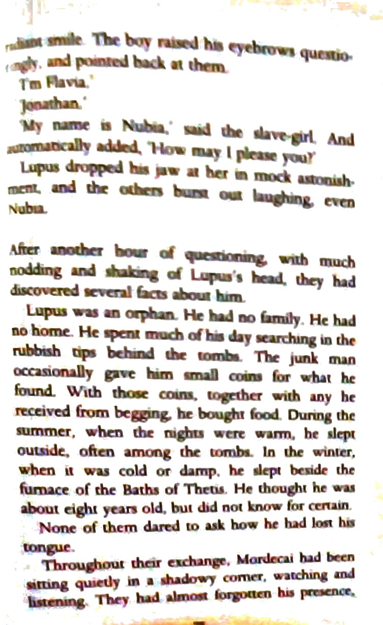

Slide 6
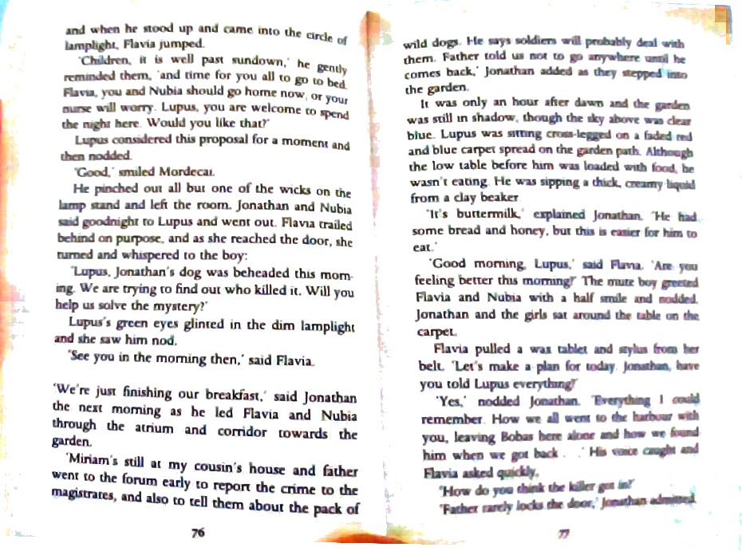

Slide 7
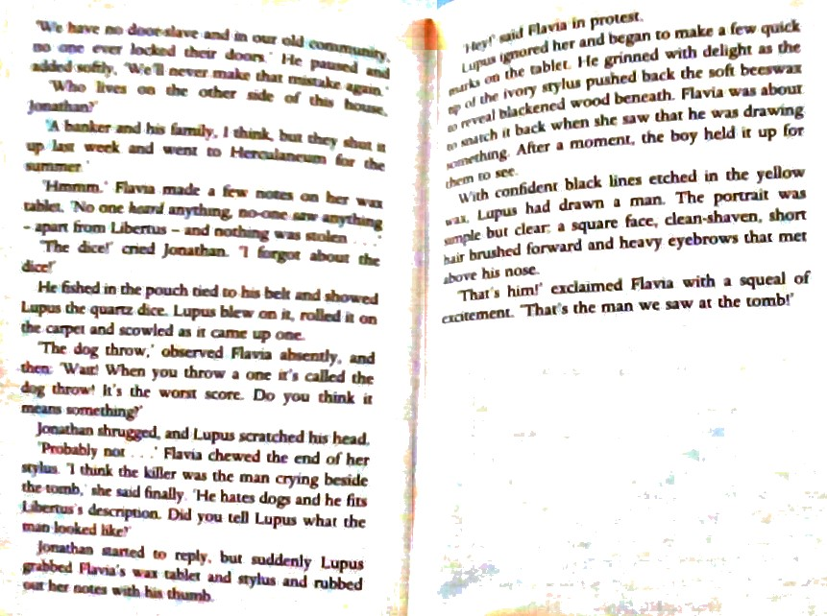

Slide 8
Questions to reflect on after reading or listening to scroll IX
Examine the way Lupus behaves and reacts. What does it tell you about him?
What do you think is his history? How do you think he came to have his tongue cut out?. What more do his experiences tell you about life in ancient Ostia?
What do the reactions of the children to Lupus reveal about each one?
Do you think Publius Avitus Proculus killed Bobus? Why or why not? What are the clues that point to his guilt? Does the author provide any other clues that it could be someone else? If so, who? What shocked you most in this section?

Slide 9
Remember to check your work before asking an adult to read it .

