Slide 1


Slide 2




Writing to Discuss
When you are writing to discuss, you must show at least two different points of view to the reader. This can help your reader to think carefully about an issue or an idea and to explore what other people think.
There are lots of different ways that you
can write to discuss.
You might have read or a heard a
discussion in a:
debate;
newspaper;
book review.
Can you think of a time when you heard two different points of view and then had to make up your own mind?

Slide 3


Features of Writing to Discuss
To help your discussion writing, you could include some of the
following features:
Share Different Ideas or Points of View
I think that we should have a class pet because some children don’t have any pets at home.
I don’t think that we should have a class pet because some children are afraid of animals.
Share at least two different ideas or points of view. This will help your reader to think carefully about the issue.
Joining Words
and but so or when
Use these words to join your ideas together and to extend your sentences. This can help you to give reasons for
each idea or point of view.
Expanded Noun Phrases
a big, juicy goat
the hot summer day
Use expanded noun phrases with amazing adjectives or modifying nouns to interest the reader in the discussion.

Slide 4

Can You Spot These Features?
Can you spot any different ideas or points of view?
Can you spot any joining words?
Did you spot any expanded noun phrases?
Click here to read the text.

Slide 5
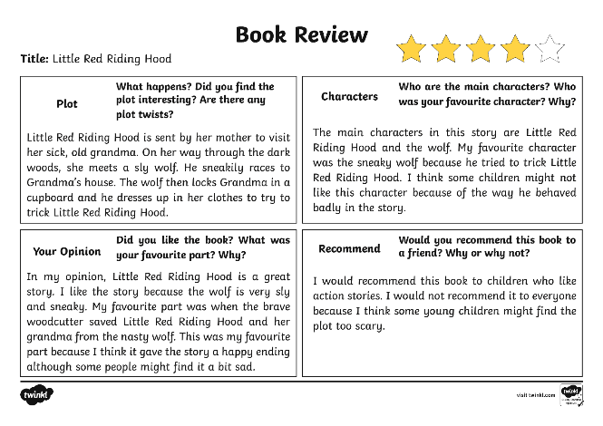
Can You Spot the Features in This Book Review?

Slide 6
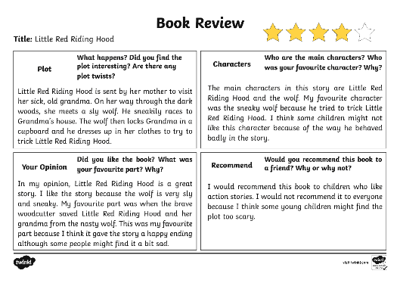
What Features Did You Spot in This Book Review?
Did you spot any other important features in this newspaper article?
Sharing different points of view
expanded noun phrases
joining words

