Slide 1

Art Day
Welcome to art day..
Watch the video in the Video Resource Centre

Slide 2

Art is about what the artist feels and thinks when they are creating their art.
Let’s look at some styles of art so that you can see that art does not have to look like a photograph.

Slide 3
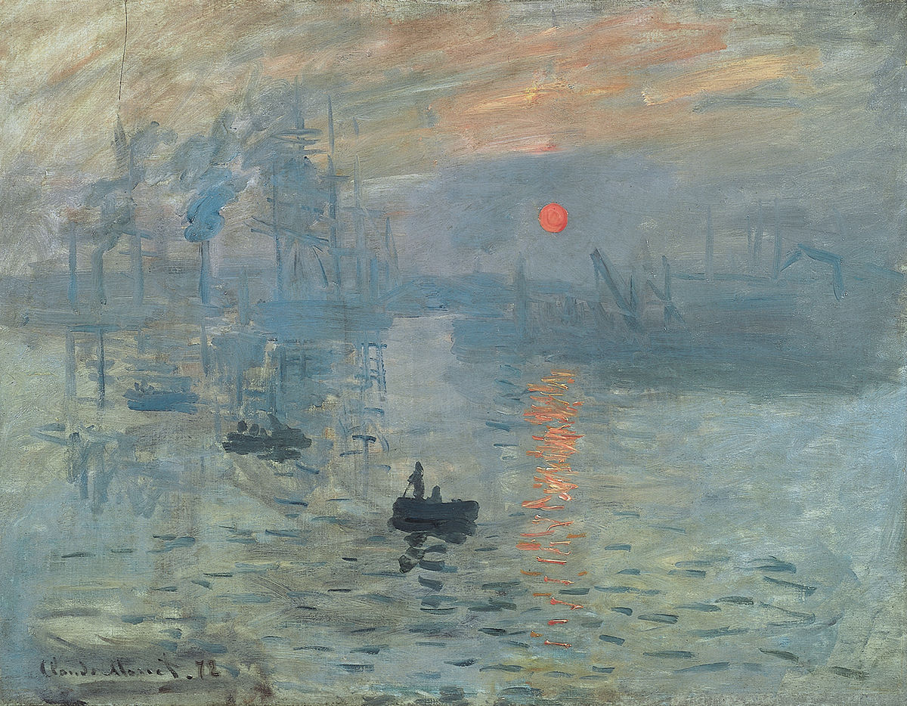
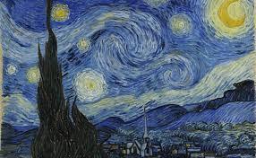
Impressionist art and post-impressionist art
Post-impressionism – vivid colours
Vincent Van Gogh – used big swirling brustrokes to show his emotions.
Starry night - 1889
Impressionism – small brushstrokes, muted palet of colours
Claude Monet
Impression, sunrise
1872

Slide 4
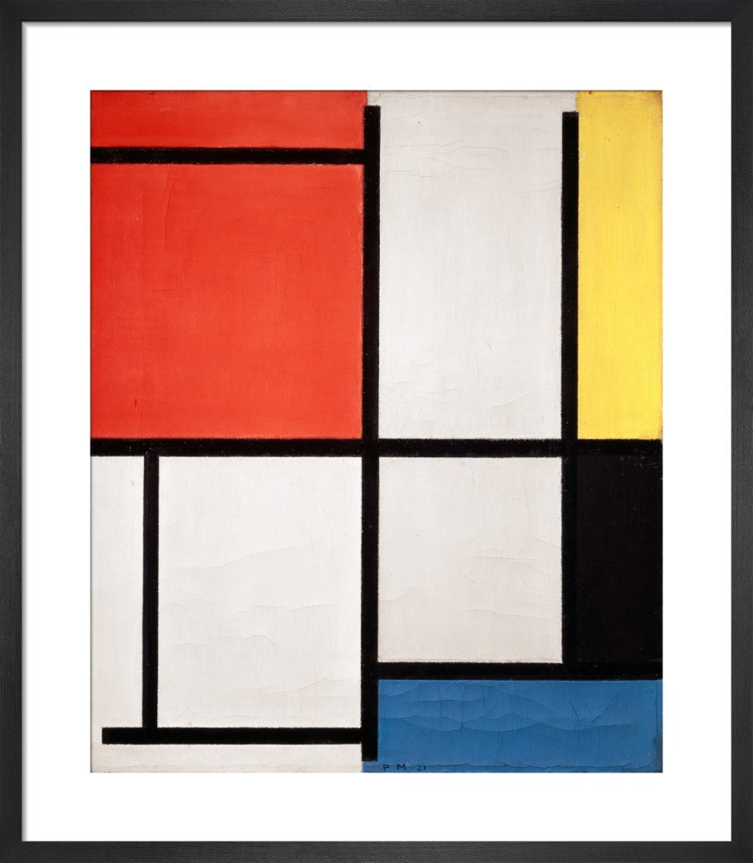
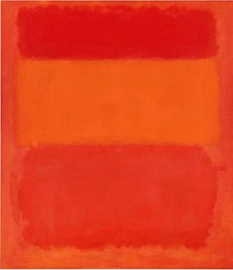
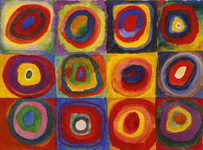
Abstract art
Wassily Kandinksy
Colour Study 960W
1913
Piet Mondrian
Composition
1921
Mark Rothko
Red Orange Yellow
1956

Slide 5
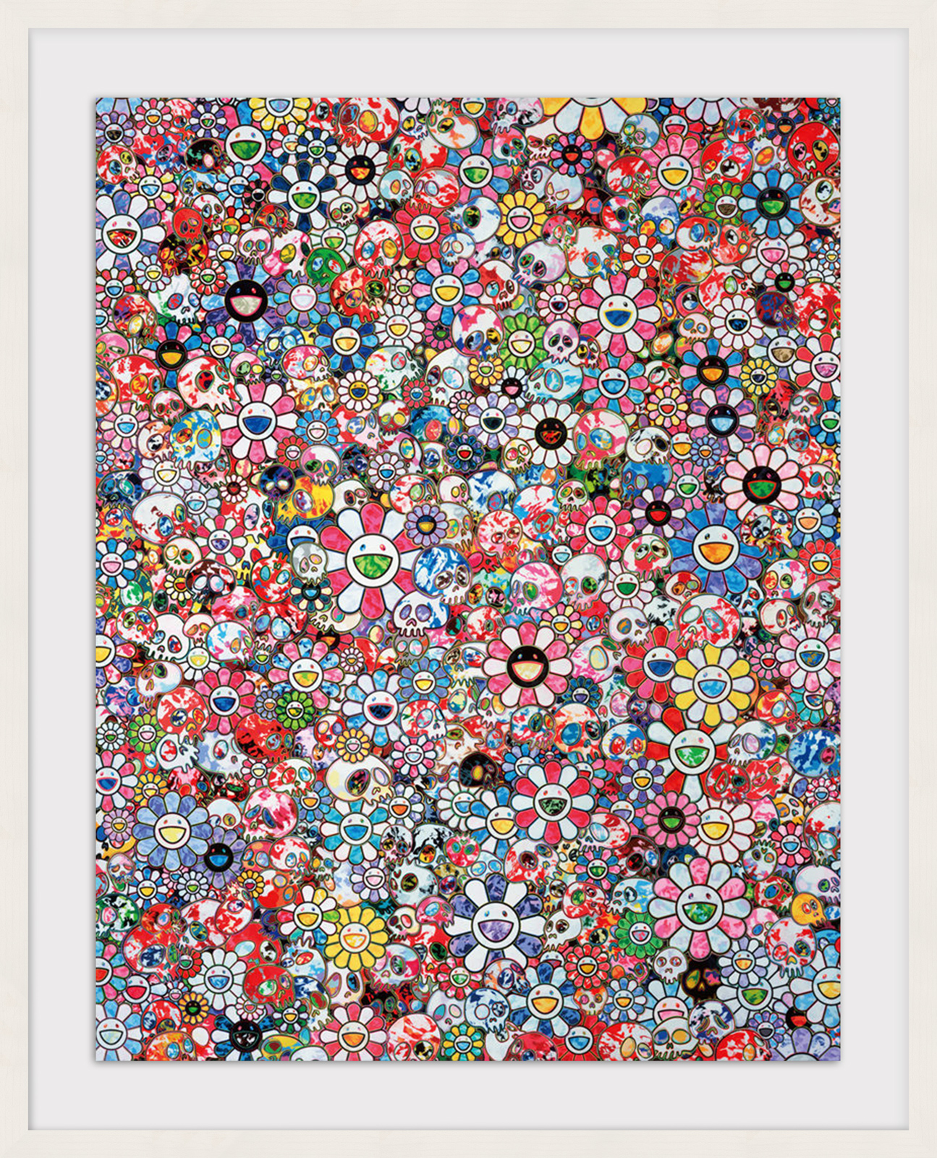
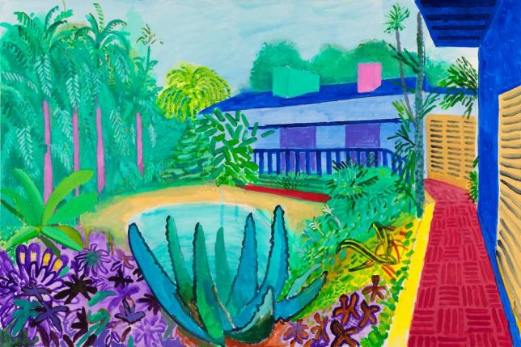
Contemporary
David Hockney
Garden
2015
Takashi Yurakami
Infinity
2020

Slide 6
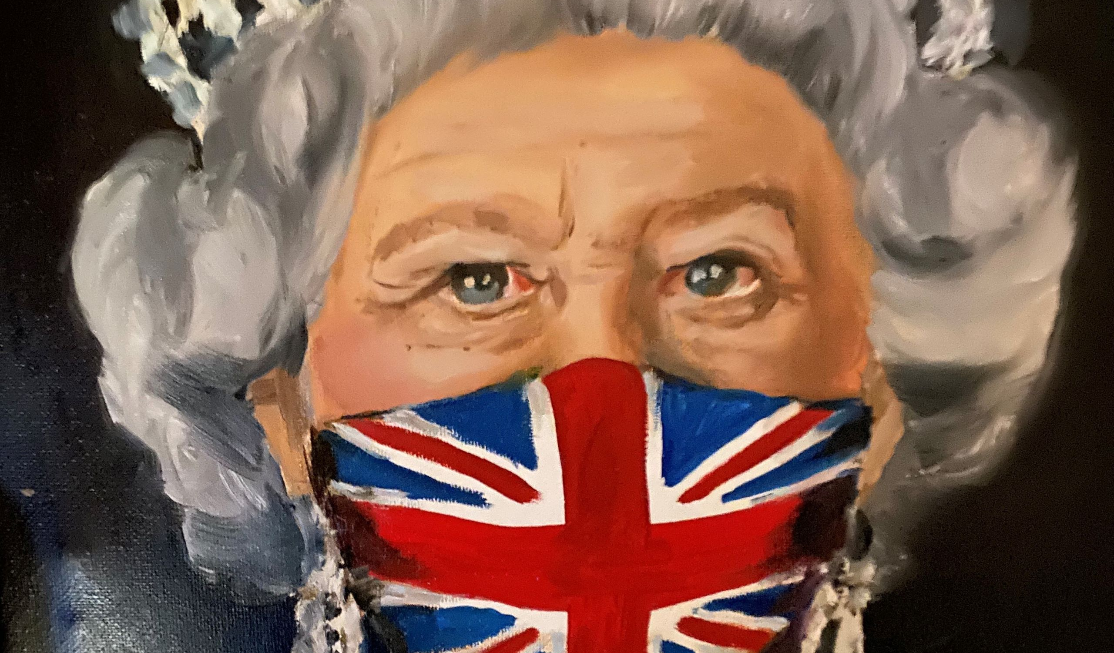
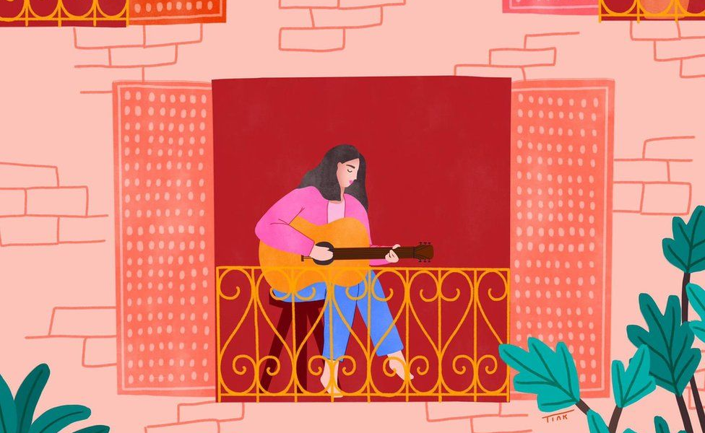
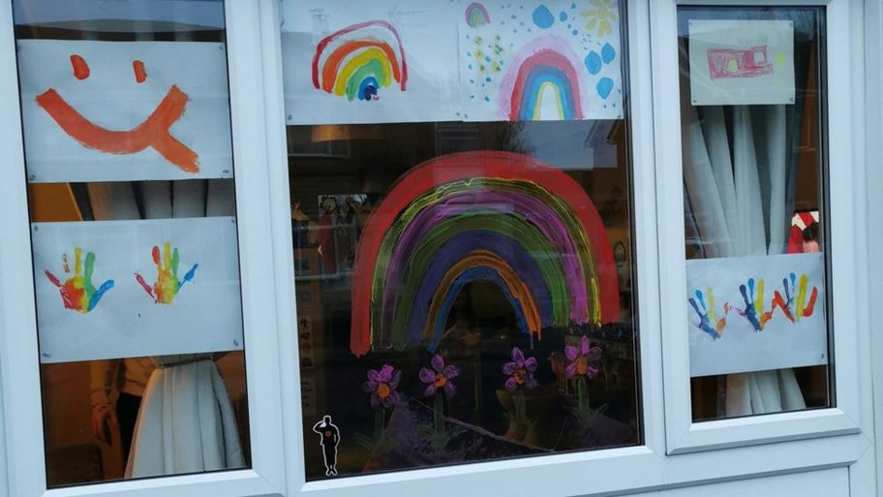
Art created in the last year

Slide 7
Your turn
Think about your feelings and emotions to do with these unusual/extraordinary times and create a piece of art to reflect those emotions.
You have a template with 150mm x 150 mm square to plan and create your art on.
If you are at home, you need two copies of the sheet.
Session one: plan your piece of art, using sketching to plan (as we would in your school art lessons)
Session two: create your piece of art using any colour you like, any medium (paint, pens, collage) that you like.

