Slide 1

World Book Day 2021
24 years old 🎂🥳

Slide 2



Where can books take us?
They can take us back in time.
They can take us forward in time.
They can take us to another place.

Slide 3

Take you to back in time…

Slide 4


Take you to forward in time…

Slide 5




Take you to another place…

Slide 6

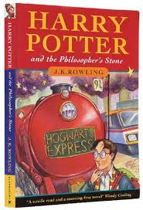





Favourite books

Slide 7
Your favourites…
Your turn
We would like you to complete the Top 5s activity.
Then you could create a Top Trumps game once you have thought about your Top 5s.

Slide 8

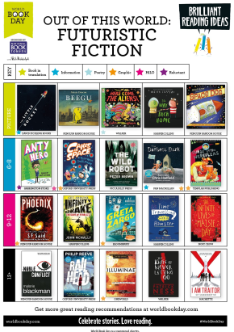
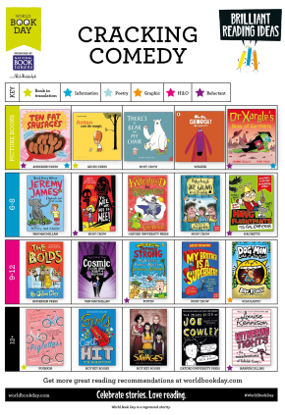
Need inspiration for a new book?
World Book Day Reading Inspiration

