Slide 1


Slide 2
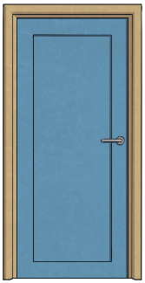
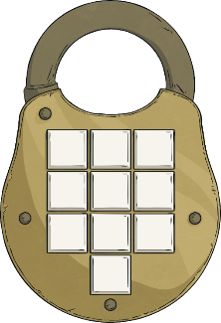
Lost in the Library
Solve the clues and puzzles to discover the passcode number needed to unlock the door to find your way out of the library.
The clues could be anywhere, so you need to keep your eyes peeled and your mind sharp!
You are having a wonderful time reading and exploring books in the library. You found some really interesting books.
As the time to leave approaches, you realise all the librarians have left the library. You try the door and it is locked!
Luckily, an adult in your group has a plan of the library with a set of clues that will give the code to open the door.
?
?
?
?
?
?
?
?
?
?

Slide 3
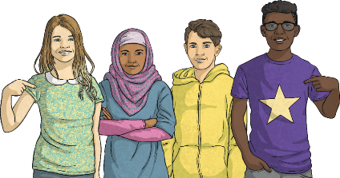
Lost in the Library
The Rules
Work to solve the puzzle and discover the clue.
You can write your answers down on a piece of paper as you go along.
Once you have discovered the passcode number for the door, you can check it on the PPT to discover if you can escape the library!

Slide 4
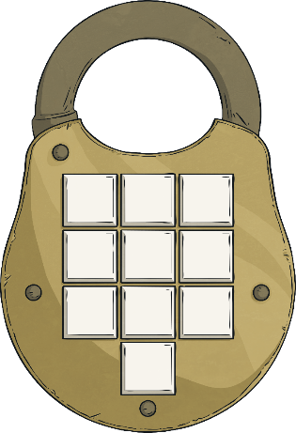
Lost in the Library
?
Click on a to check your answers.
When you have all the digits for
the code, you can press the
button to unlock the door
and escape the library!
Unlock
Digit 1
Digit 2
Digit 3
3
5
0
?
?
?
Unlock
Unlock
Unlock
Unlock
Unlock
Unlock
Unlock
Unlock
Unlock
Unlock
Unlock
Digit 4
Digit 5
Digit 6
?
1
4
?
?
8
Digit 7
Digit 8
Digit 9
7
4
?
6
?
It’s still locked.
?
It’s still locked.
It’s still locked.
It’s still locked.
It’s still locked.
It’s still locked.
It’s still locked.
It’s still locked.
It’s still locked.
Digit 10
?
5

Slide 5


































Clues for Digit 1
A book on fractions provides the first clue. A page in the book contains some fractions.
There are a number of pairs of equivalent fractions and one fraction will be left over.
The numerator in the fraction left over provides the first clue.
$$\frac{\text{2}}{\text{3}}$$
$$\frac{\text{2}}{\text{3}}$$
$$\frac{\text{6}}{\text{9}}$$
$$\frac{\text{1}}{\text{2}}$$
$$\frac{\text{4}}{\text{8}}$$
$$\text{=}$$
$$\frac{\text{4}}{\text{8}}$$
$$\frac{\text{1}}{\text{2}}$$
$$\text{=}$$
$$\frac{\text{12}}{\text{16}}$$
$$\frac{\text{2}}{\text{5}}$$
$$\frac{\text{4}}{\text{10}}$$
$$\frac{\text{3}}{\text{4}}$$
$$\frac{\text{12}}{\text{16}}$$
$$\frac{\text{2}}{\text{12}}$$
$$\text{=}$$
$$\frac{\text{4}}{\text{10}}$$
$$\text{=}$$
$$\frac{\text{6}}{\text{16}}$$
$$\frac{\text{3}}{\text{4}}$$
$$\frac{\text{2}}{\text{5}}$$
$$\frac{\text{3}}{\text{8}}$$
$$\frac{\text{6}}{\text{16}}$$
$$\frac{\text{1}}{\text{6}}$$
$$\frac{\text{1}}{\text{6}}$$
$$\text{=}$$
$$\frac{\text{2}}{\text{12}}$$
$$\text{=}$$
$$\frac{\text{3}}{\text{8}}$$
$$\frac{\text{3}}{\text{10}}$$
$$\frac{\text{3}}{\text{10}}$$
$$\frac{\text{6}}{\text{9}}$$
Reveal answer
3
The first digit of the code is

Slide 6

Clues for Digit 2
In a dictionary, a set of verbs are listed. Convert each word using the suffix –able or –ible
The number of words using the suffix –able provides the second clue.
accessible
access
enjoyable
enjoy
comfortable
comfort
desirable
desire
likeable
like
responsible
response
horrible
horror
usable
use
-able
-ible
5
3
Reveal answer
5
The second digit of the code is

Slide 7









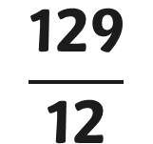

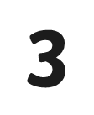






Clues for Digit 3
A second page in the book on fractions gives the third clue:
There are some mixed numbers. To find the required digit, convert the mixed numbers to improper fractions, convert to equivalent fractions with the same denominator, add together and convert back to a mixed number.
The digit that appears in the ones place of the whole number gives the third clue.
$$\frac{\text{129}}{\text{12}}$$
$$\text{2}$$
$$\frac{\text{32}}{\text{12}}$$
$$\frac{\text{8}}{\text{3}}$$
$$\frac{\text{2}}{\text{3}}$$
$$\text{+}$$
$$\frac{\text{46}}{\text{12}}$$
$$\frac{\text{23}}{\text{6}}$$
$$\text{3}$$
$$\frac{\text{5}}{\text{6}}$$
=
$$\text{+}$$
=
$$\frac{\text{17}}{\text{4}}$$
$$\frac{\text{51}}{\text{12}}$$
$$\text{4}$$
$$\frac{\text{1}}{\text{4}}$$
$$\frac{\text{9}}{\text{12}}$$
$$\frac{\text{3}}{\text{4}}$$
10
or
10
Reveal answer
0
The third digit of the code is

Slide 8

Clues for Digit 4
A grammar book provides the fourth clue.
How many of the following words are modal verbs?
live
carry
could
could
went
can
can
must
must
try
might
might
want
may
may
mould
sight
would
would
walk
ought to
ought to
will
will
Reveal answer
8
The fourth digit of the code is

Slide 9



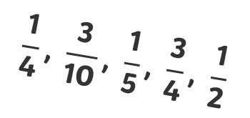





Clues for Digit 5
The library has a shelf of books that have been purchased at a discount.
Alongside is a set of fractions. Match the percentage discounts to the fractions. One percentage has no matching fraction.
15% off £5
15% off £5
25% off £2.80
30% off £3.50
20% off £3.35
$$\frac{\text{3}}{\text{10}}$$
$$\frac{\text{1}}{\text{4}}$$
$$\frac{\text{1}}{\text{5}}$$
75% off £3.99
$$\frac{\text{3}}{\text{4}}$$
50% off £4.50
$$\frac{\text{1}}{\text{2}}$$
$$\frac{\text{1}}{\text{4}}\text{,} \frac{\text{3}}{\text{10}}\text{,} \frac{\text{1}}{\text{5}}\text{,} \frac{\text{3}}{\text{4}}\text{,} \frac{\text{1}}{\text{2}}$$
Find the digit in the tens place of the percentage with no matching fraction.
Reveal answer
1
The fifth digit of the code is

Slide 10

Clues for Digit 6
Perhaps
The sixth clue is in an adventure story. How many adverbs of possibility are in this paragraph?
The children explored the library carefully, looking for clues that would help them escape. They
knew they had to find the clues quickly, so they would not be stuck in the library all night.
they should split up and work in small groups on as individuals. They searched each shelf systematically. They would find the clues soon!
Perhaps
probably
probably
obviously
obviously
surely
The number of adverbs of possibility is the sixth clue.
surely
Reveal answer
4
The sixth digit of the code is

Slide 11

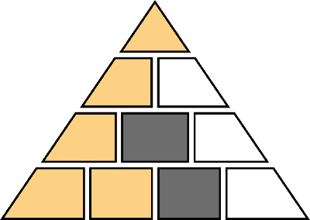
Clues for Digit 7
Clue number 7 is found on a poster in the library, which shows a pyramid with the following numbers. Look at the relationship between the three decimal fractions in the bottom left hand corner, and use that to complete the pyramid.
21.8
10.92
10.88
4.67
6.25
4.63
Find the common digit in the shaded boxes for the seventh clue.
3.02
1.65
4.6
0.03
Reveal answer
6
The seventh digit of the code is

Slide 12
Clues for Digit 8
Clue number 8 is found in a notebook which has a set of words and a set of prefixes.
happy
complete
Match each word to the correct prefix:
correct
fair
in
spell
lead
in
mis
un-
in
un
un
in-
dis-
dis
mis-
mis
Add the number of words using the prefix un- and in- and subtract the number of words using the dis- prefix. The answer gives the eighth clue.
obey
visible
un- in-
dis-
5
–
1
=
4
Reveal answer
4
The eighth digit of the code is

Slide 13

Clues for Digit 9
The ninth clue appears on a computer screen, which shows a line graph.
The chart shows the temperature in the library overnight.
7
Find the number of hours between the two times when the temperature was 17°C.
Reveal answer
7
The ninth digit of the code is

Slide 14
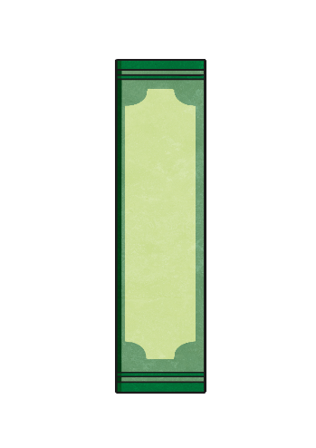


Clues for Digit 10
The final clue is found on a bookmark with a list of anagrams. (Anagrams are words where the letters are mixed up, usually to make a new word or words.)
Solve these anagrams. The first letter of each answer gives the last number.
wolf
ladies
serve
auctioned
fowl
sailed
cautioned
ideals
verse
education
flow
ideals
verse
education
flow
Reveal answer
5
The tenth digit of the code is

Slide 15


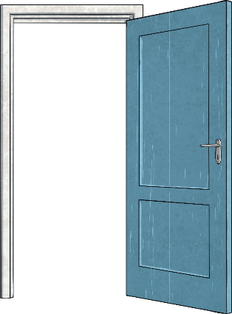

You unlocked the door!

