Slide 1
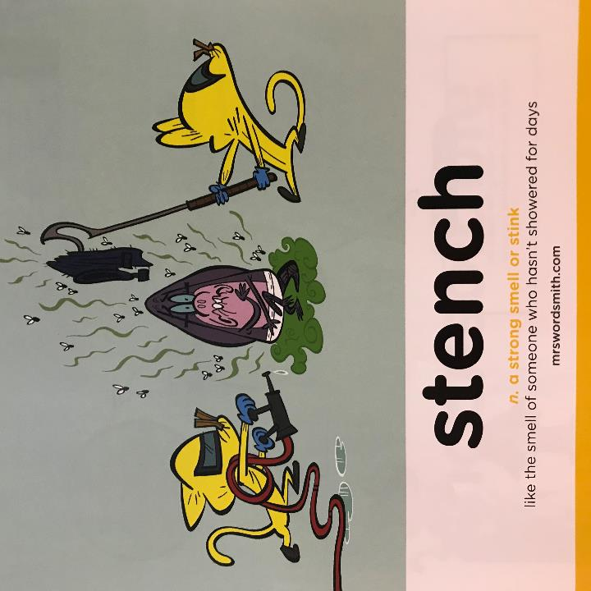
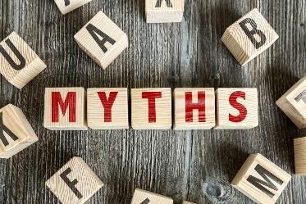

Day 3
Week 2

Slide 2
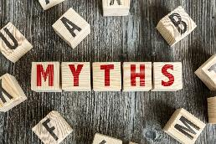
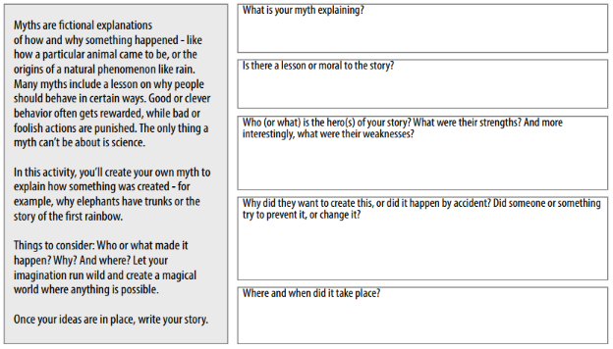
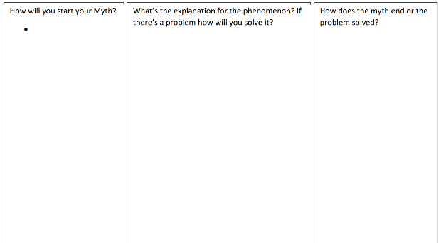
Yesterday…
L.O:I can plan my own myth.

Slide 3
L.O: I can write my own myth.
S.C: Apply the rules of speech accurately.
Use adjectives to describe.
Include a purpose to your story.
Edit my work to identify errors and correct them.

