Slide 1

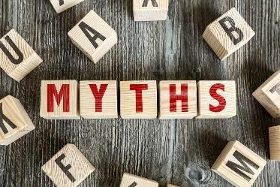

Day 2
Week 2

Slide 2
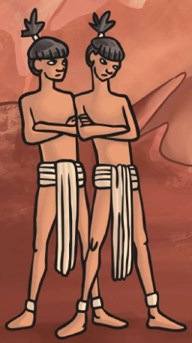
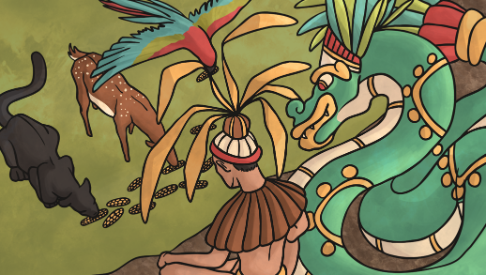

What are myths?
What Mayan myths have you looked at so far?

Slide 3
Myths
What Myths do you know that explain something?
You are going to write your own myth explaining a natural phenomenon.
Name some natural phenomenon's…
Sun / moon
fog
tornados
flooding
volcanic eruption
rainbow
thunder
natural phenomenon
earthquakes
rainstorm
the tide

Slide 4
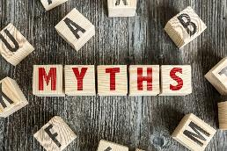
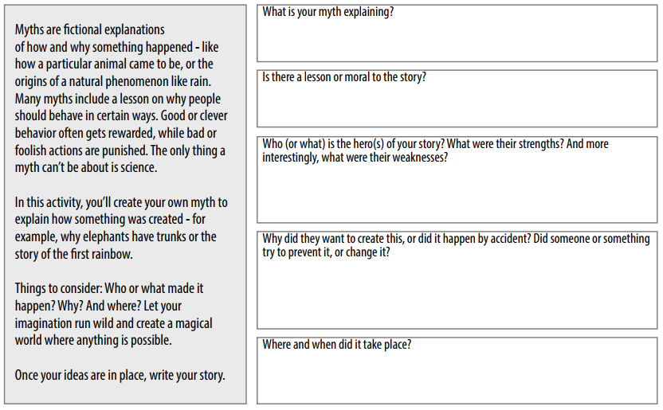
L.O:I can plan my own myth.
Once you’ve completed the first part of your plan come back to the PPT and listen to the next slide.

Slide 5
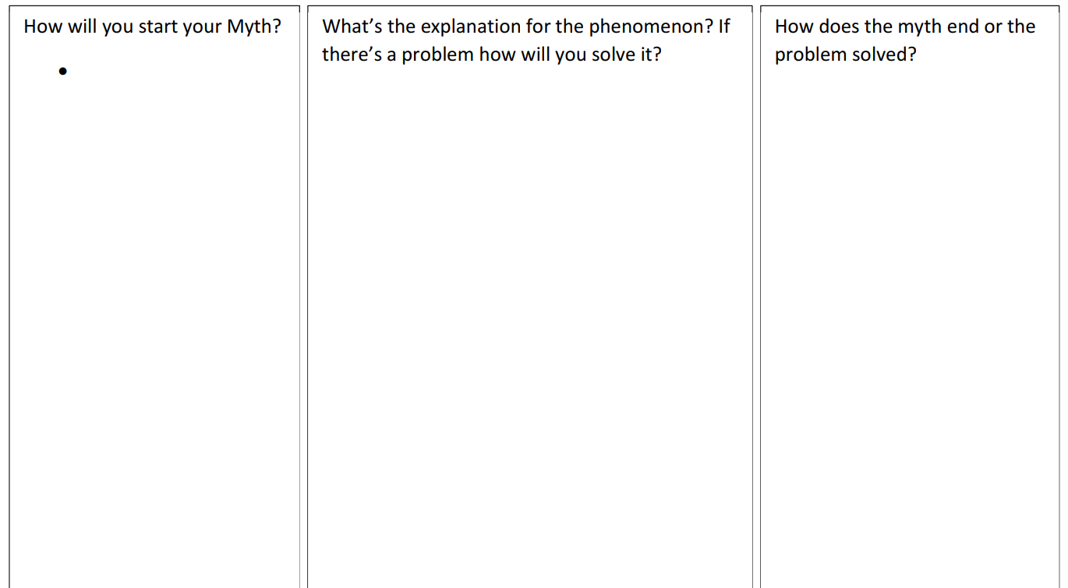
L.O:I can plan my own myth.

