Slide 1
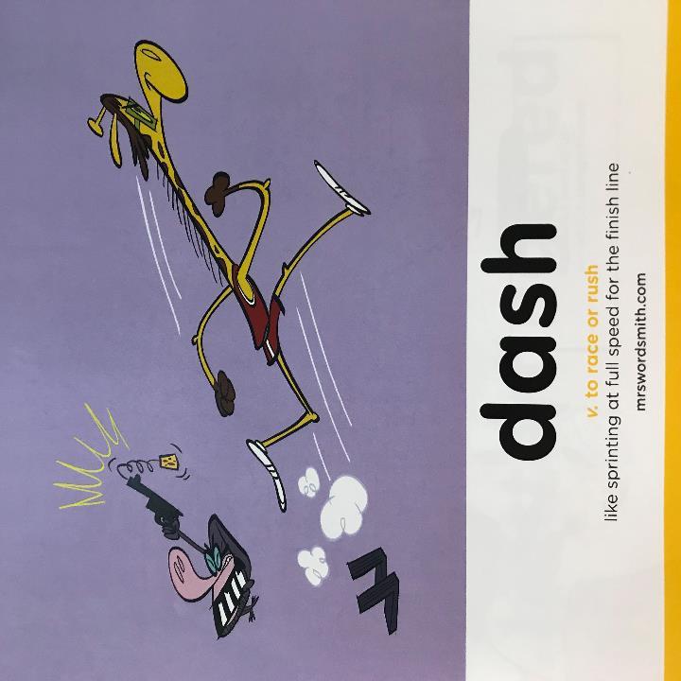

Day 1

Slide 2
English comprehension on a Mayan myth.

Slide 3
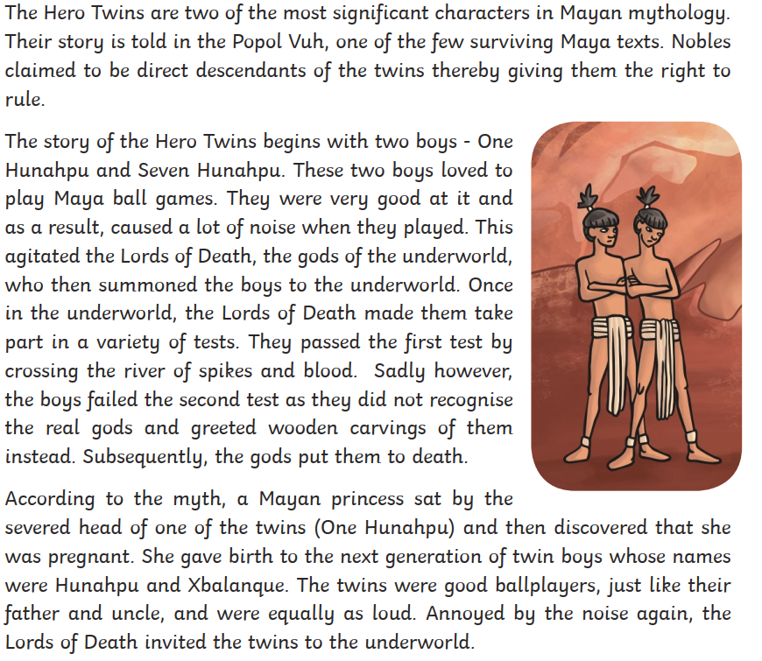

Slide 4
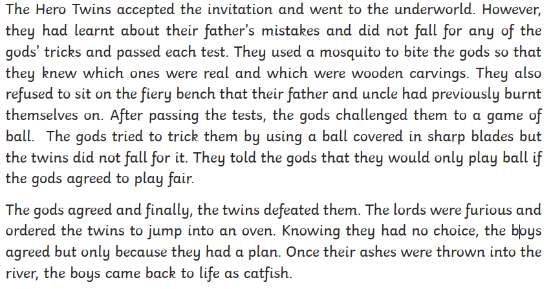

Slide 5
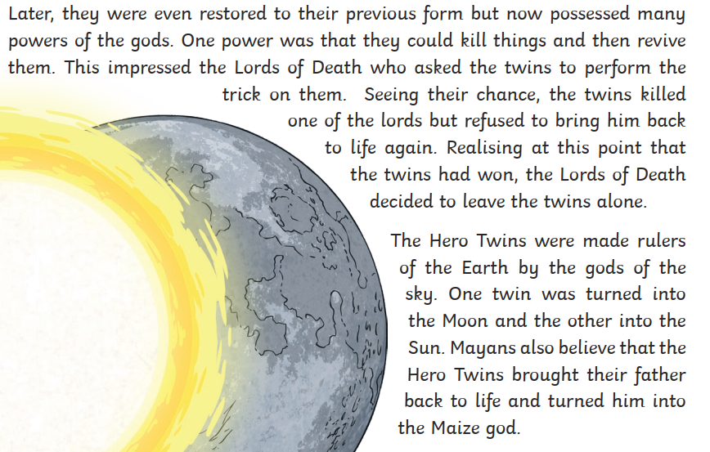

Slide 6
What are the top tips for comprehension
1. Don’t panic.
Read the text carefully, underline the key parts.
2. Carefully read the myth again and do what it asks you to do.
3. Look in the text for the answer and reference or quote the text to support your answer.
4. DON'T PANIC
Look back in the text.
5. If you cannot find the answer go on to the next question.

Slide 7
Your work
L.O: To answer comprehension questions carefully.
Your turn
Read the myth again.
Answer the questions.
As we’ve discussed myths have a purpose. Your last question is to think about the myths purpose. Think carefully, there might be more than one answer.

