Slide 1
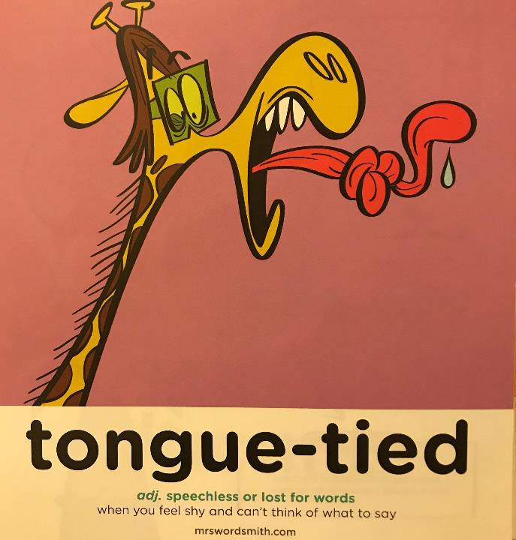

Day 4

Slide 2
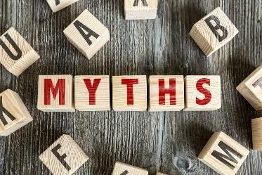
Myths
Yesterday we looked at:
What is the role of myths in a culture?
They explain how a people came to be and what happens when they die; explains natural phenomena; how to behave in society; teaches a lesson.
Some myths have happy endings but unlike fairy tales they don’t always have a happy ending.
Are myths important?
What do you think?
They help people make sense of the world and explain things that otherwise would be unable to explain.

Slide 3
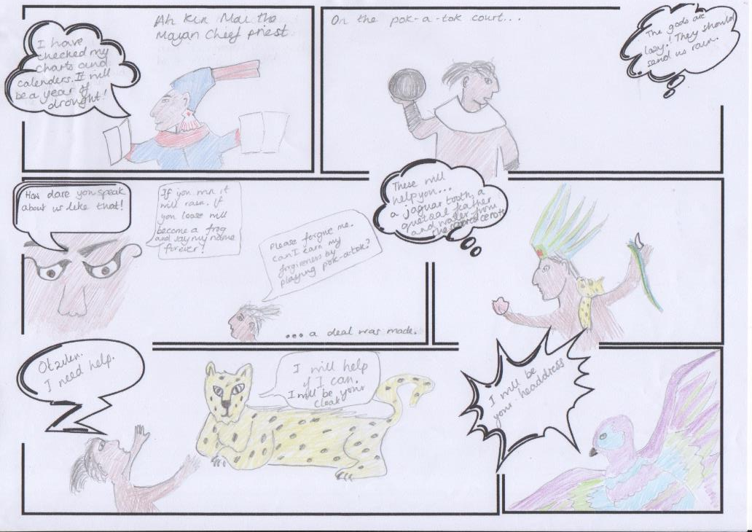
Comic
Page
1 of 2

Slide 4
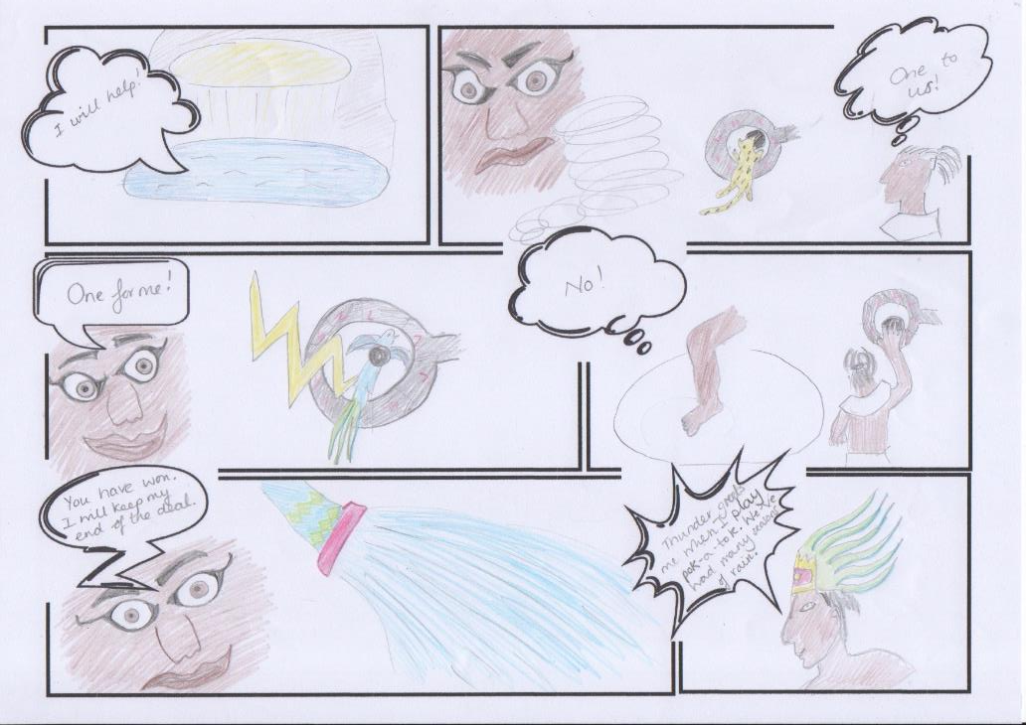
Comic
Page
2 of 2

Slide 5
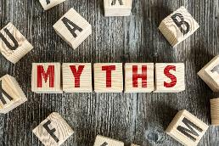
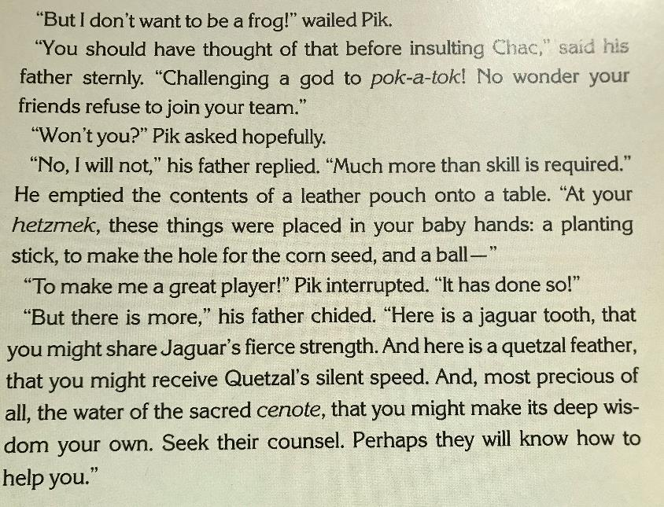
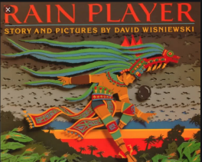
Read Pik’s conversation with his father.
What rules did the author follow when writing a dialogue?
Can you create a checklist?

Slide 6
What did you come up with?
Speech marks at the beginning and end of what is said.
Begin the direct speech with a capital letter.
Includes a piece of punctuation before closing the inverted commas.
□ Include in your sentences information about who is speaking and even how they are speaking or what they are doing. This is called the reporting clause.
□ If the same person is speaking but you break the speech with a reporting clause keep the speech on the same line and if the sentences is continued the first part of speech should be punctuate with a comma and the next bit of speech start with a lower case letter.
□ Start a new line whenever someone new speaks.

Slide 7
Can you add in the missing punctuation?
It’s a bit like a journey to another world isn’t it said Cole
Wait he yelled desperately sprinting uphill as fast as he could come back
Cole felt his face flush pink I’m nothing special he said
This Cole said the king in a hushed voice is the source of our magic

Slide 8
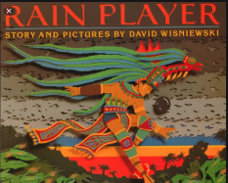
Can you add in the missing punctuation?
“It’s a bit like a journey to another world, isn’t it?” said Cole
“Wait!” he yelled desperately, sprinting uphill as fast as he could. “Come back!”
Cole felt his face flush pink. “I’m nothing special,” he said.
“This, Cole,” said the king in a hushed voice, “is the source of our magic.”

Slide 9
Did Pik’s friends agree to join his Pok-A-Tok team?
What evidence is there?
Why did the author miss the scene?
What might the conversation have looked like?

Slide 10
What might the conversation before Pik and friends have looked like as he asked them to join his pok-a-tok team?
L.O: I can describe the scene using dialogue to advance the action.
S.C: Apply the rules of speech accurately.
Use adjectives to describe.
Use synonyms for said.

